Slide 1
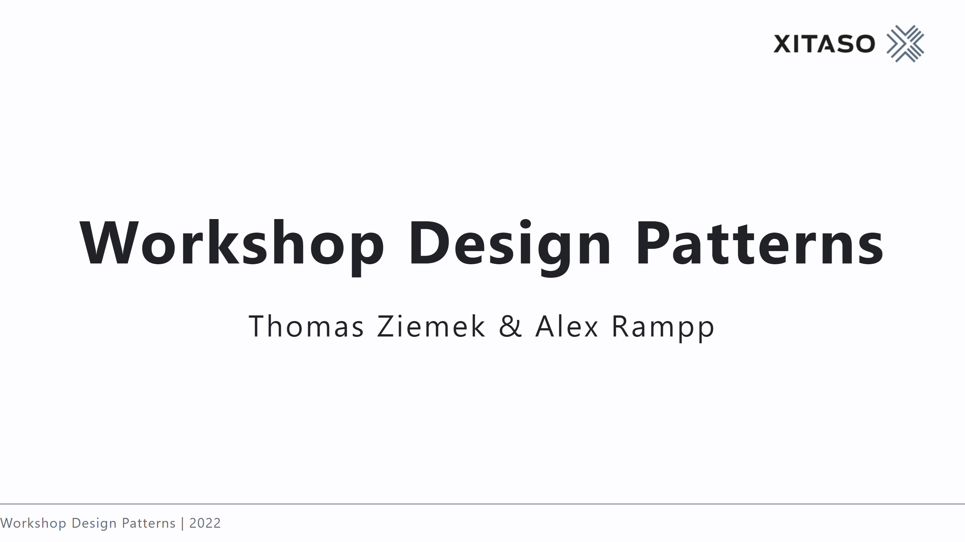

Slide 2
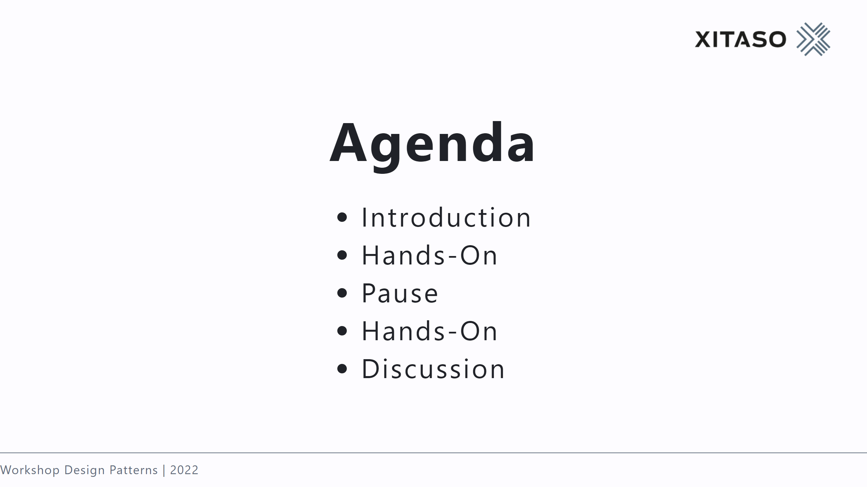

Slide 3
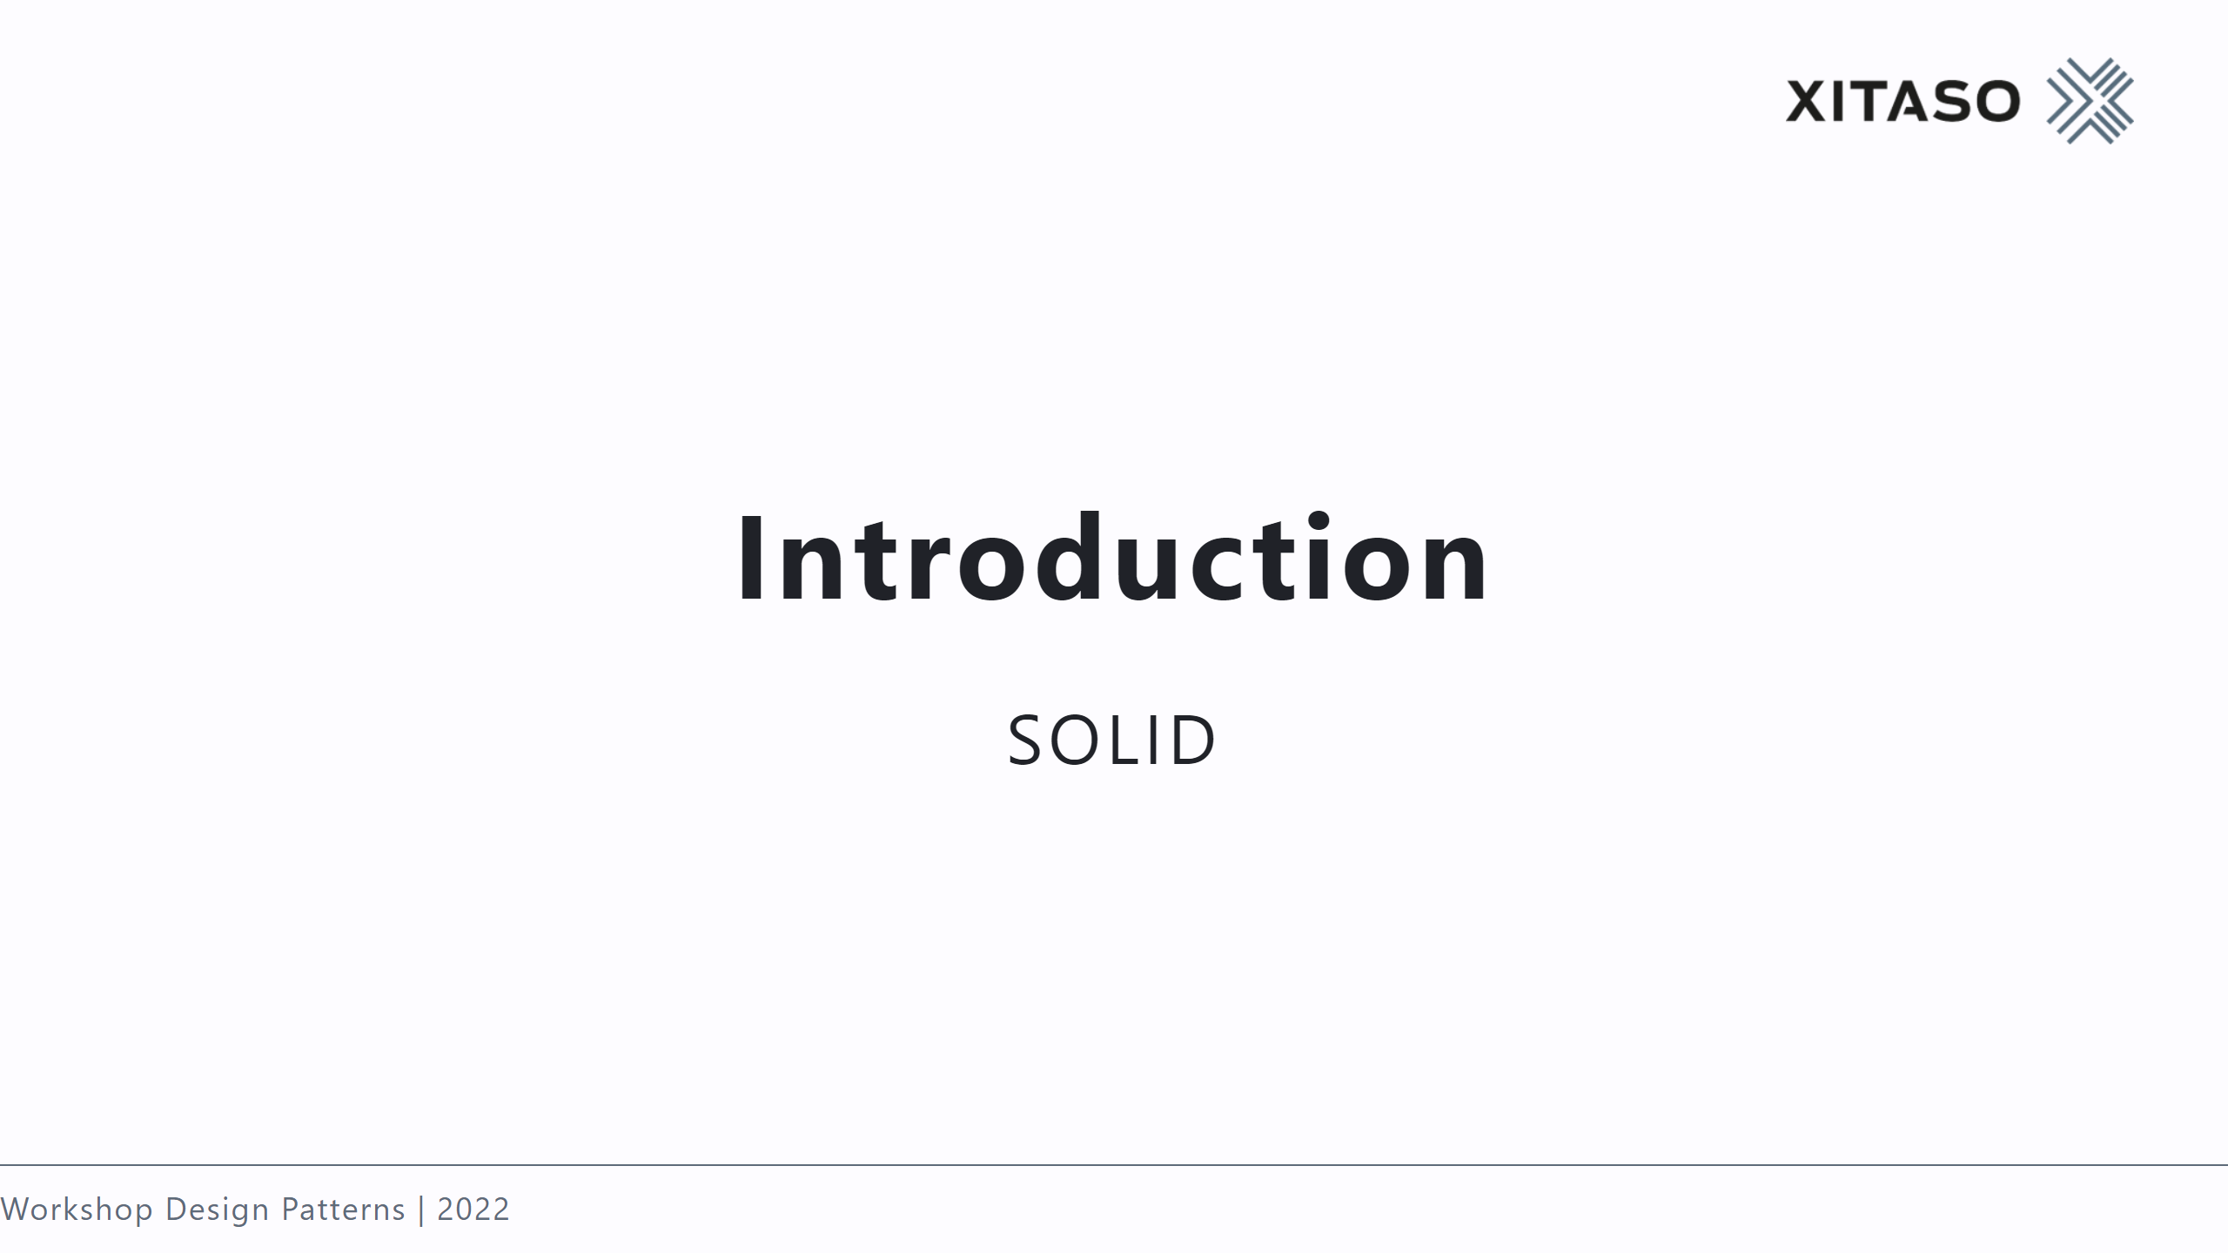

Slide 4
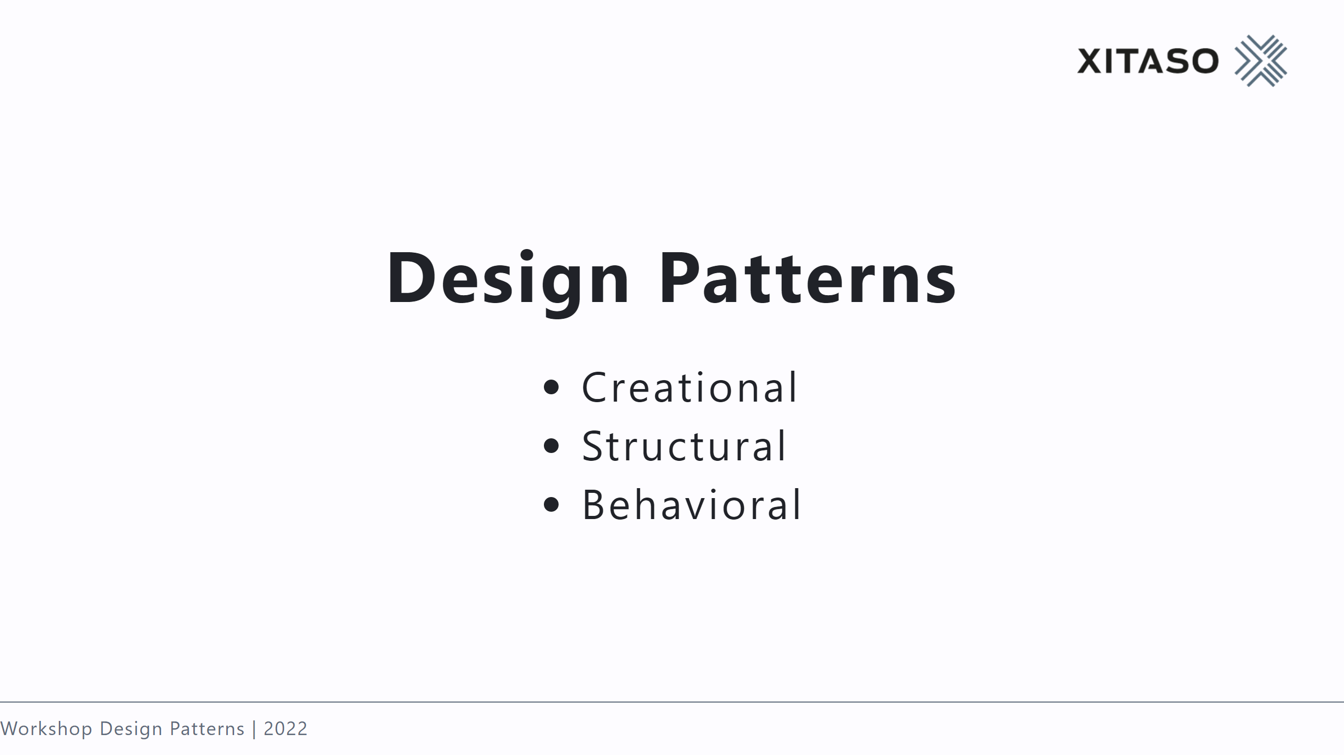

Slide 5
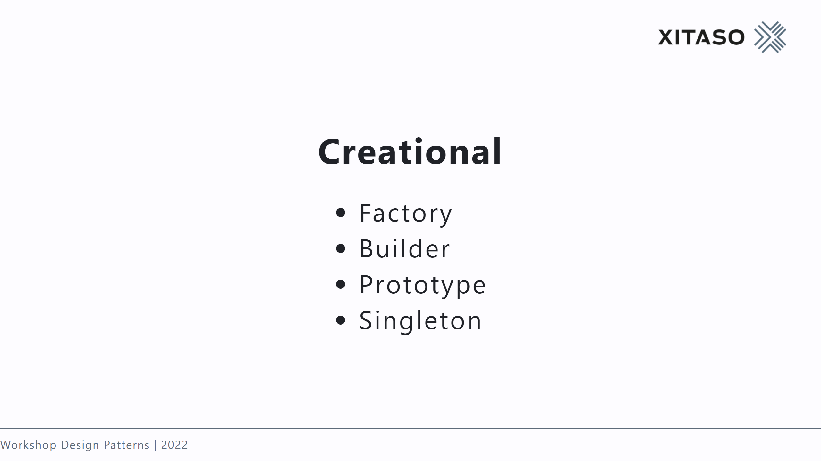

Slide 6
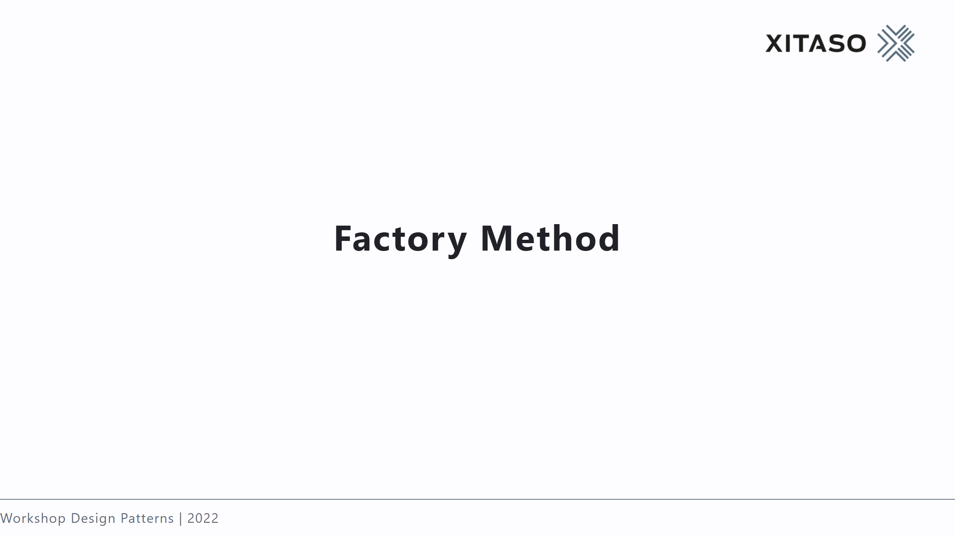

Slide 7
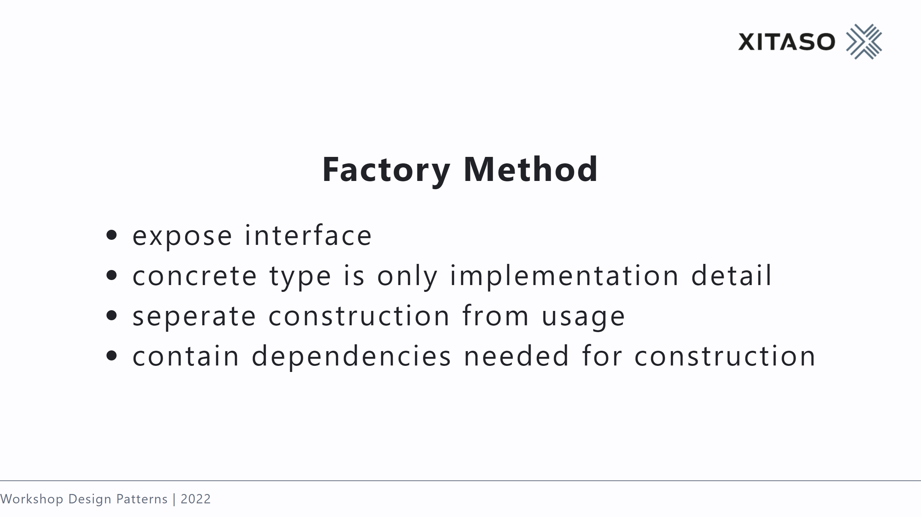

Slide 8
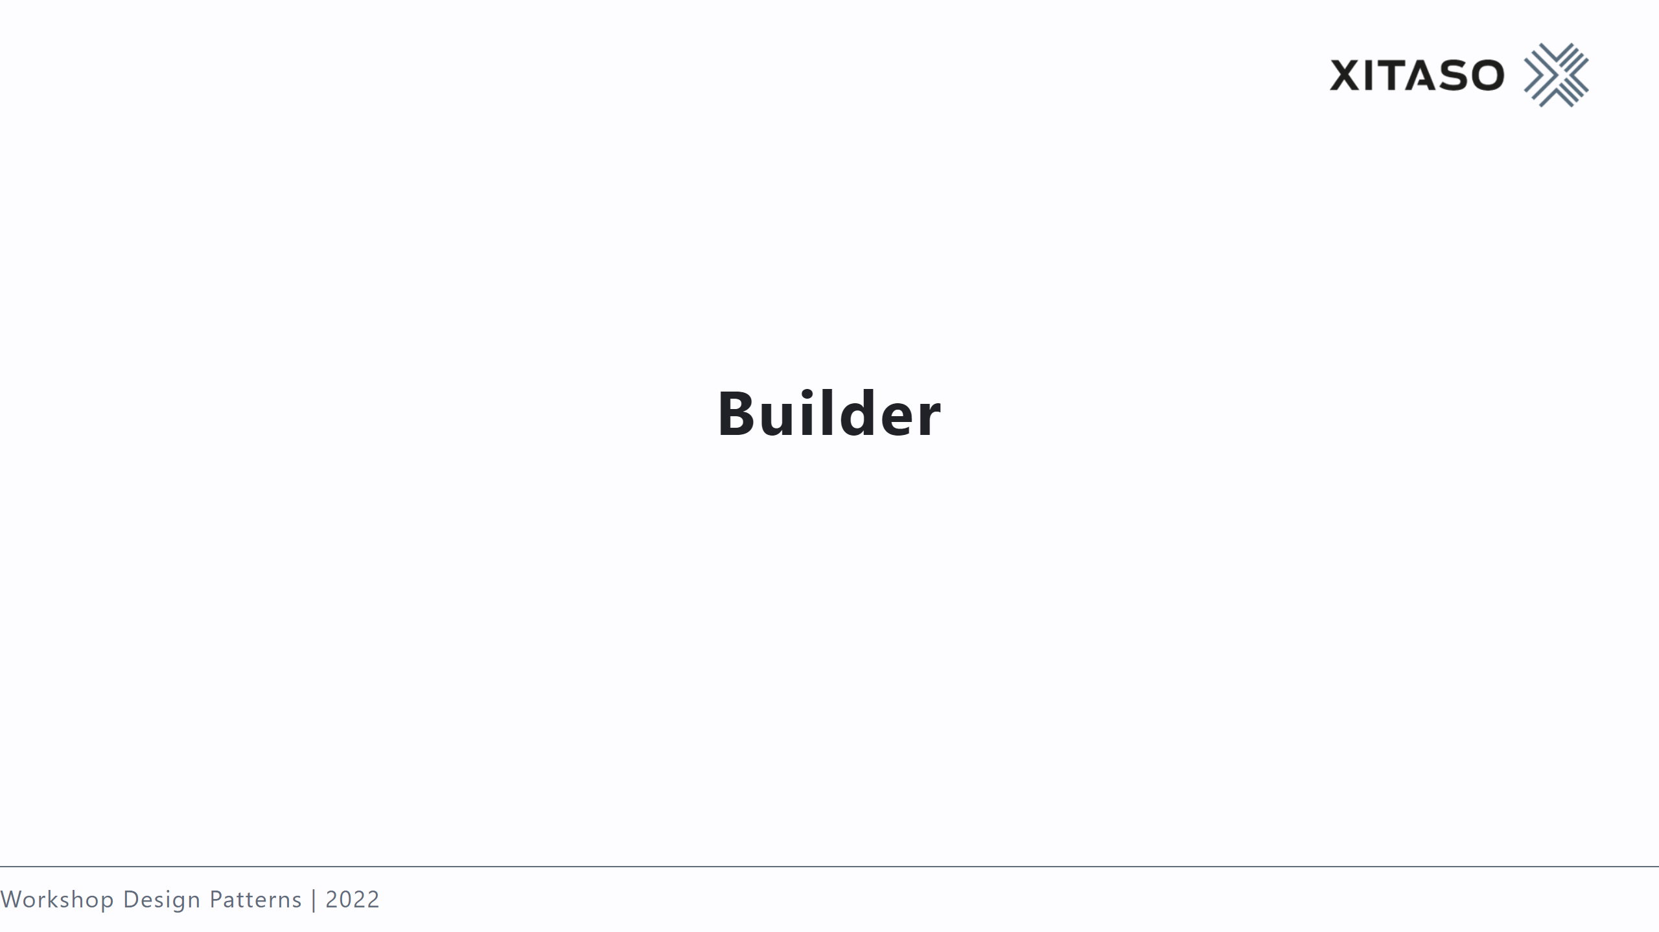

Slide 9
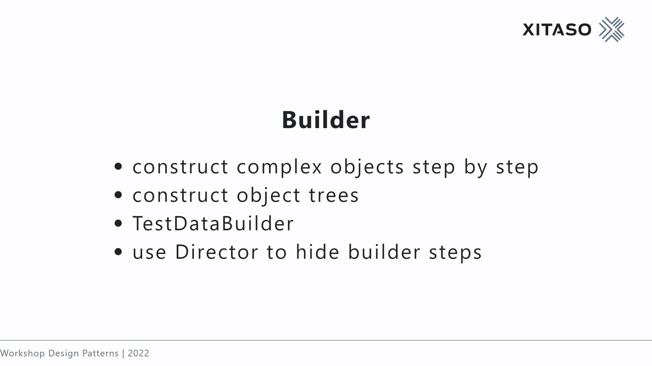

Slide 10
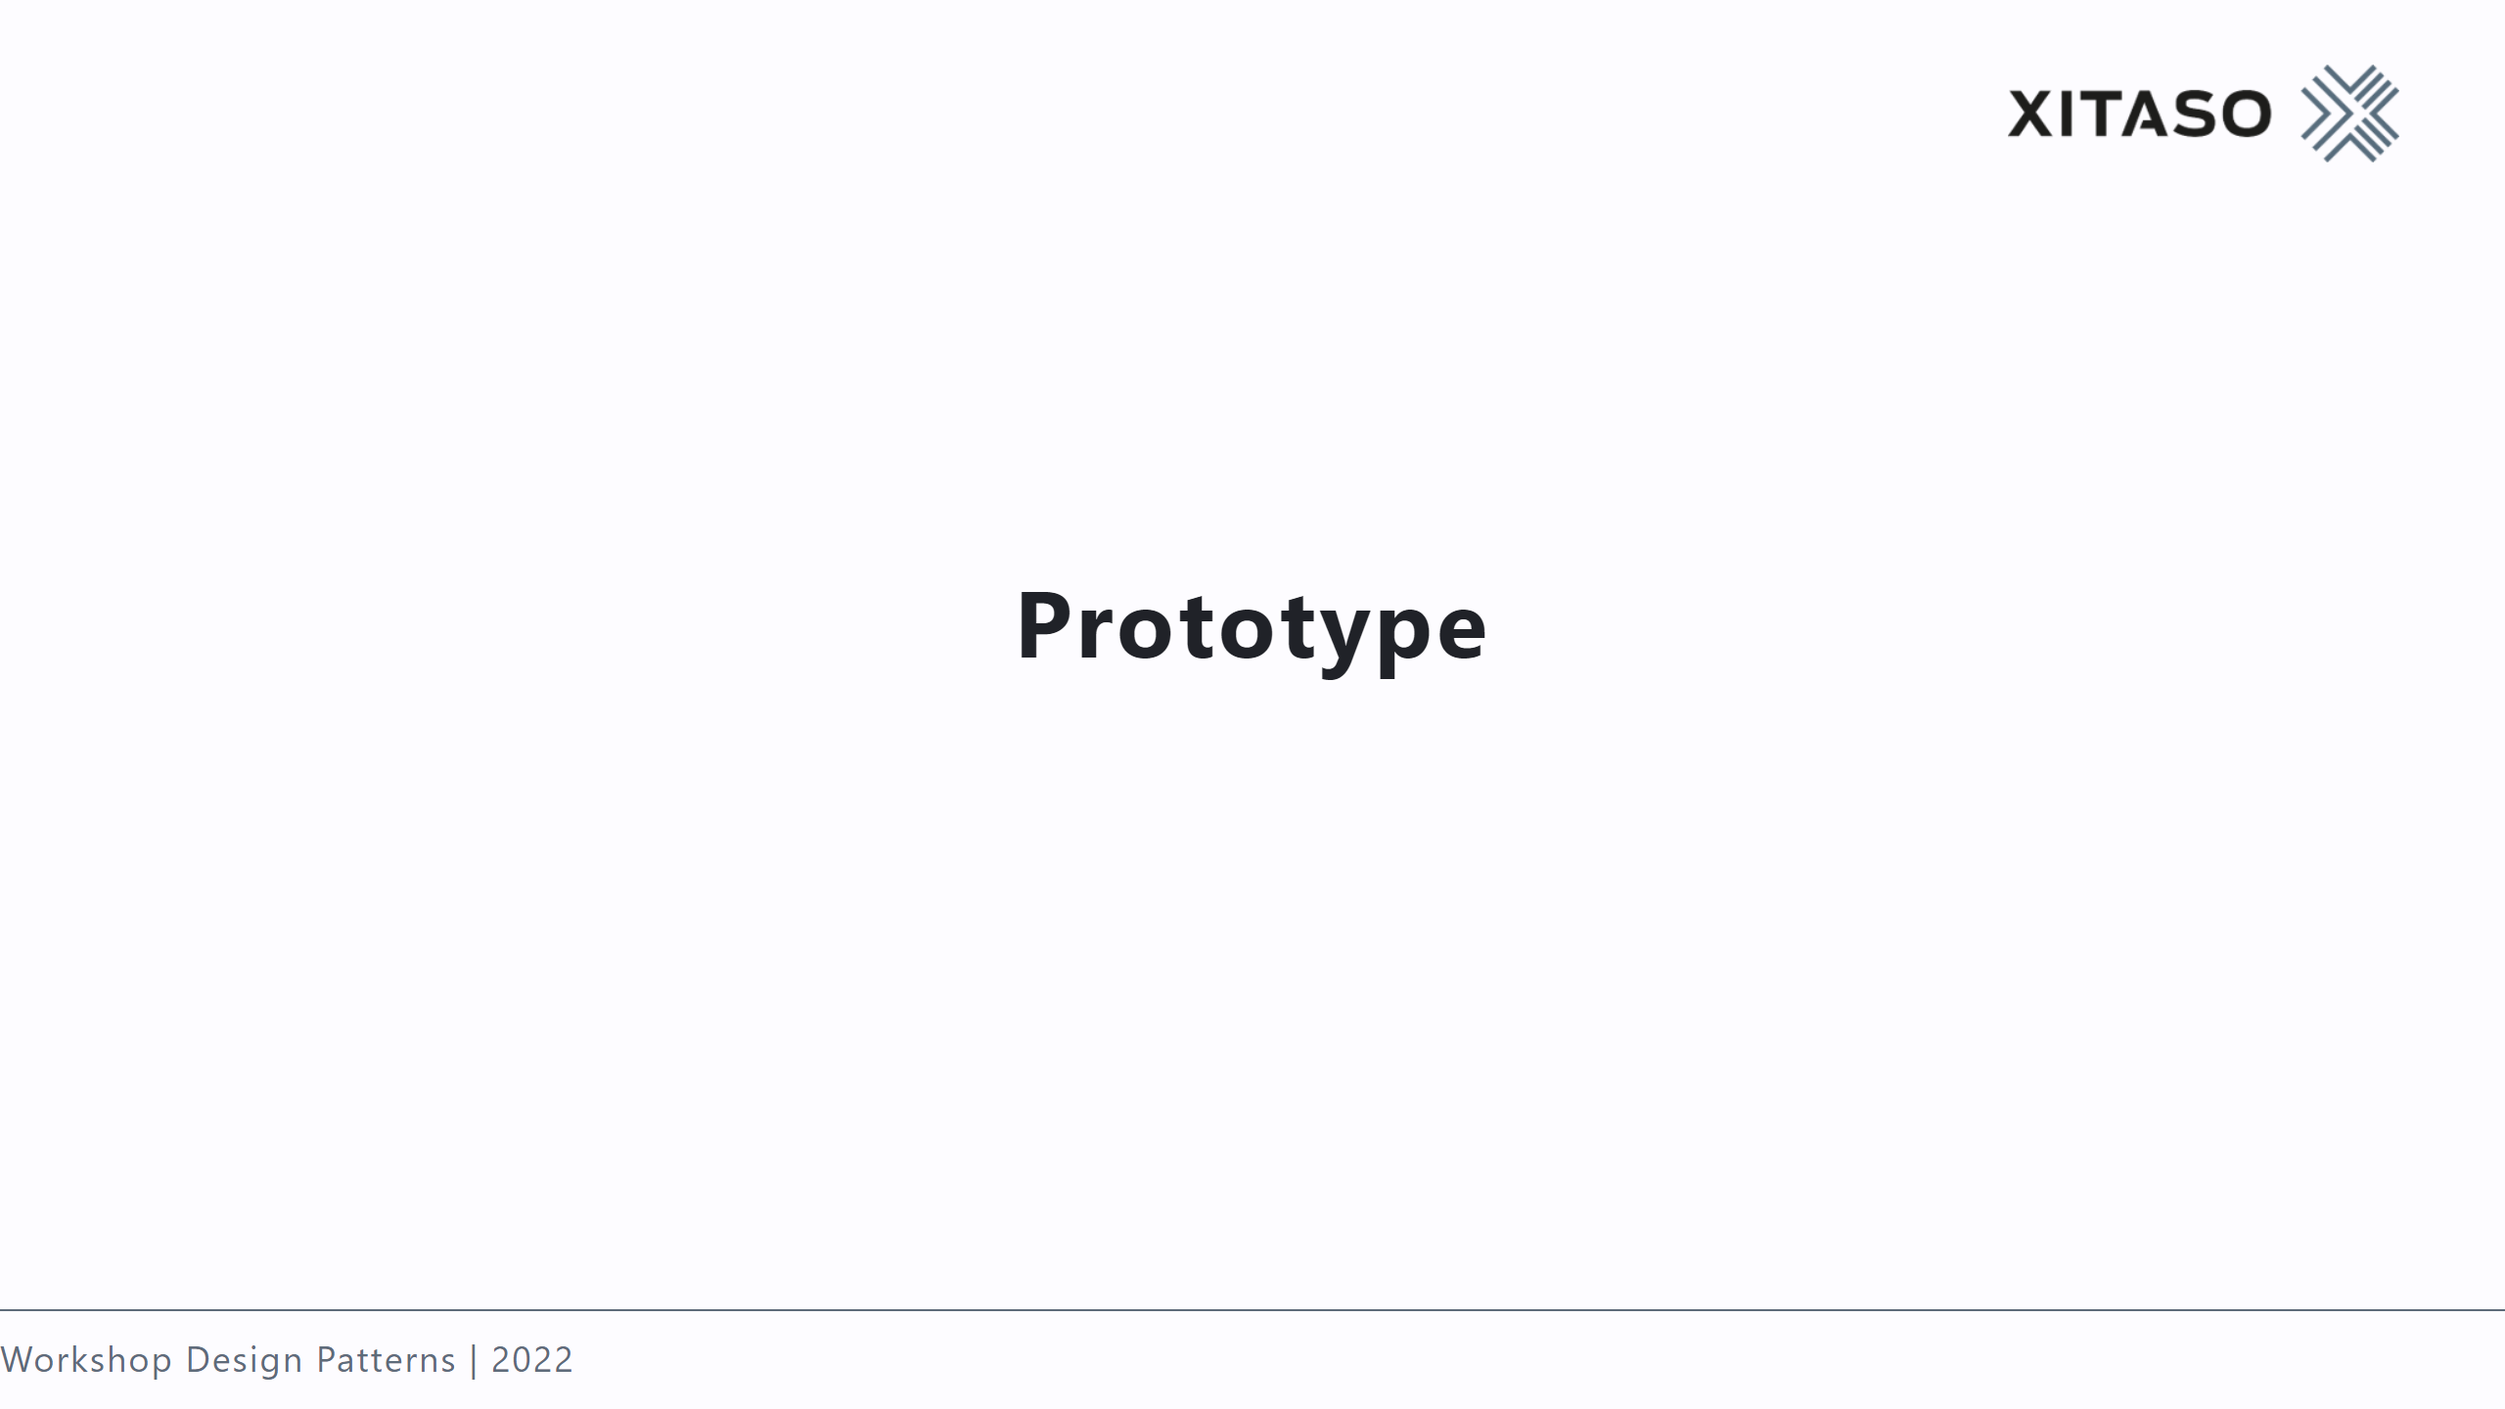

Slide 11
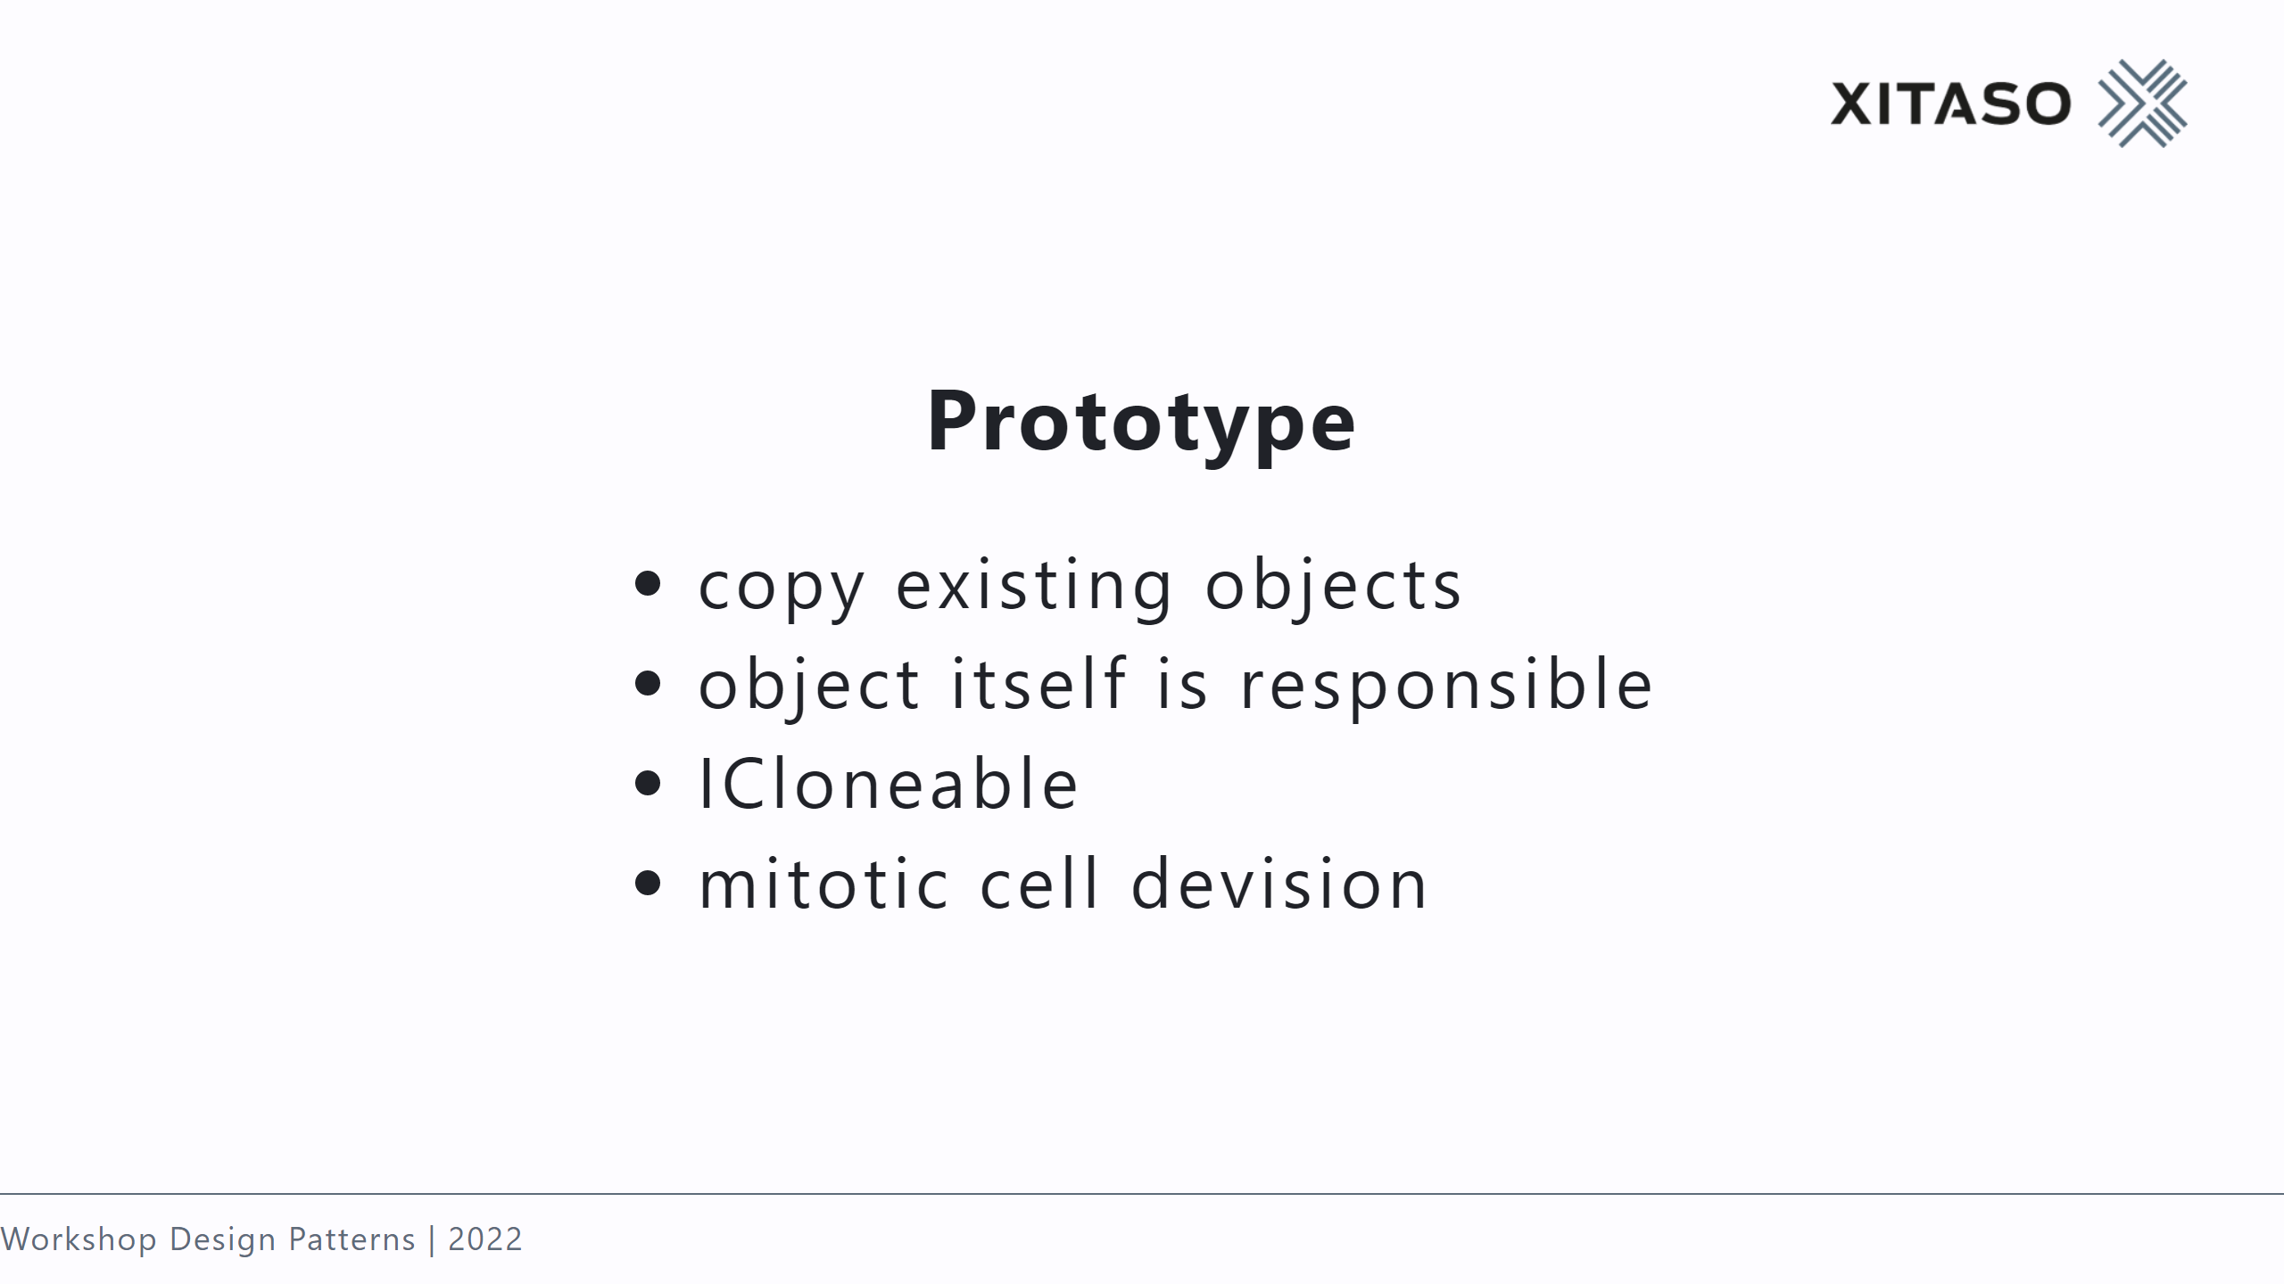
Notes:
Problem: - copy from outside may not know private fields - may only know interface

Slide 12
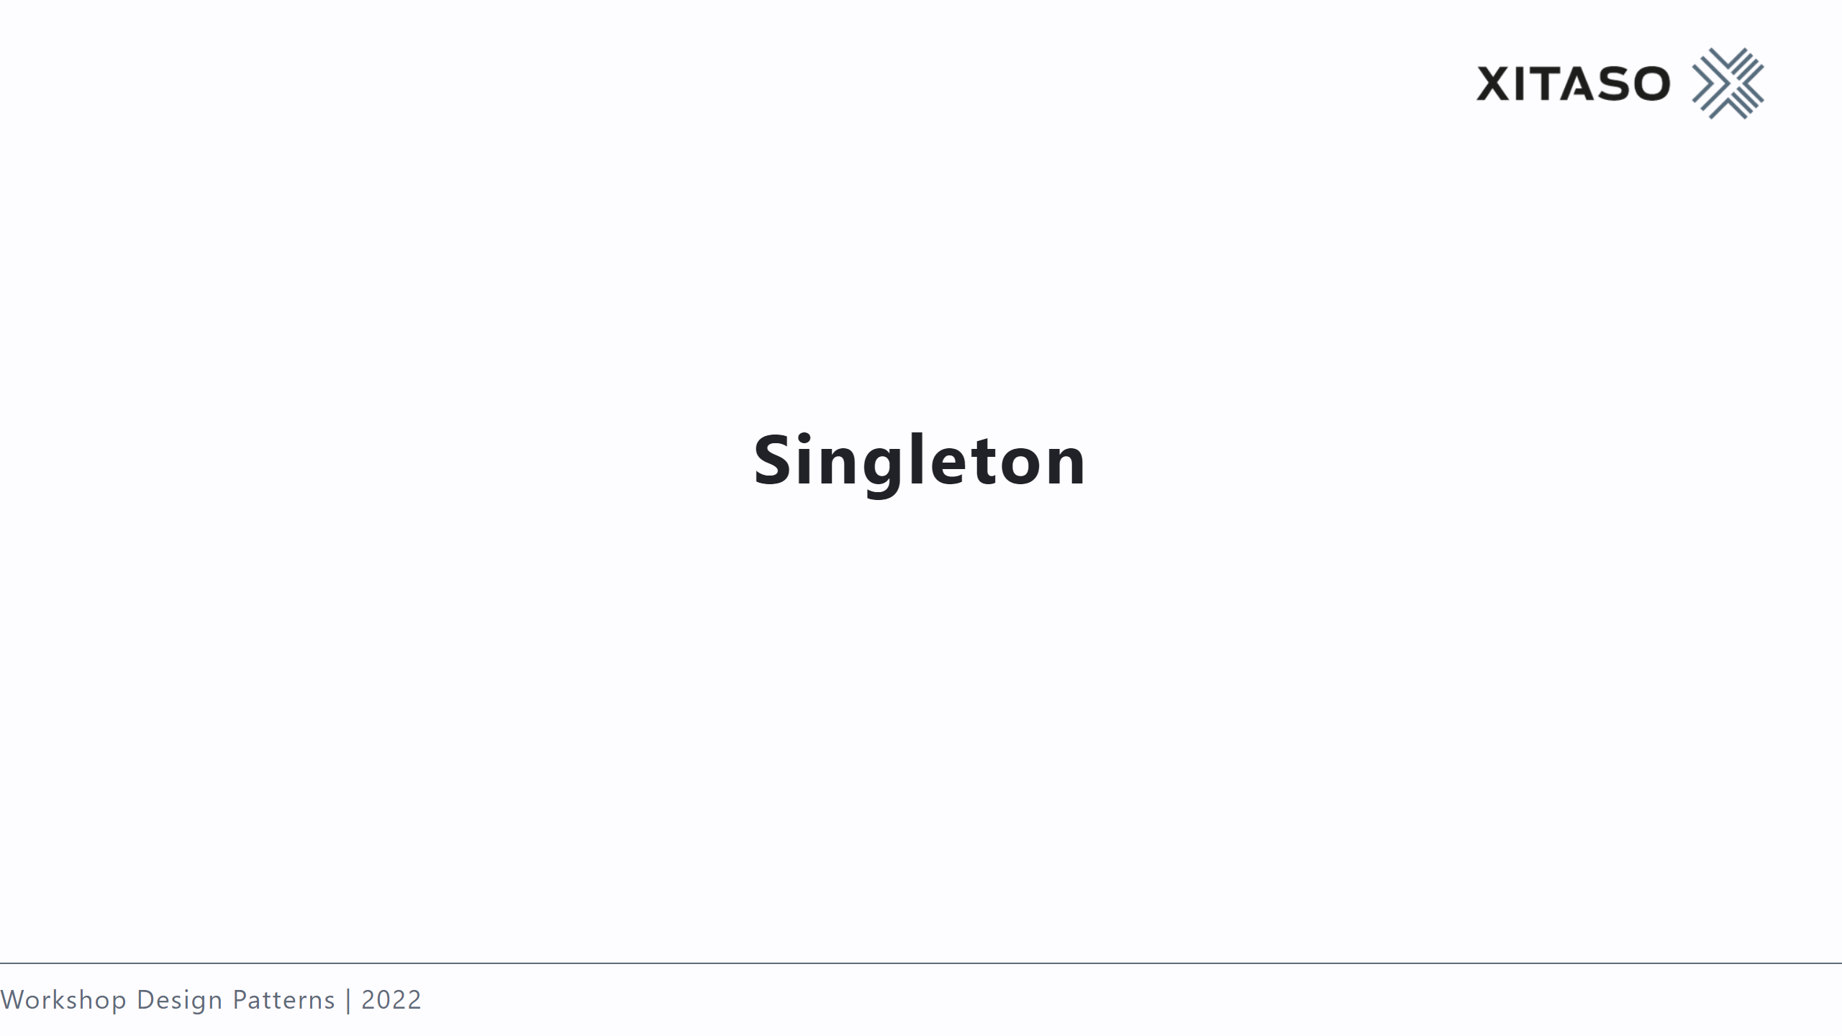

Slide 13
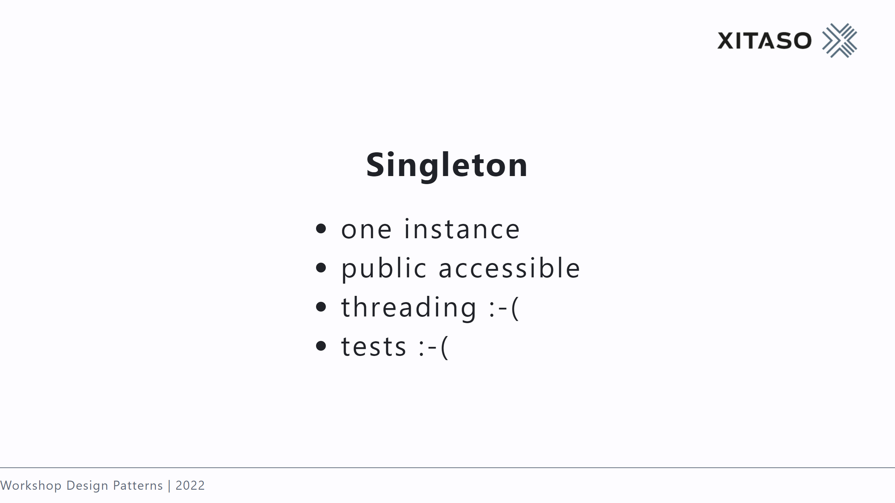
Notes:
Government

Slide 14
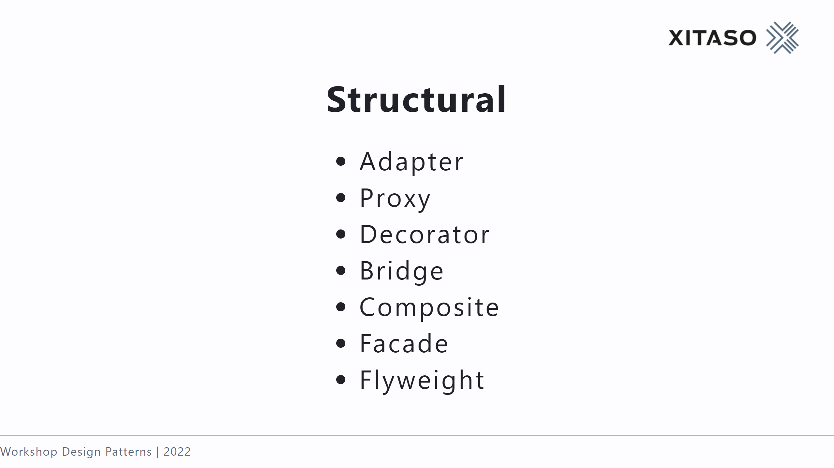

Slide 15


Slide 16
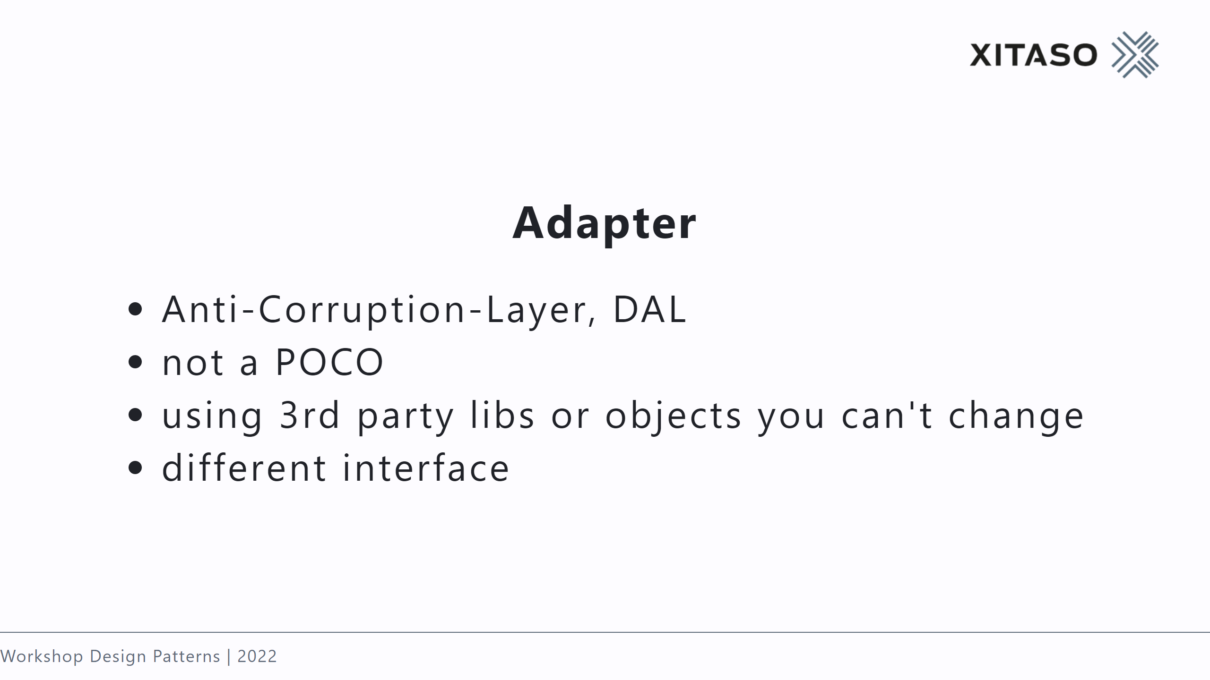

Slide 17
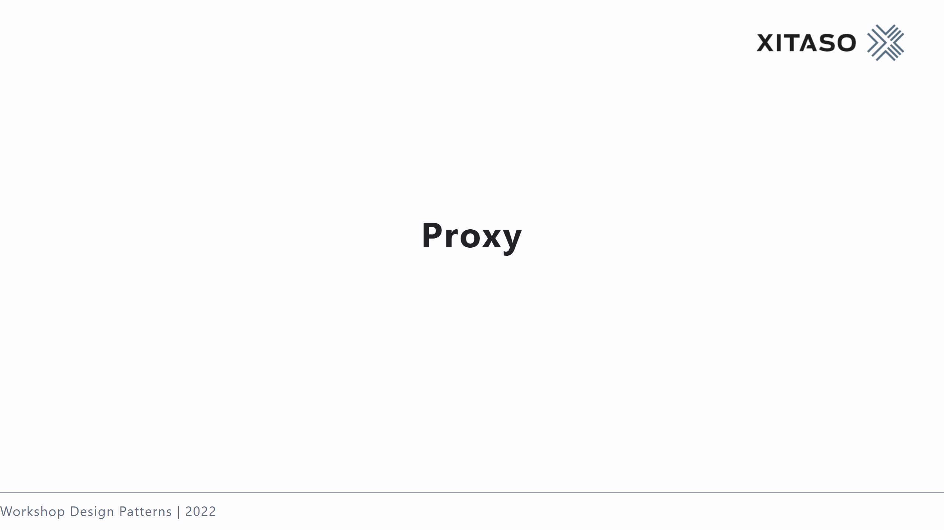

Slide 18
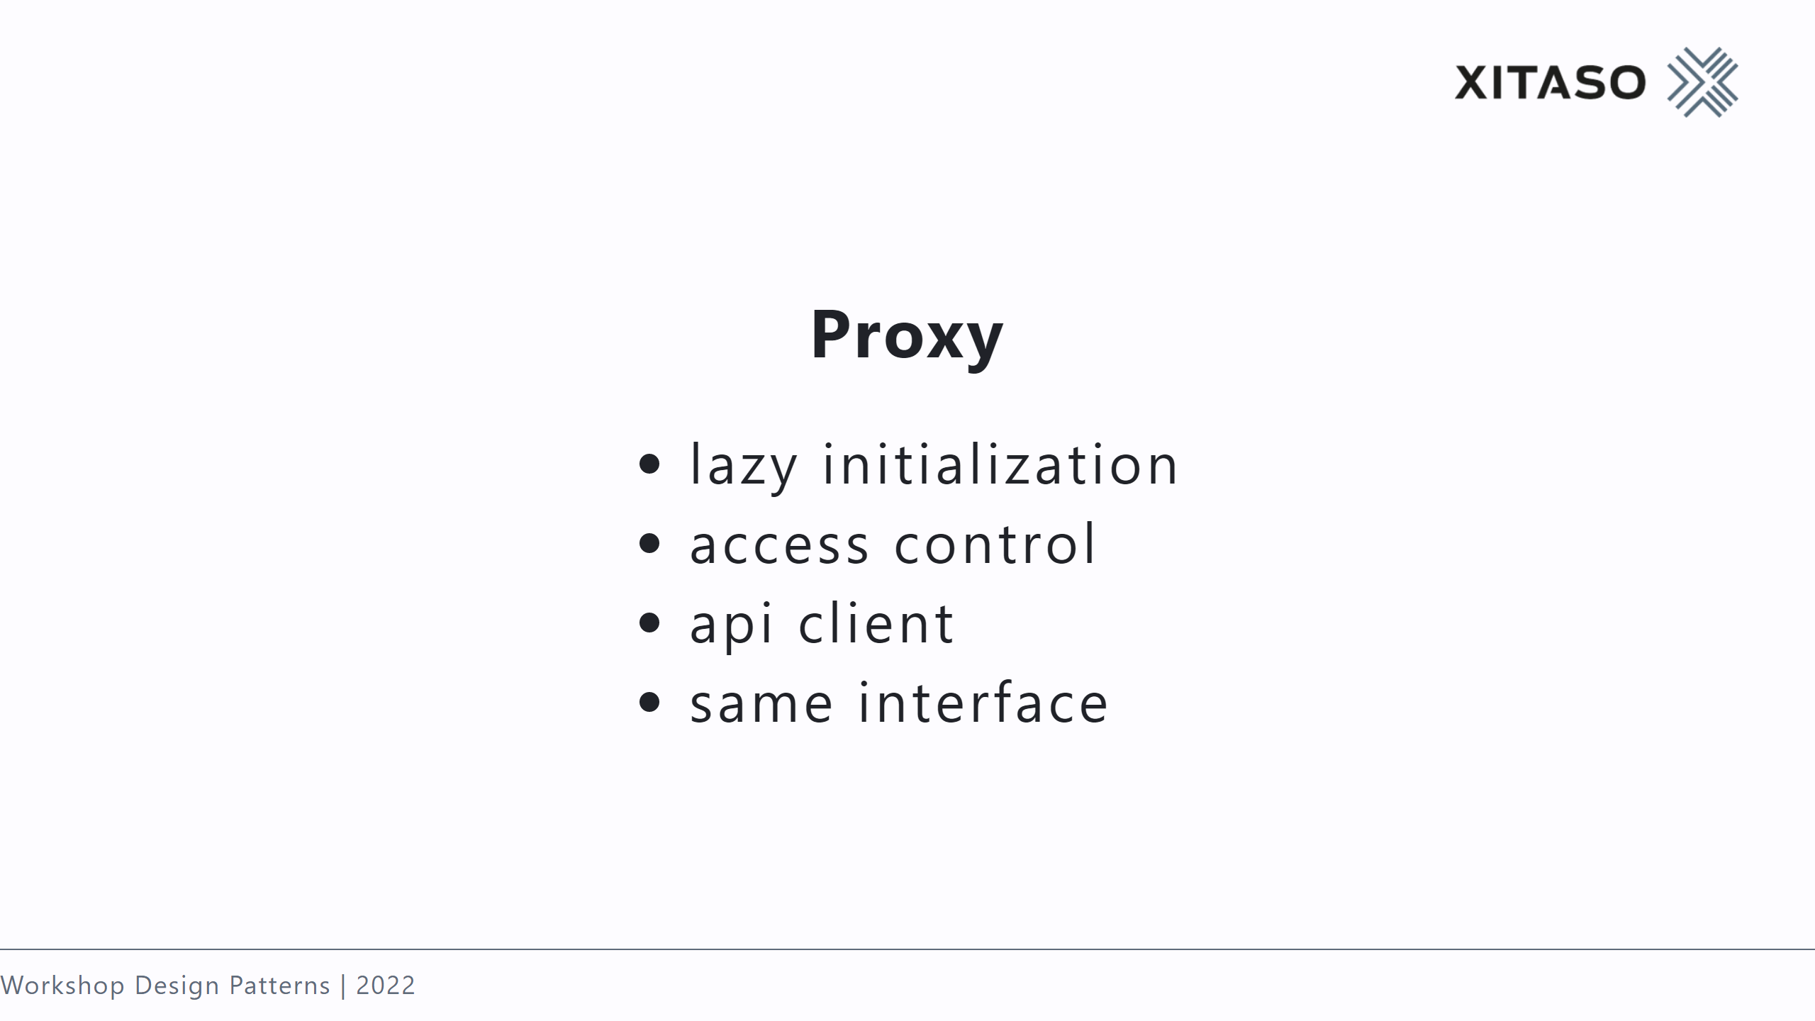

Slide 19


Slide 20
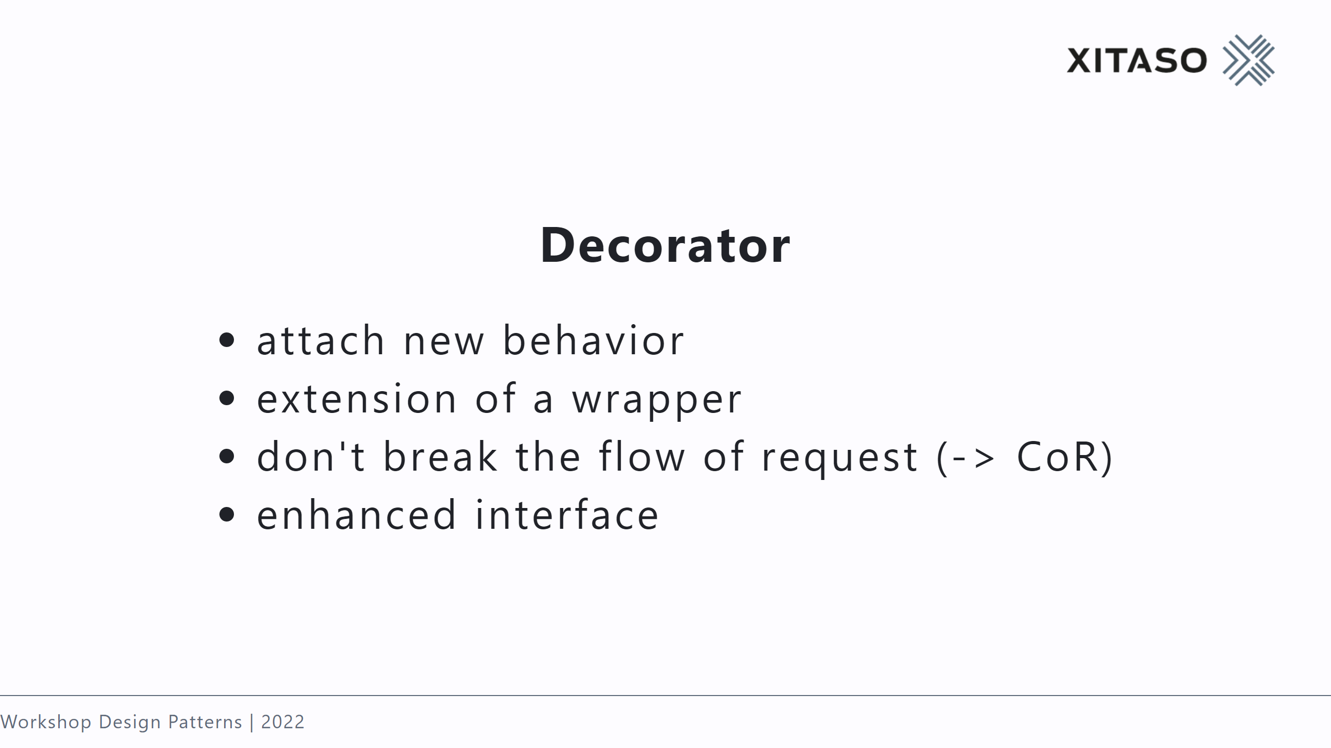

Slide 21


Slide 22
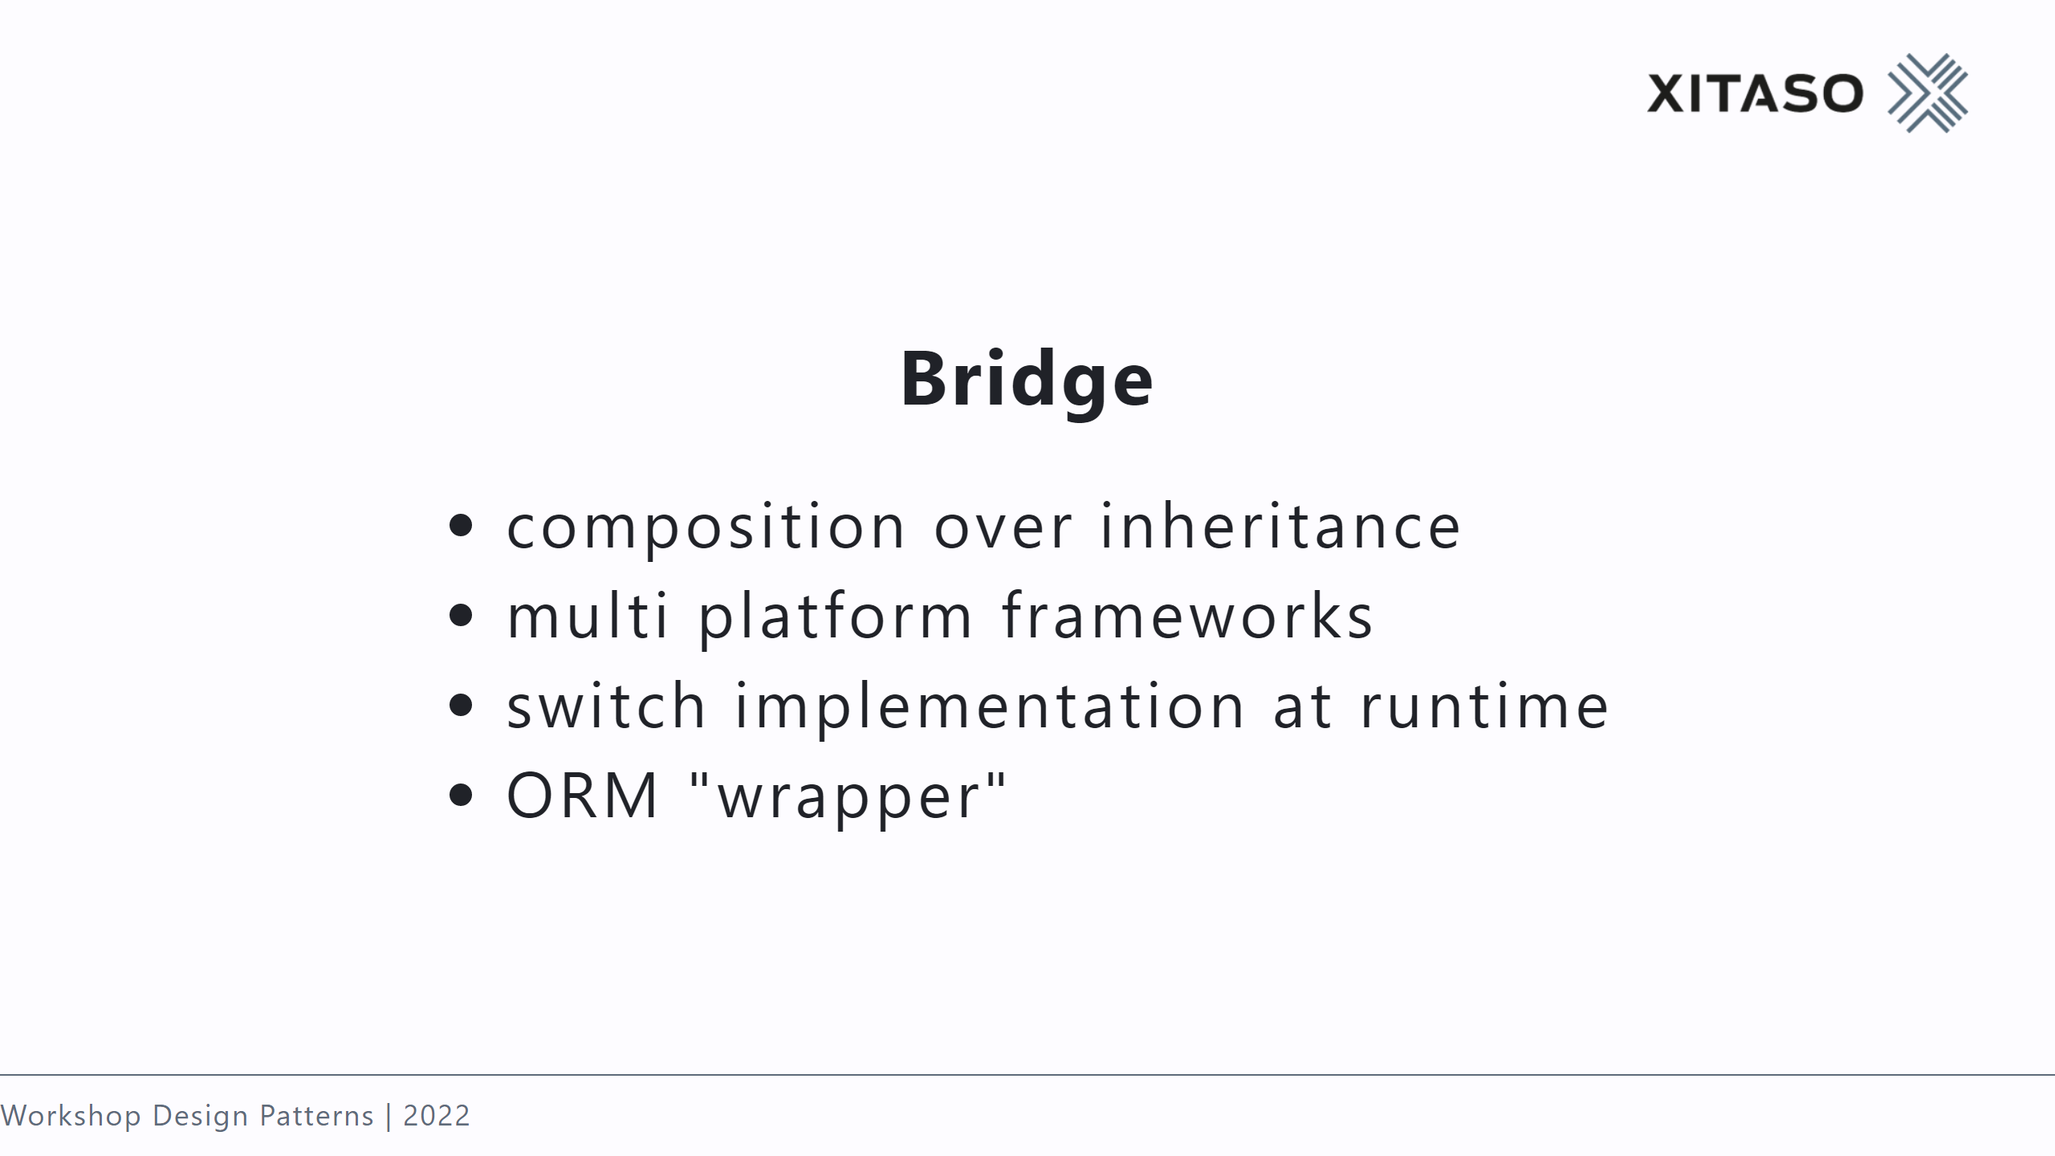
Notes:
universal remote controls

Slide 23
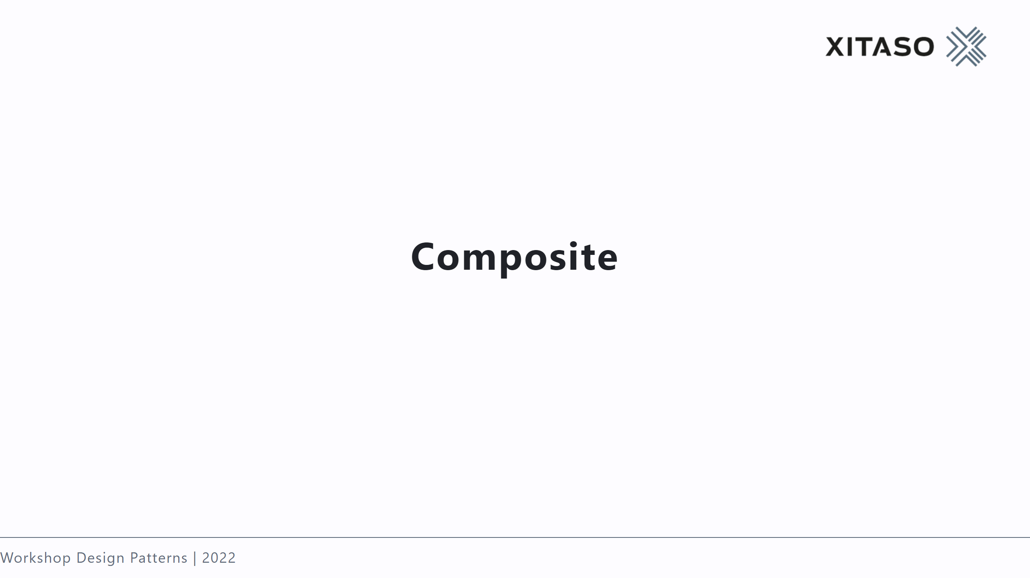

Slide 24
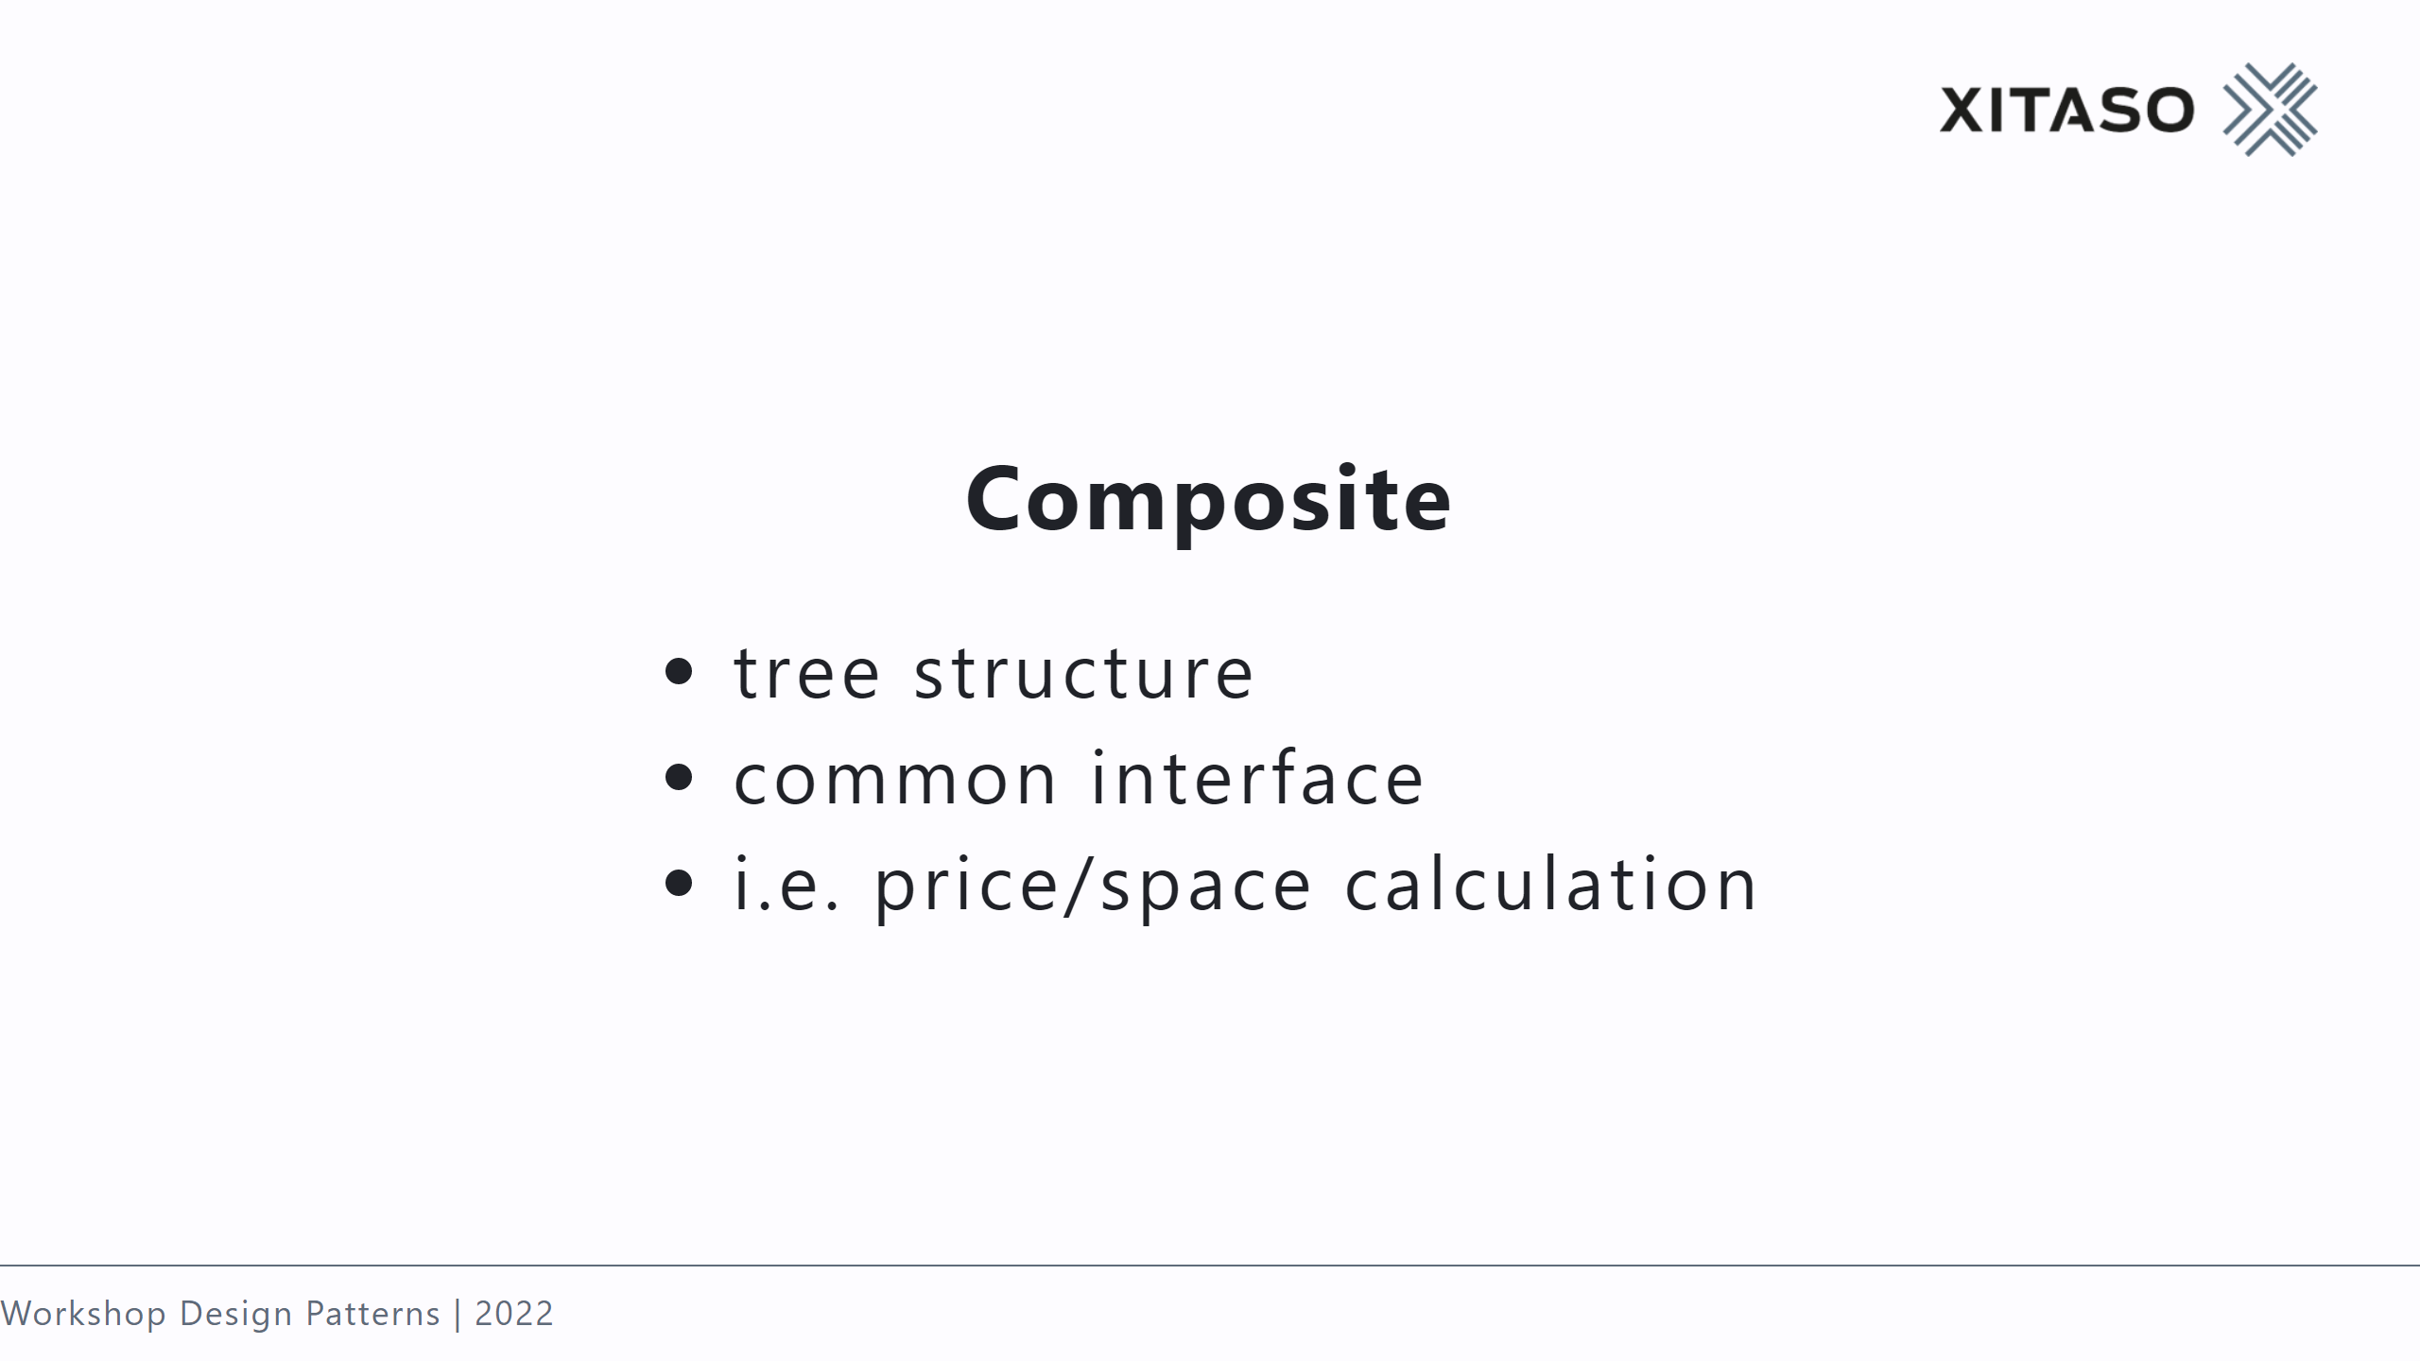
Notes:
WPF layouting

Slide 25


Slide 26
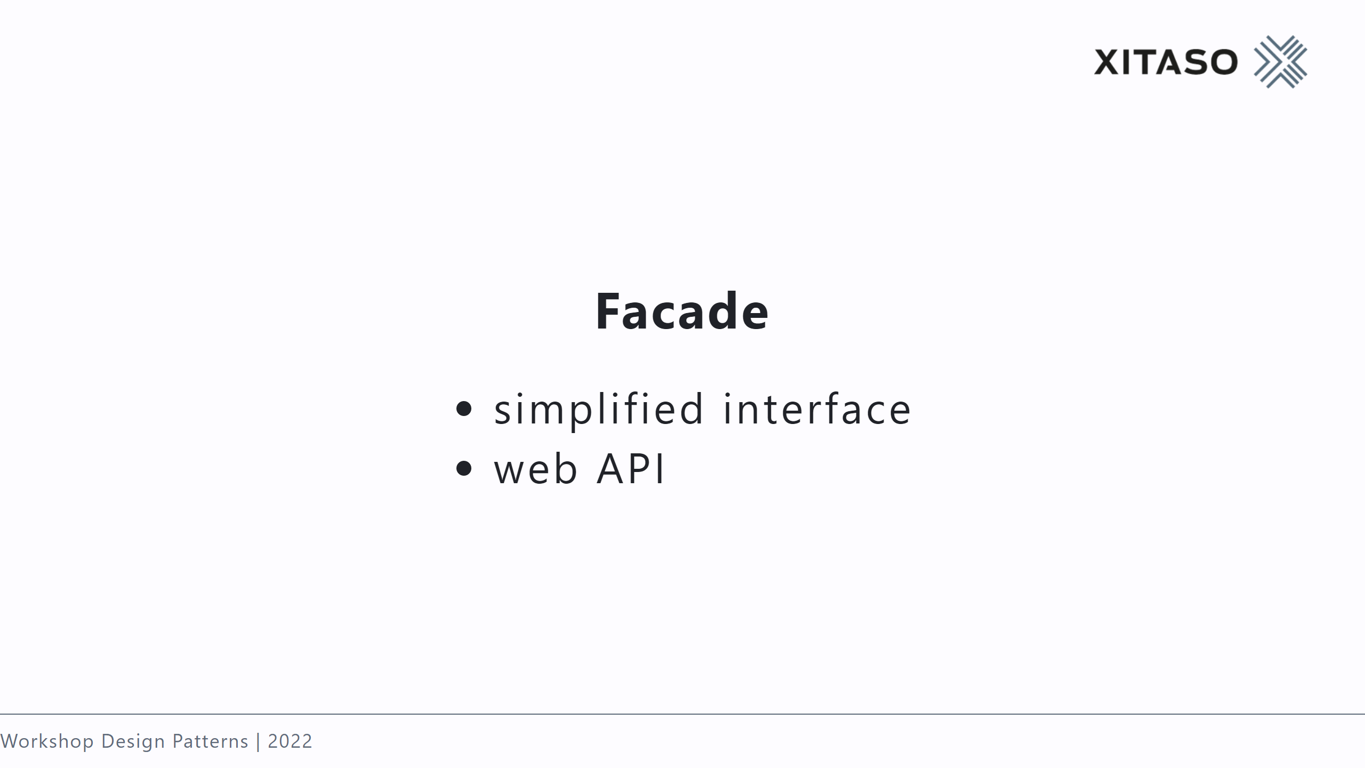
Notes:
new interface for existing objects, system of objects

Slide 27
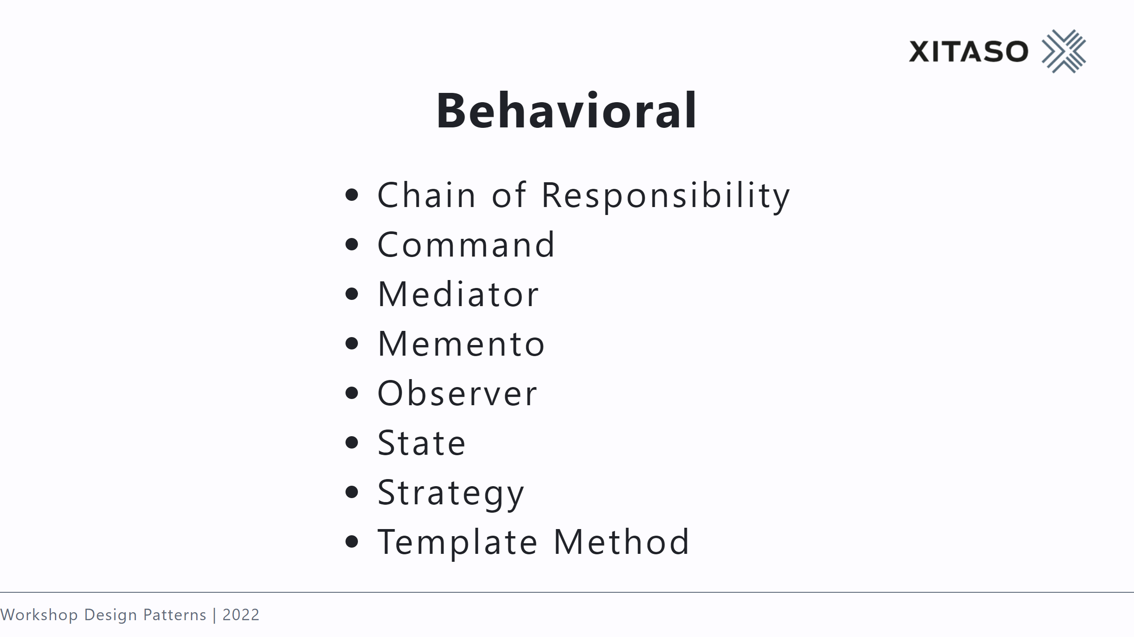

Slide 28
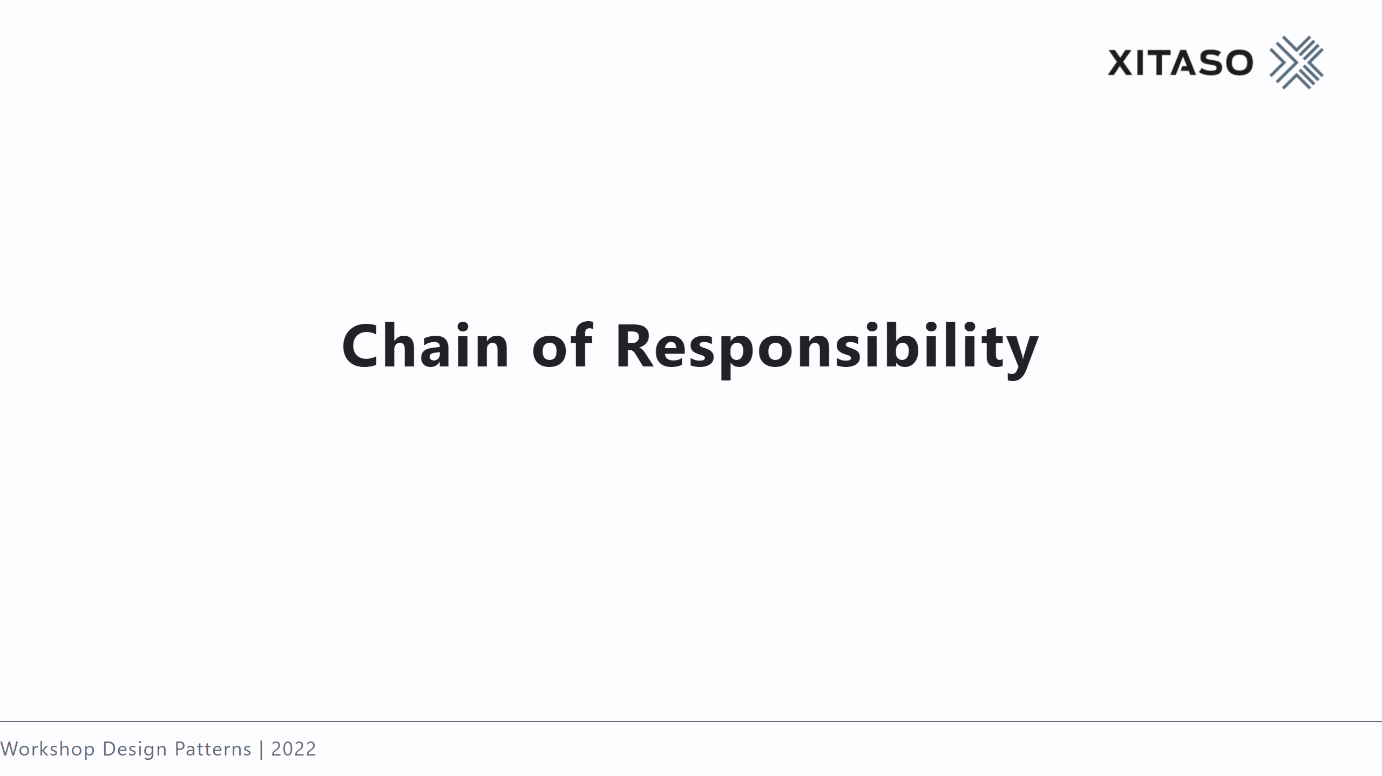

Slide 29
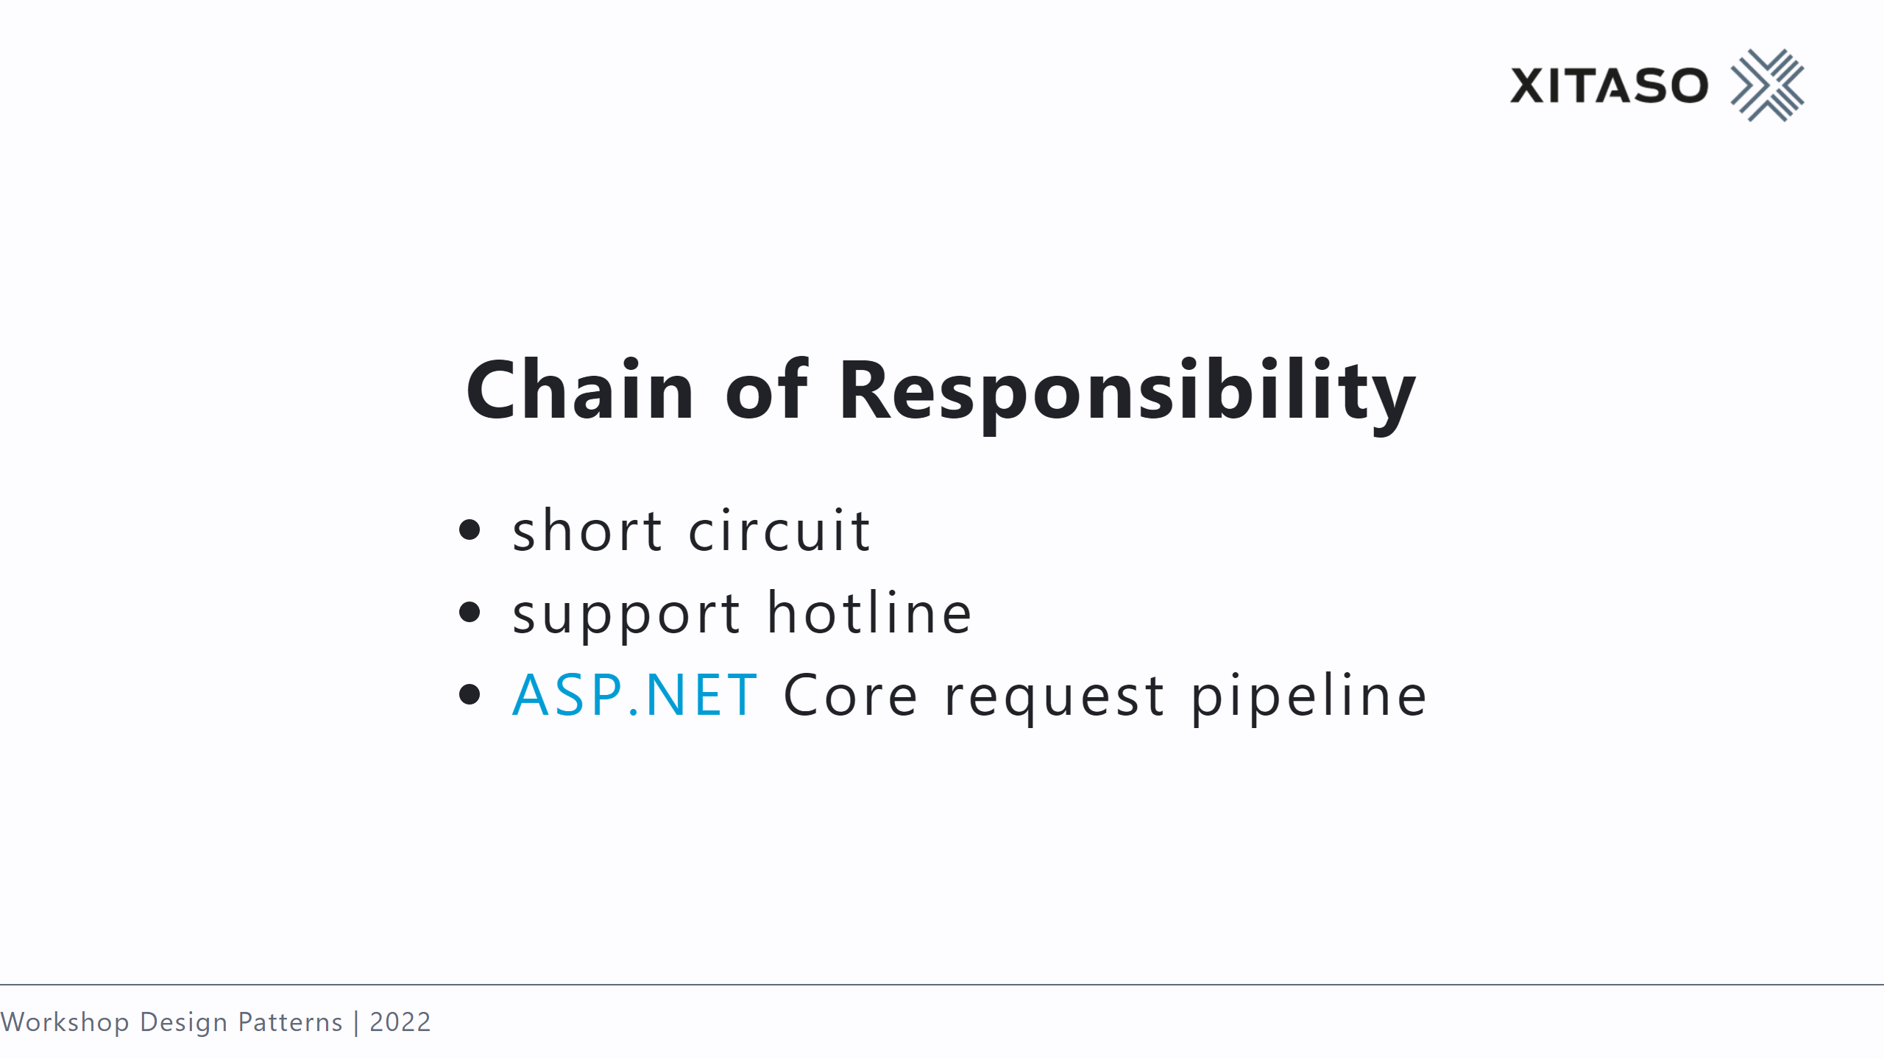
Notes:
compare with decorator

Slide 30


Slide 31
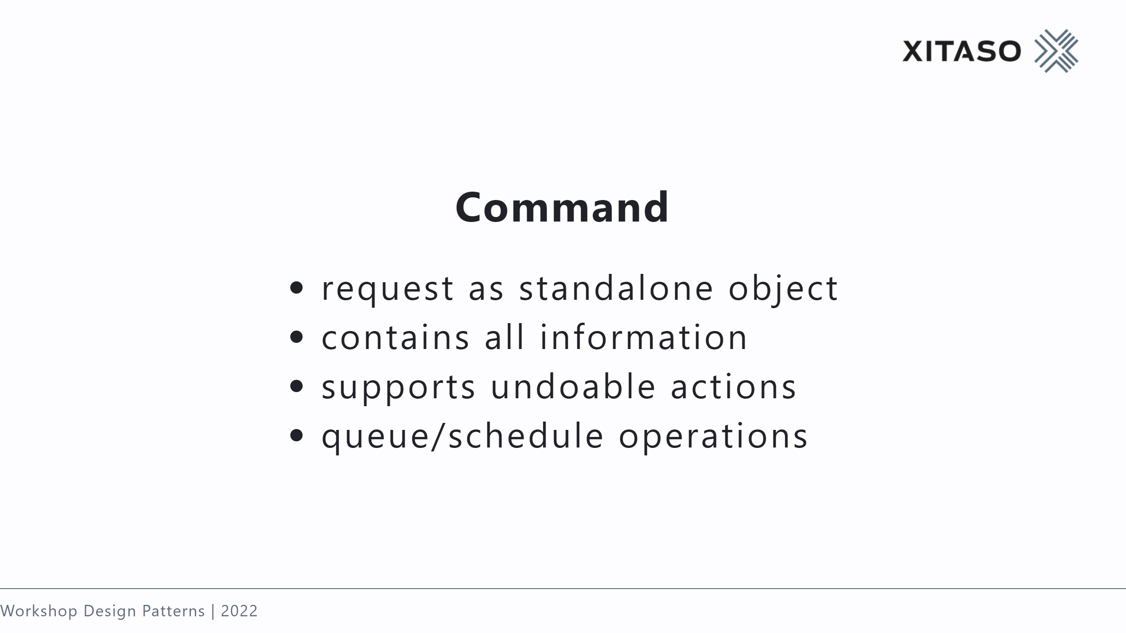
Notes:
unidirectional connection, restaurant order!

Slide 32
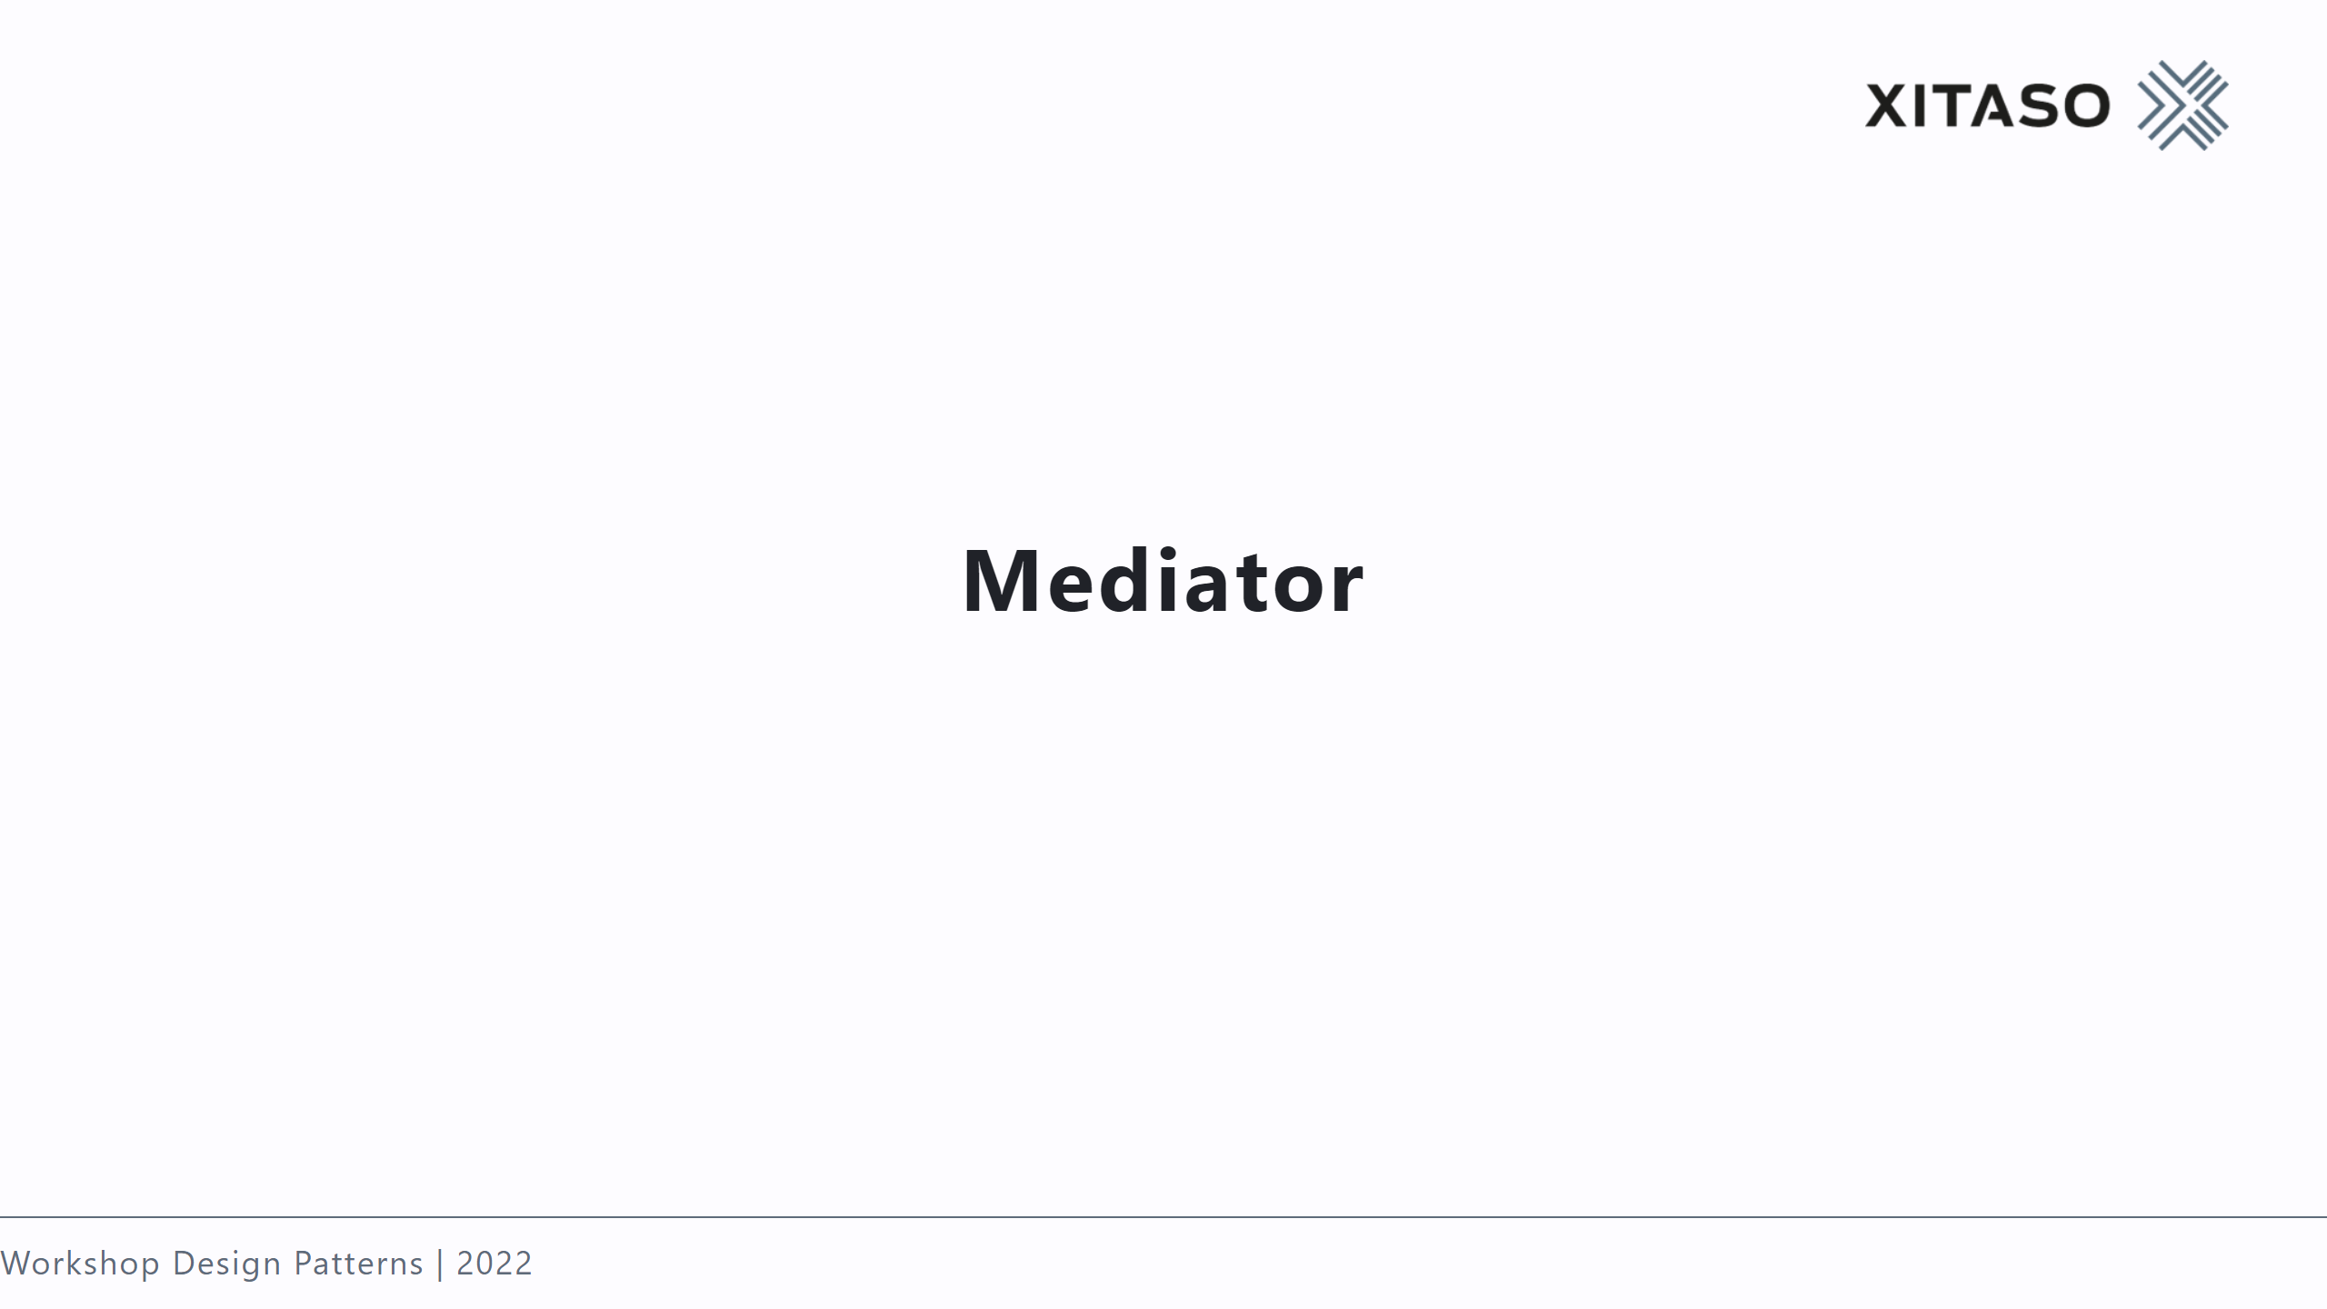

Slide 33
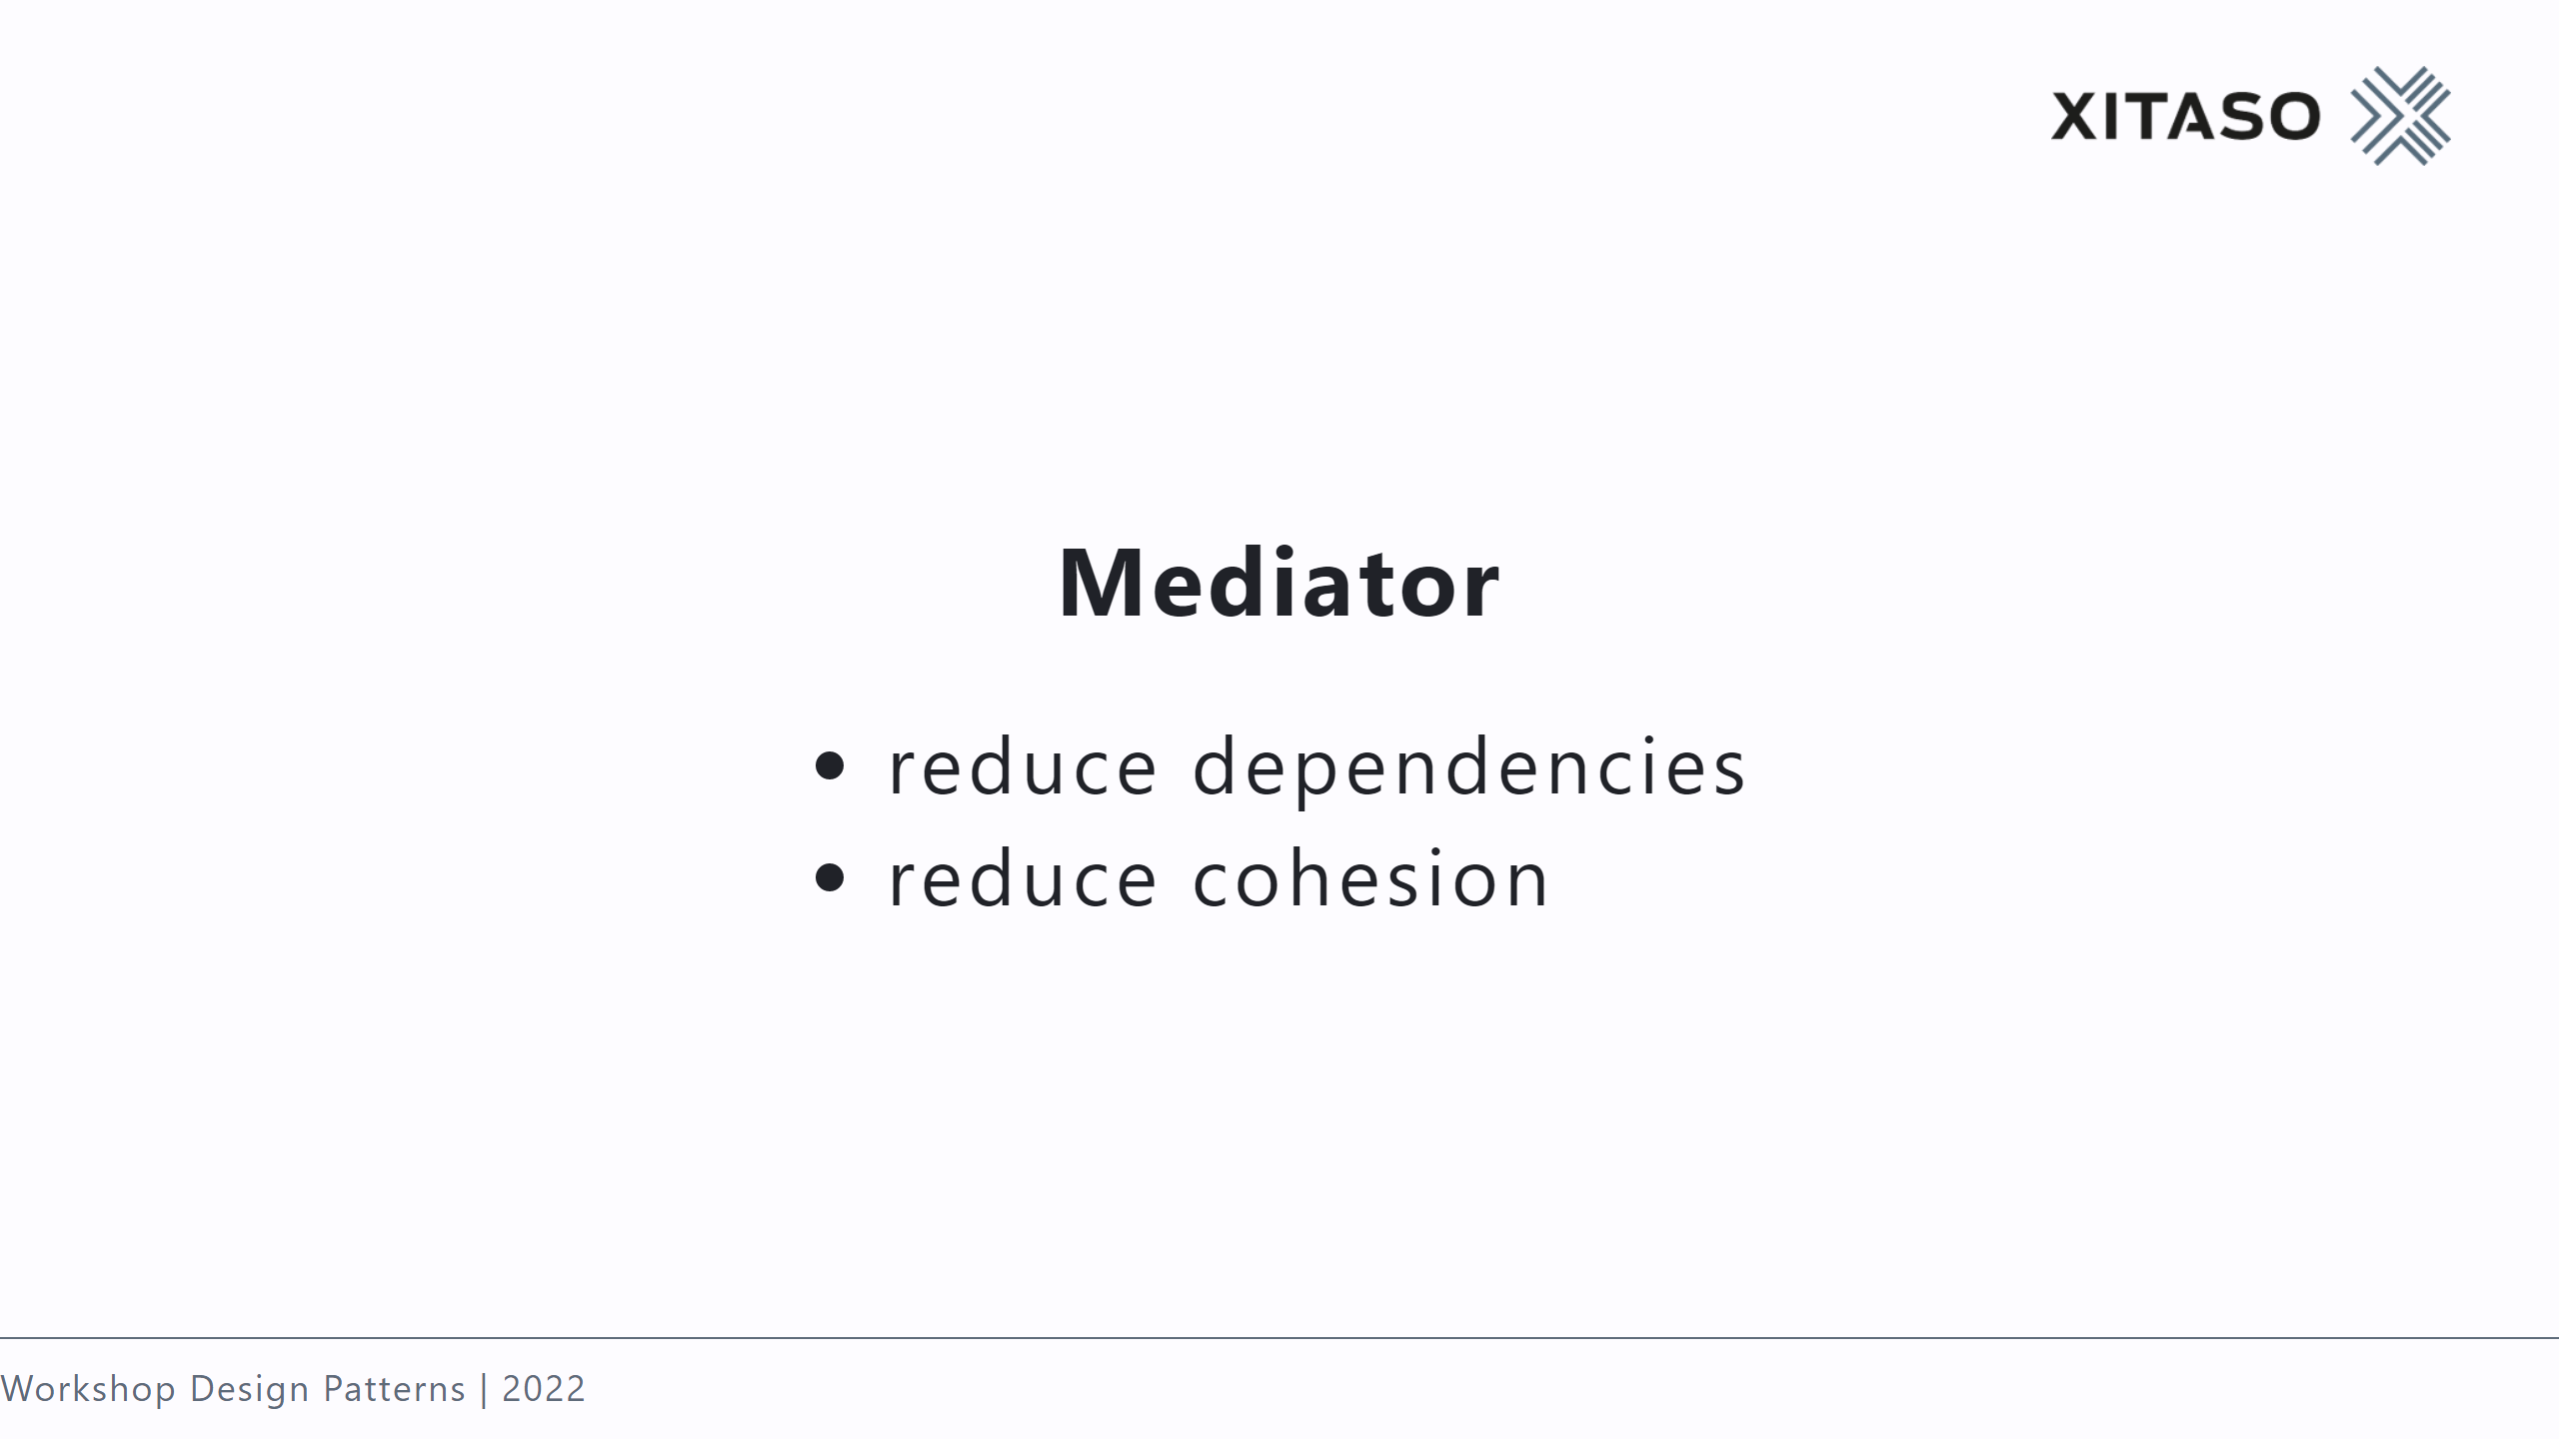
Notes:
no connection! flight control

Slide 34
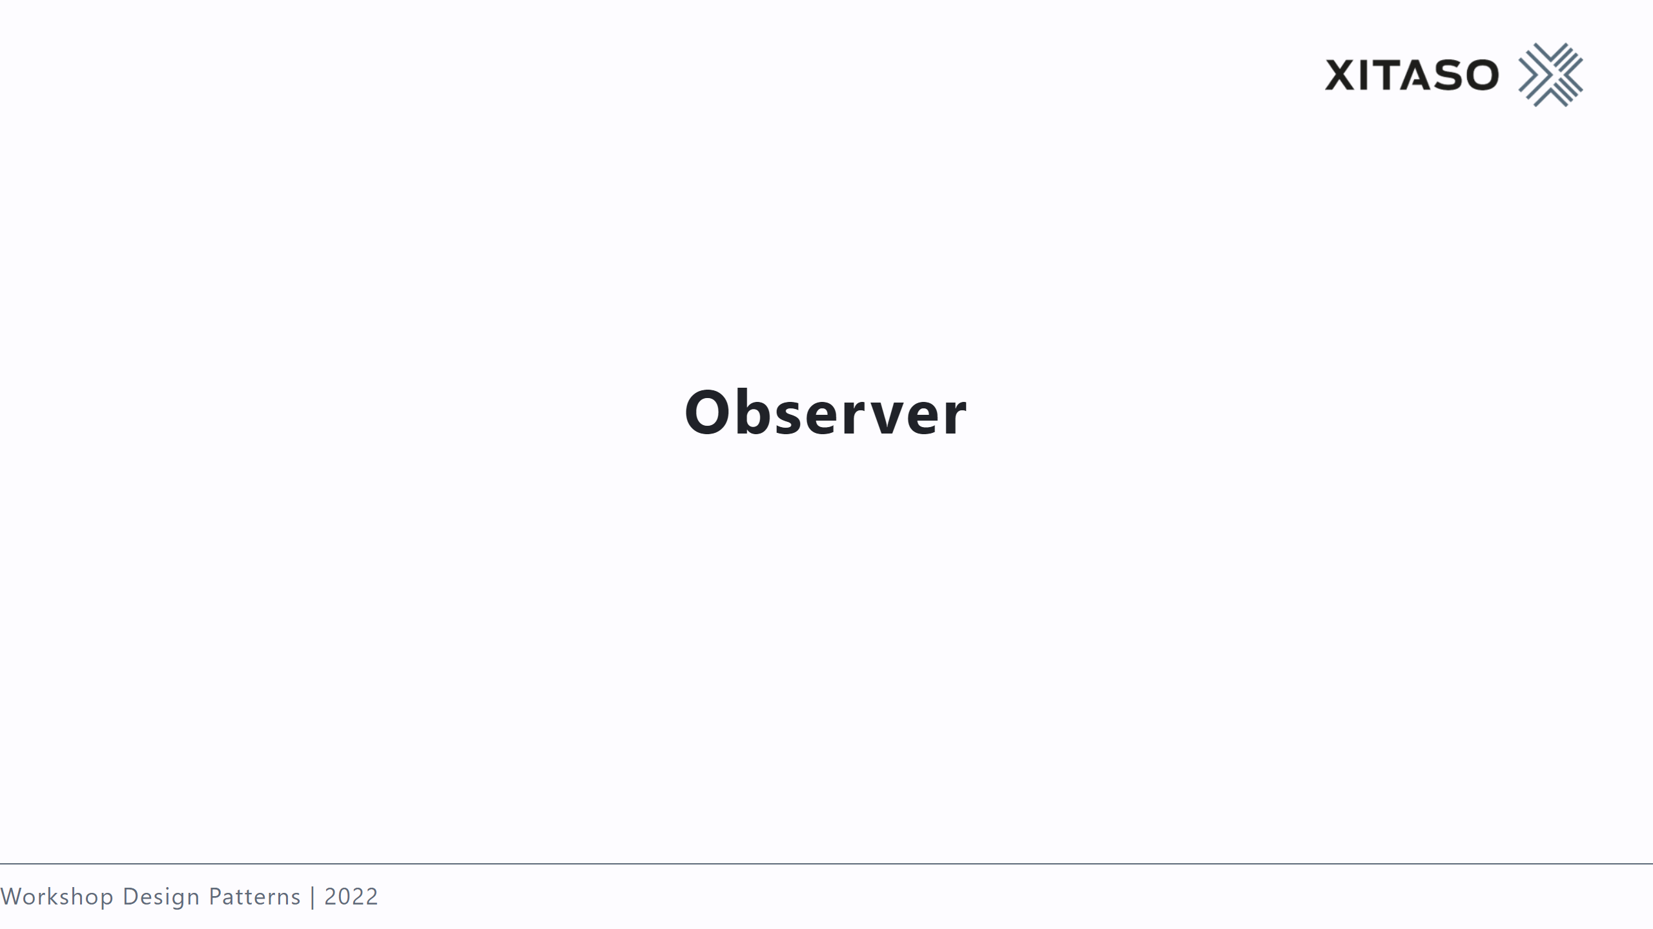

Slide 35
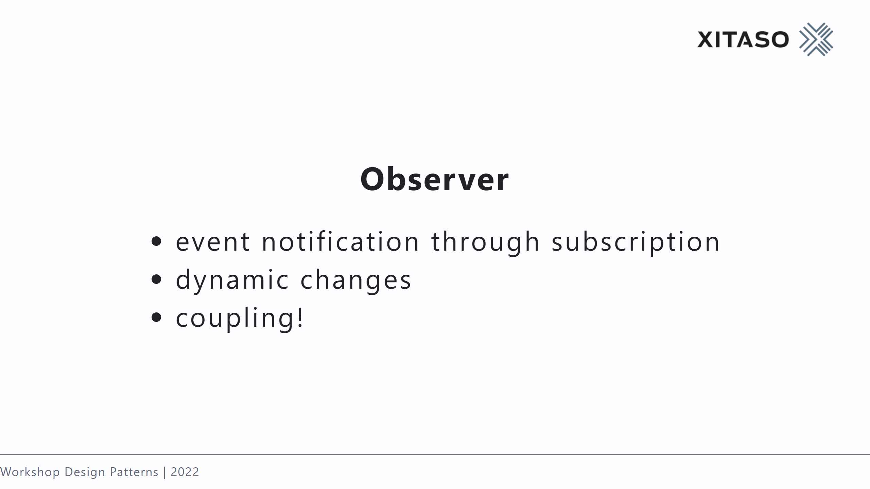
Notes:
unidirectional connection

Slide 36


Slide 37
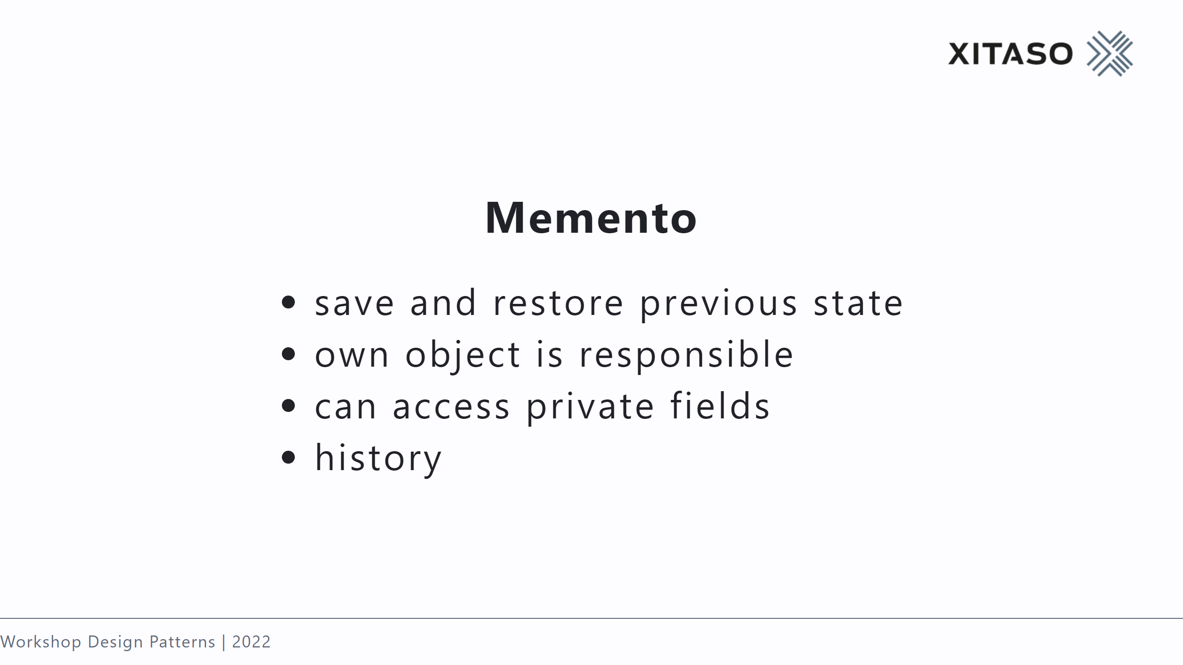

Slide 38


Slide 39
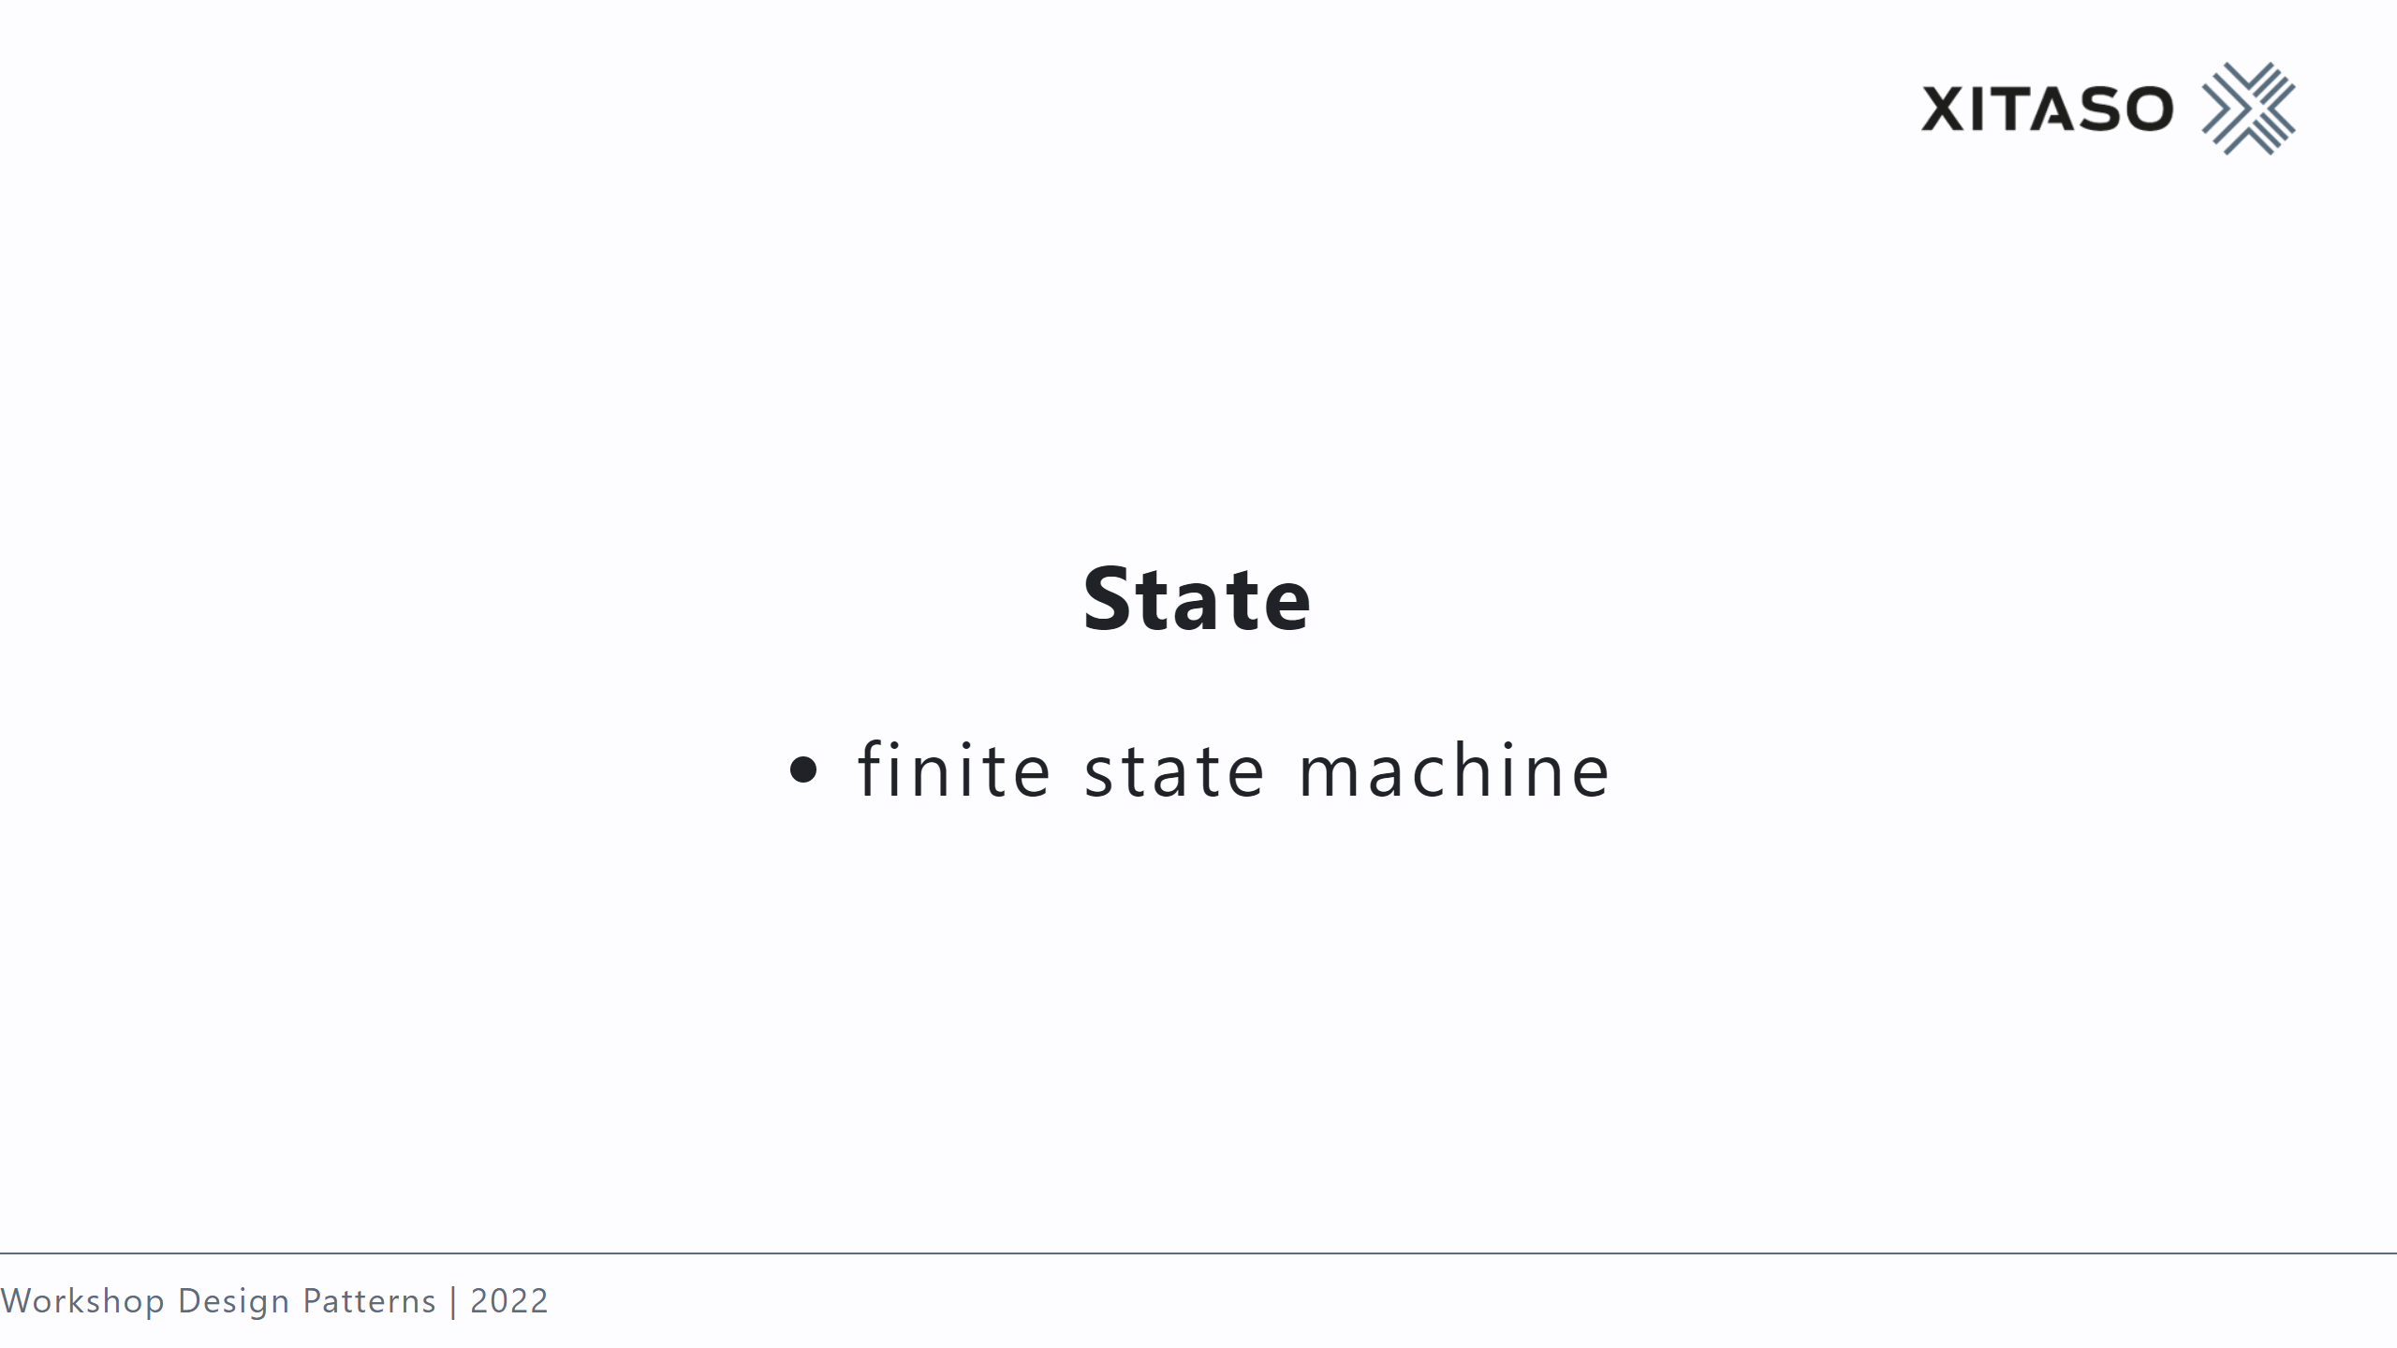

Slide 40
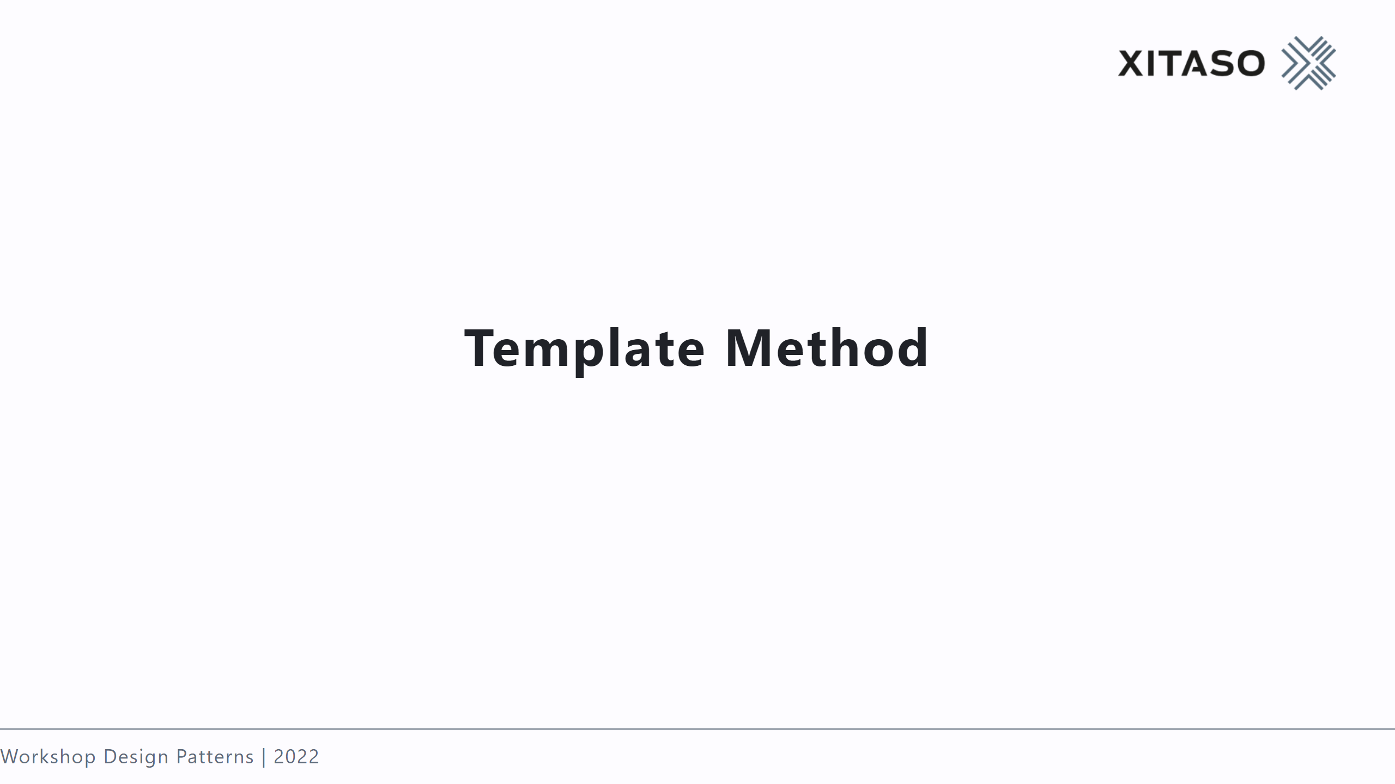

Slide 41
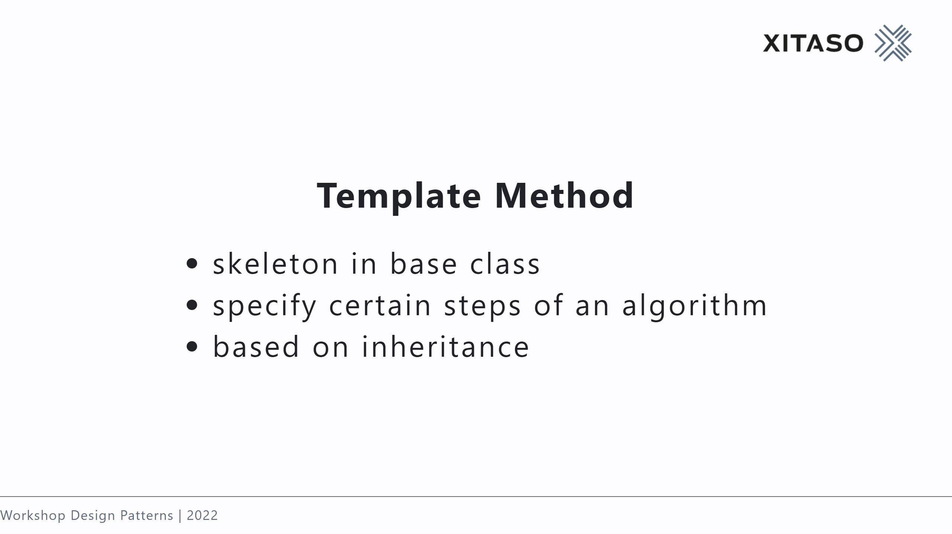
Notes:
factory method is specialized template method

Slide 42
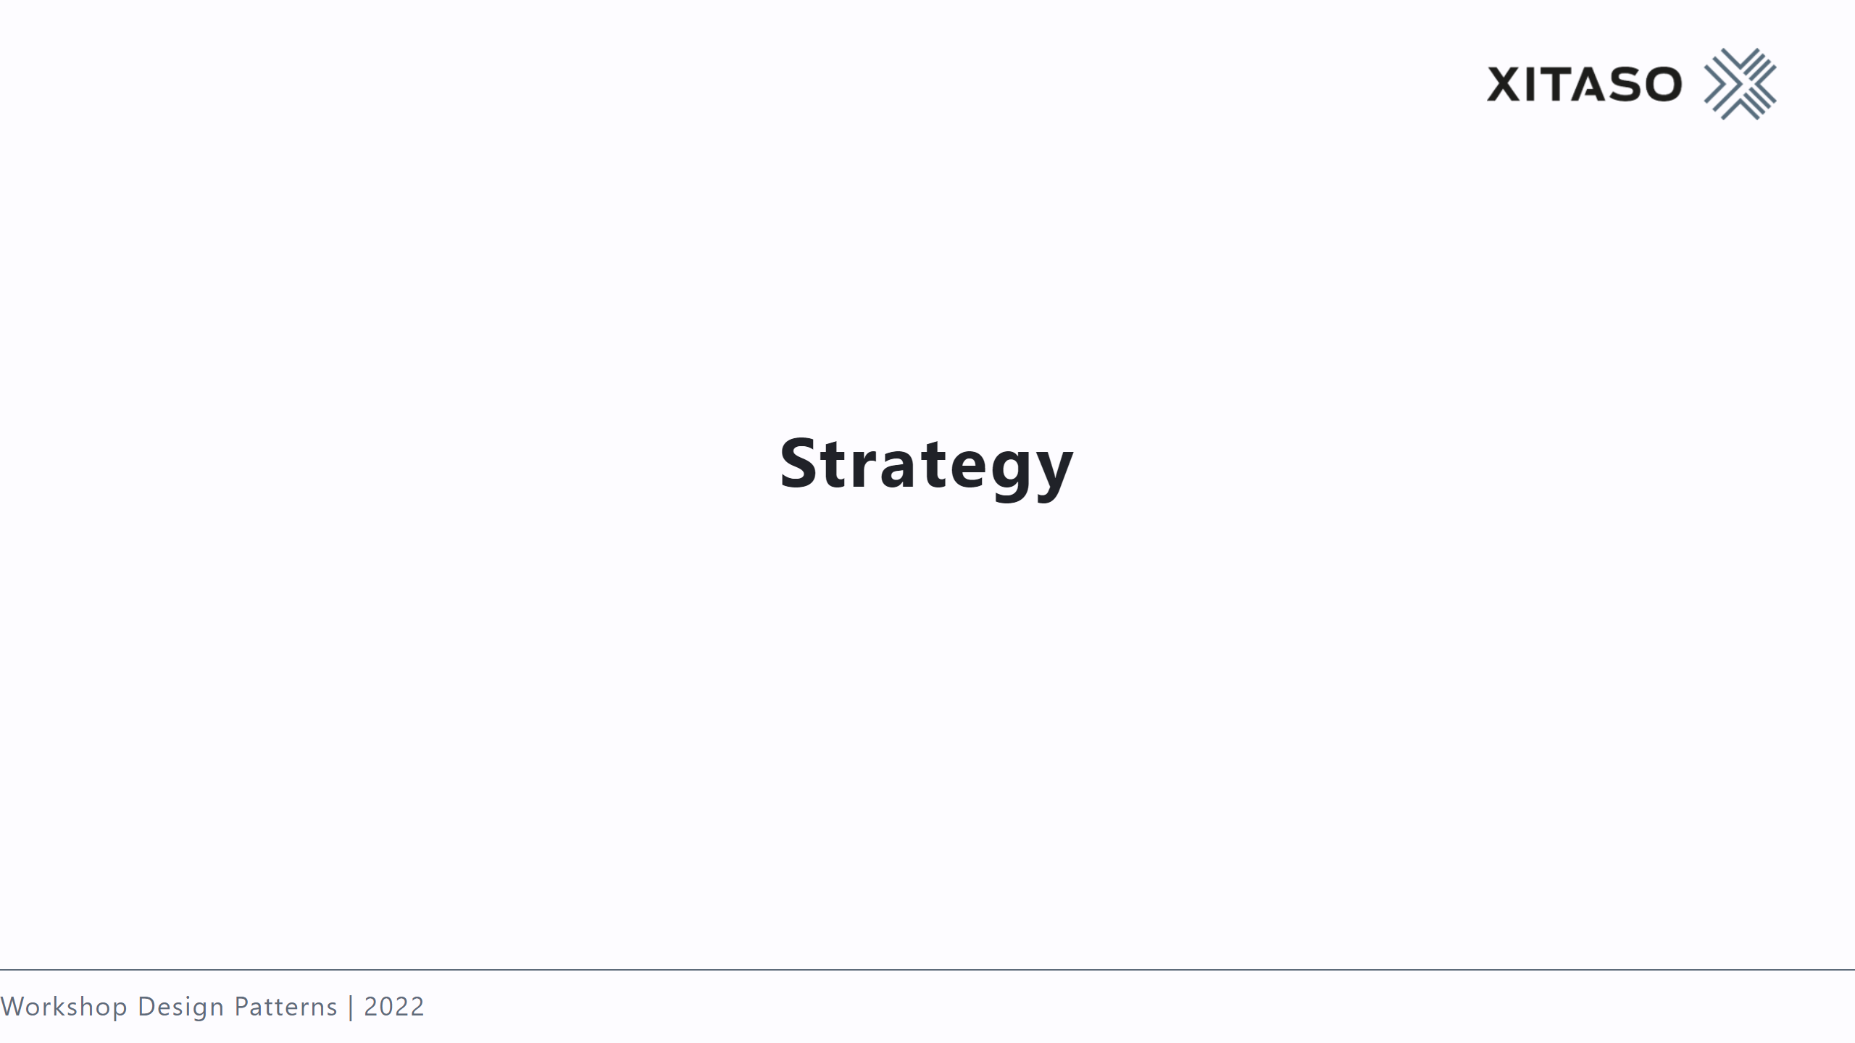

Slide 43
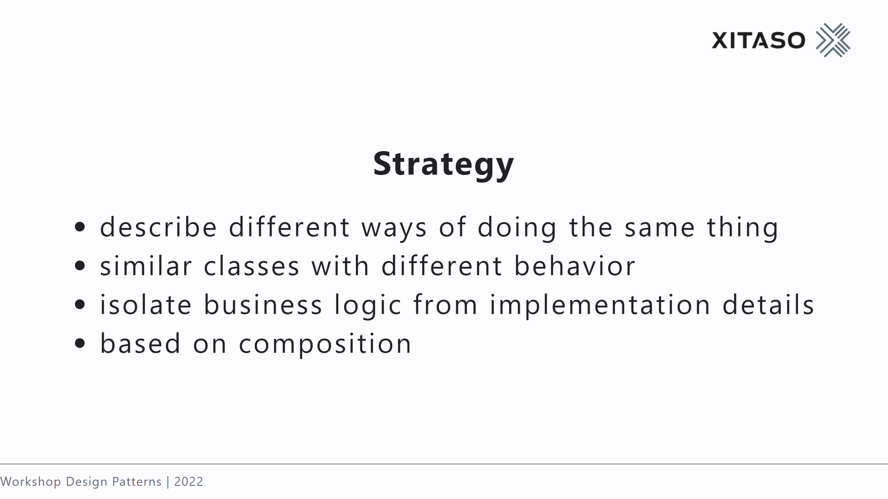
Notes:
routing algorithms

Slide 44
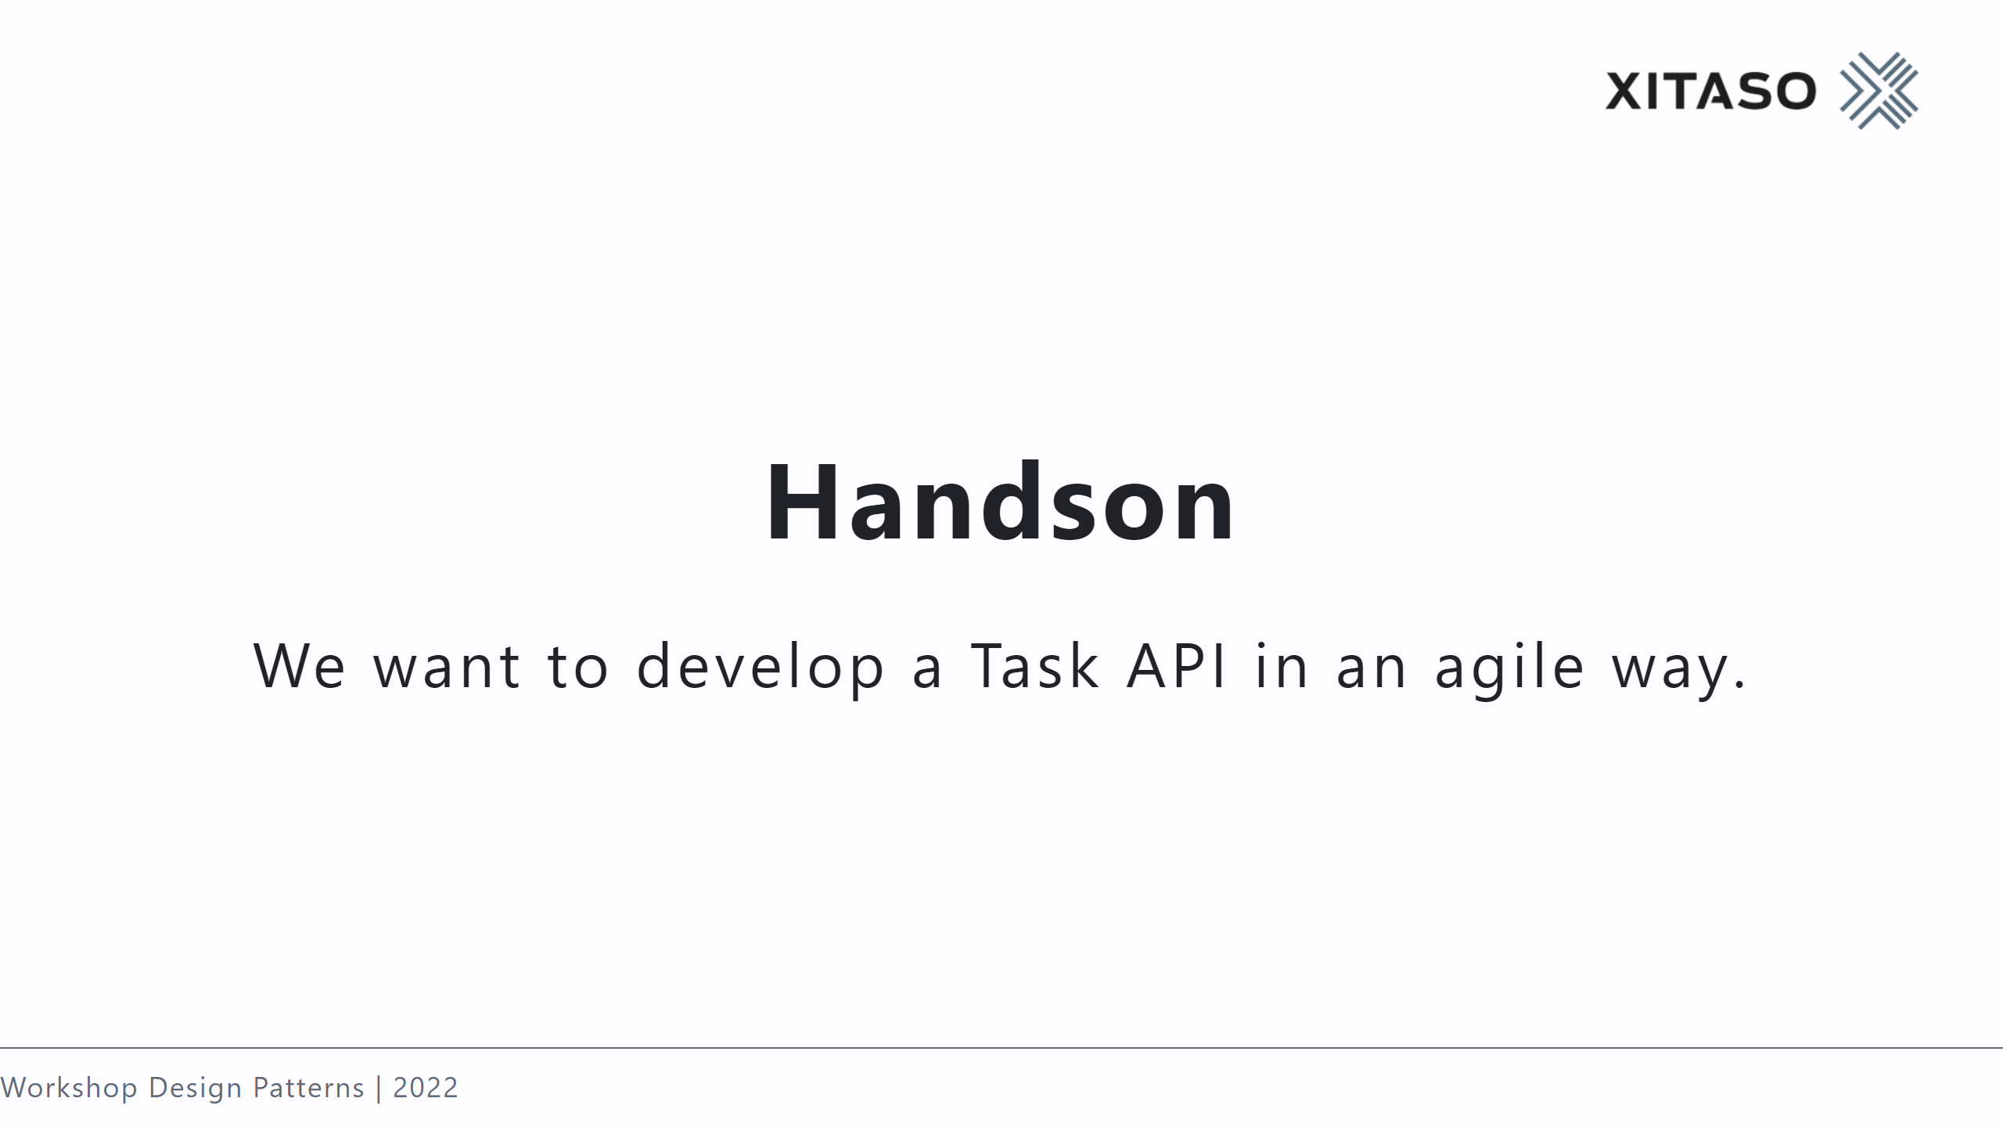

Slide 45
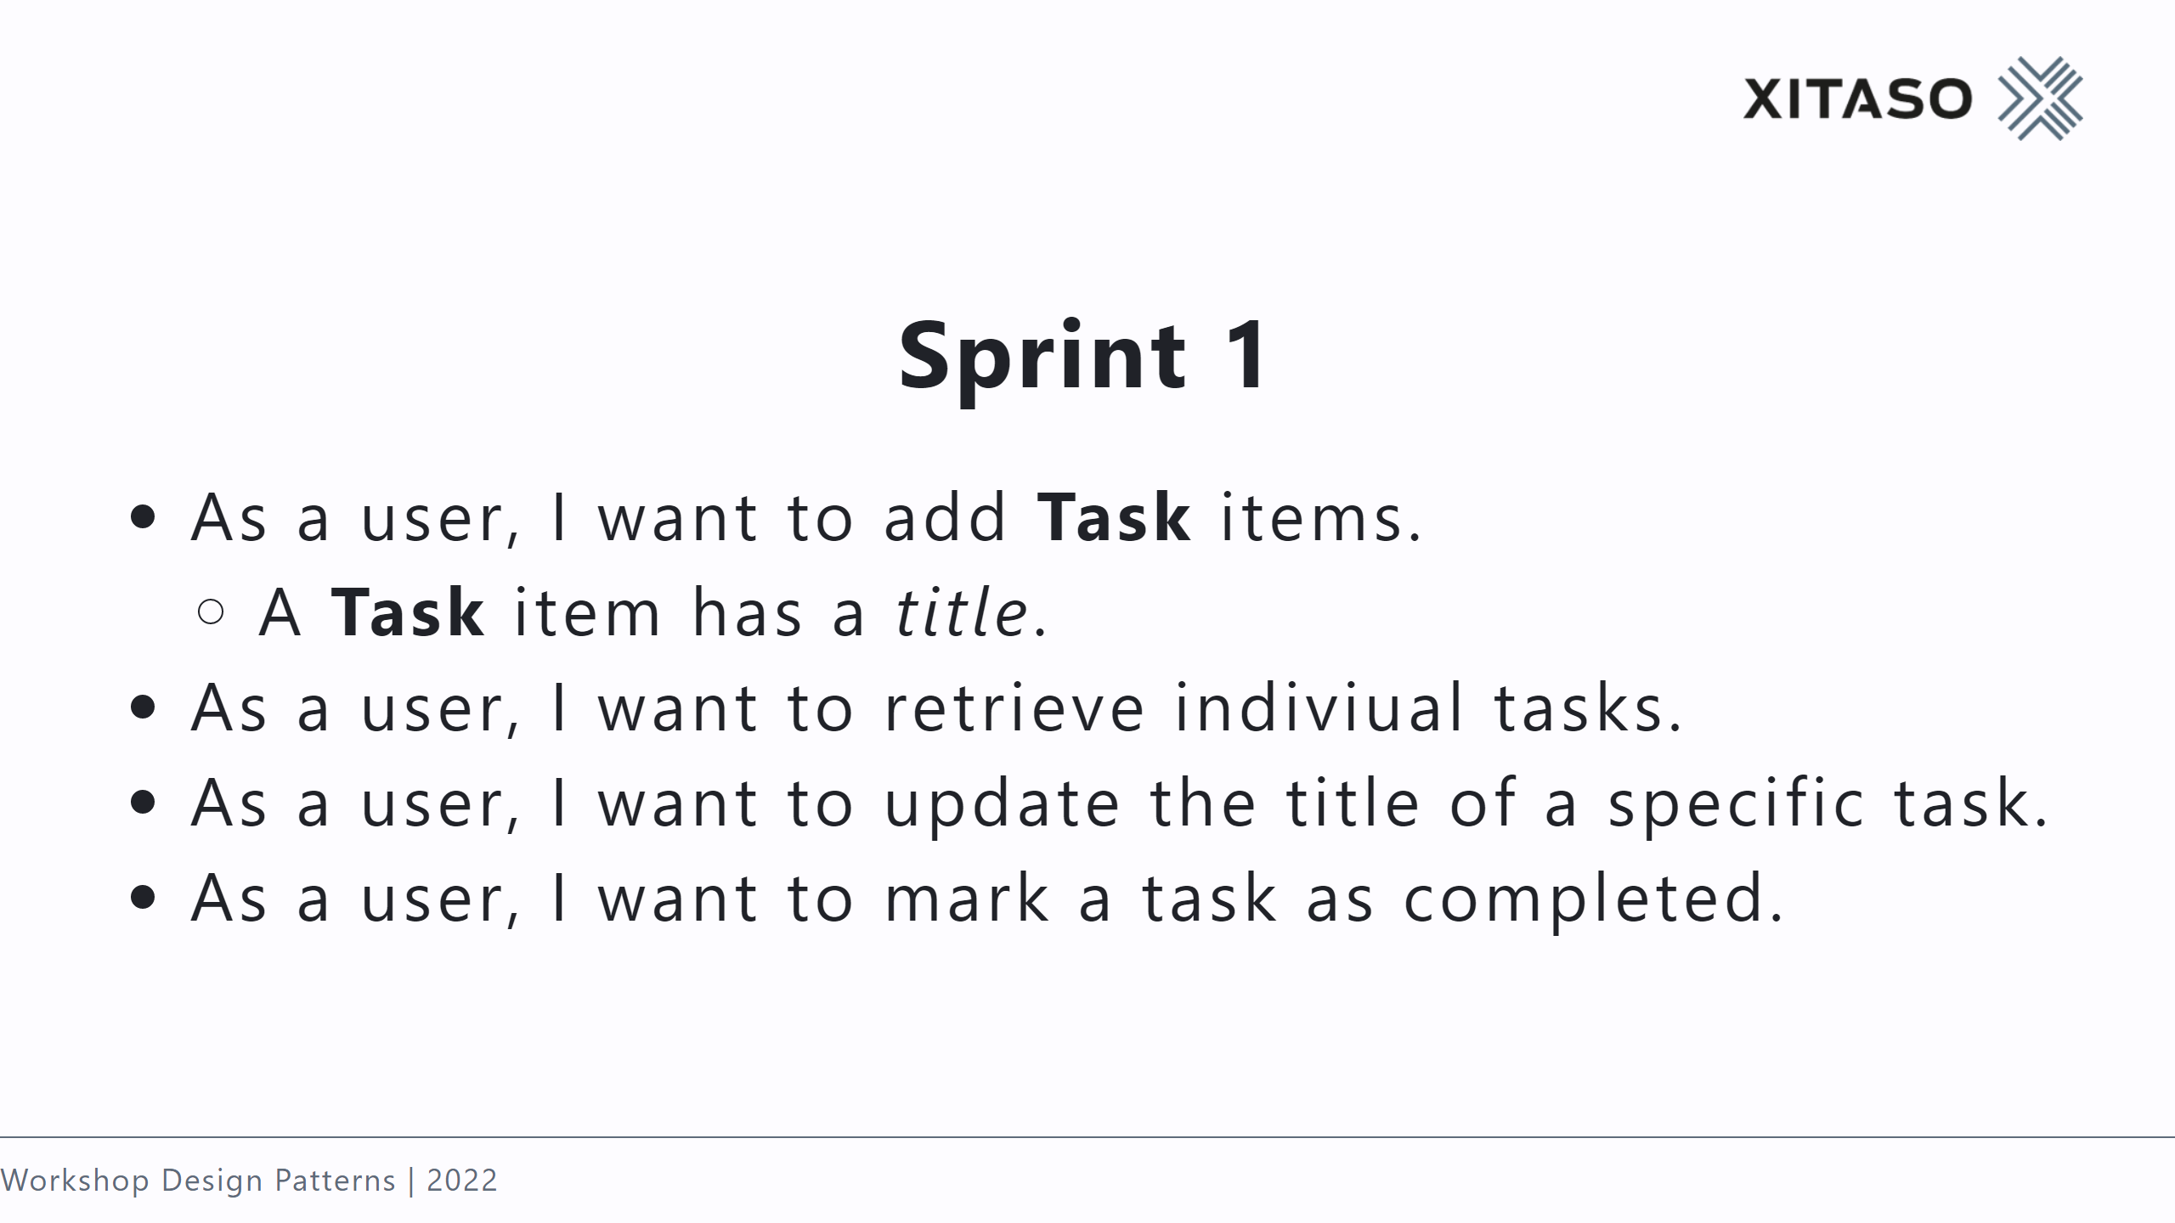
Notes:
- Facade -> API - Adapter for DTOs -> explain Proxy and Decorator - Factory -> static creation method - Builder for tests - Template Method for specific builders - DbContext -> Repository, UnitOfWork - Chain of Responsibility (ASP Pipeline)

Slide 46
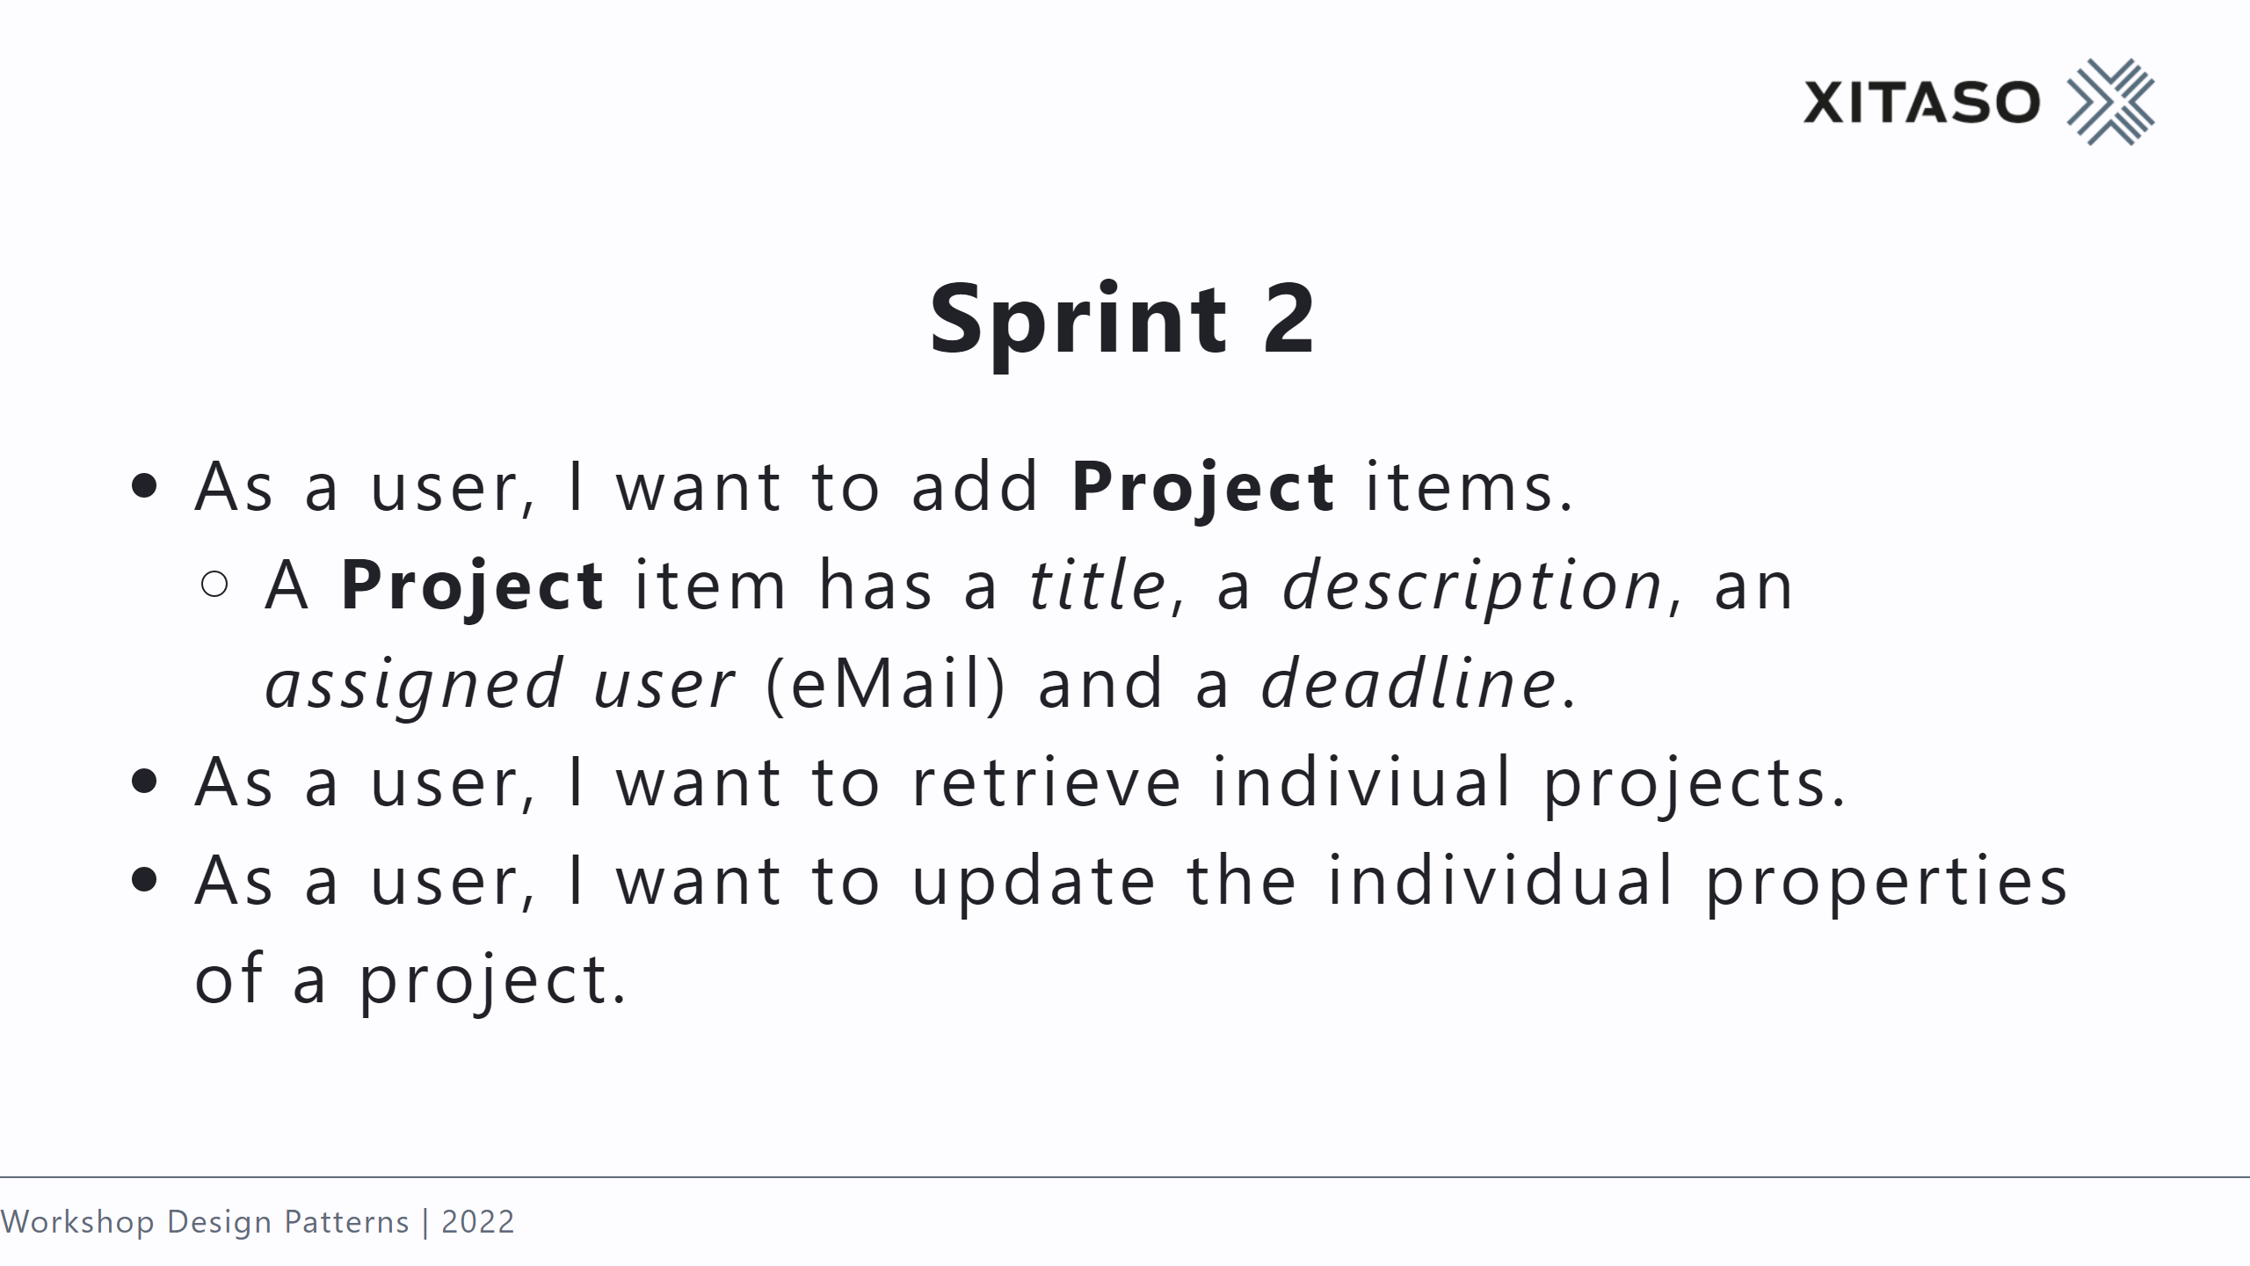

Slide 47
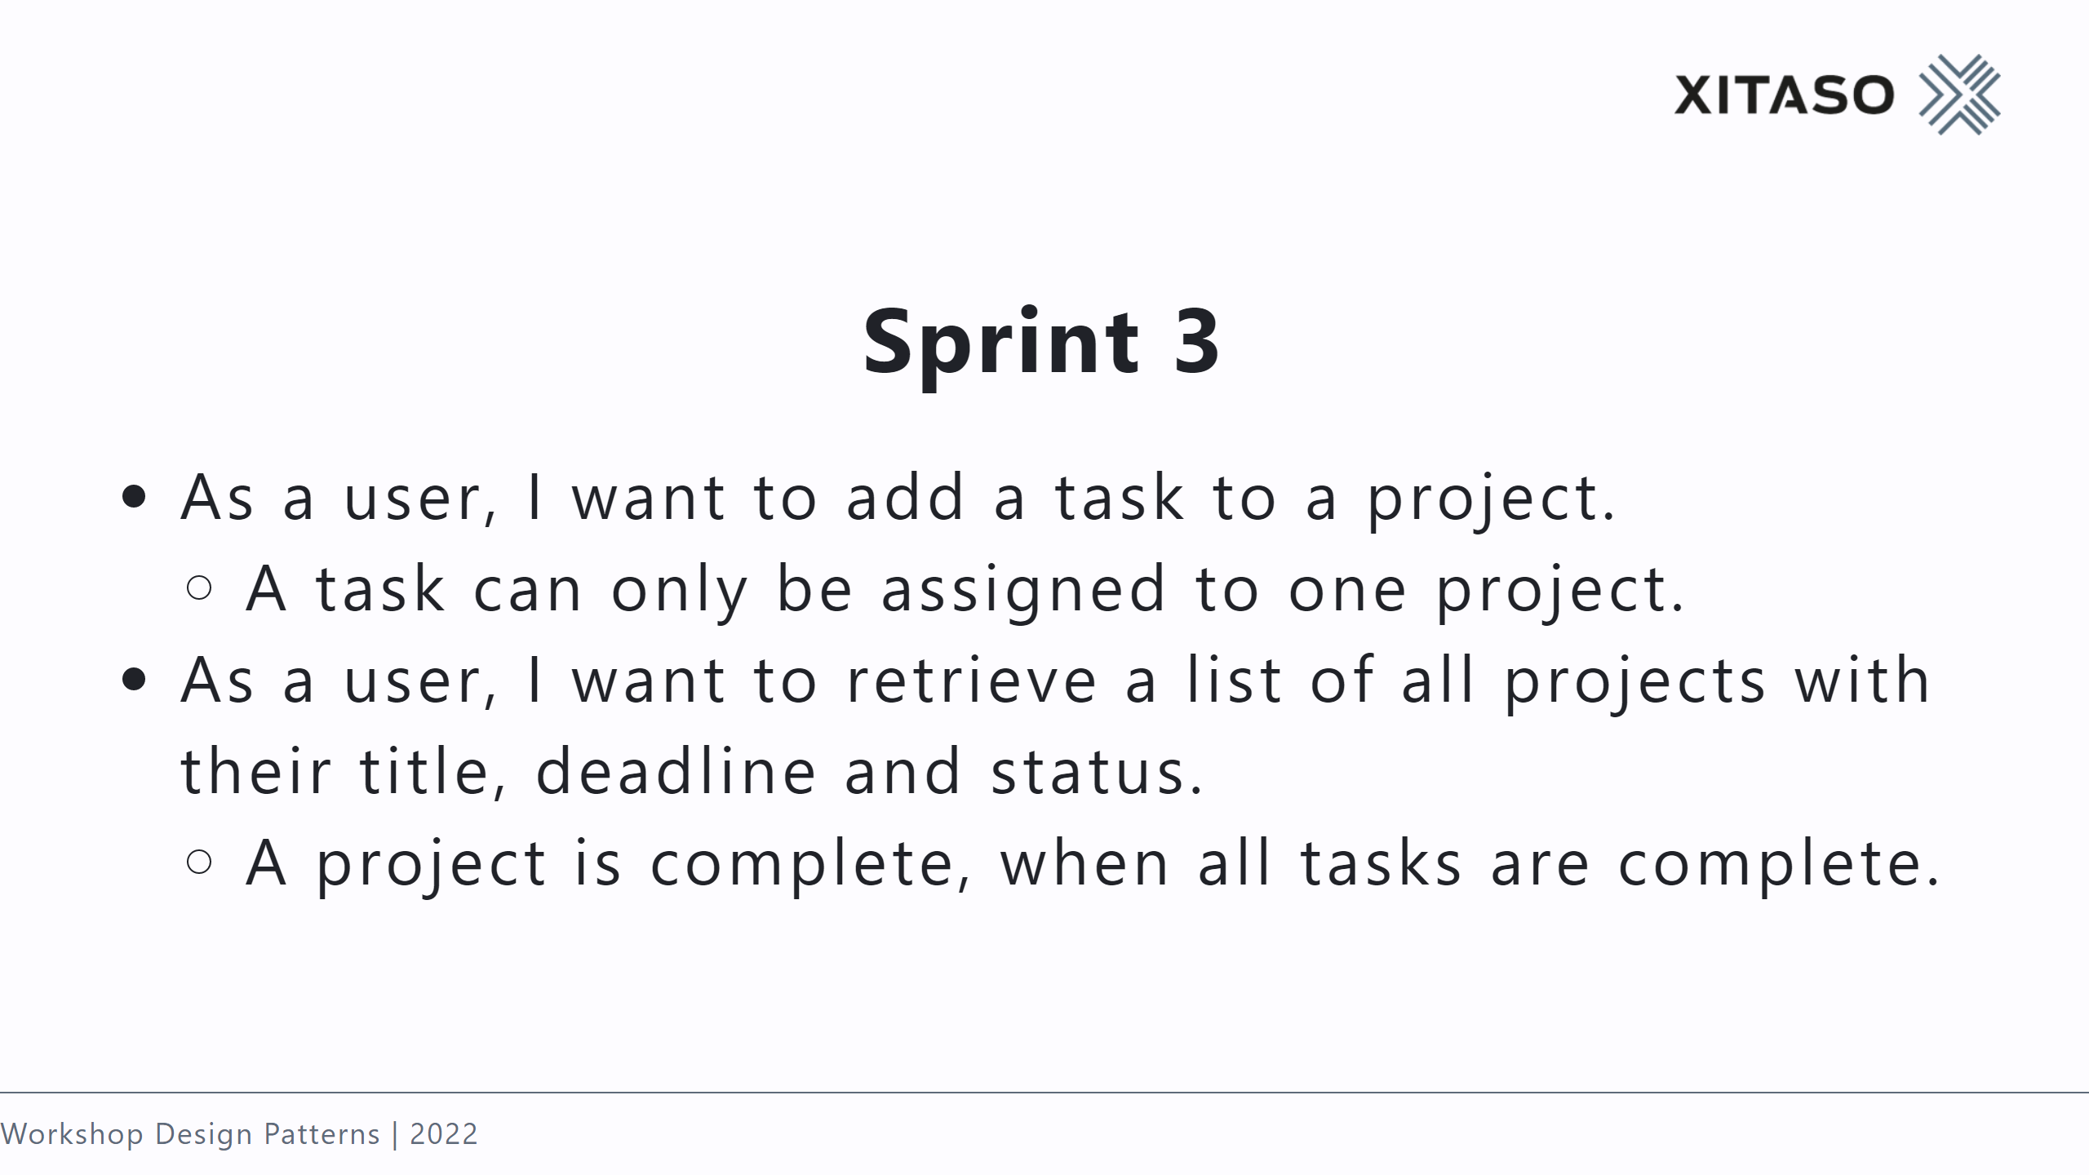
Notes:
- Composite: Completed state of project depends on tasks

Slide 48
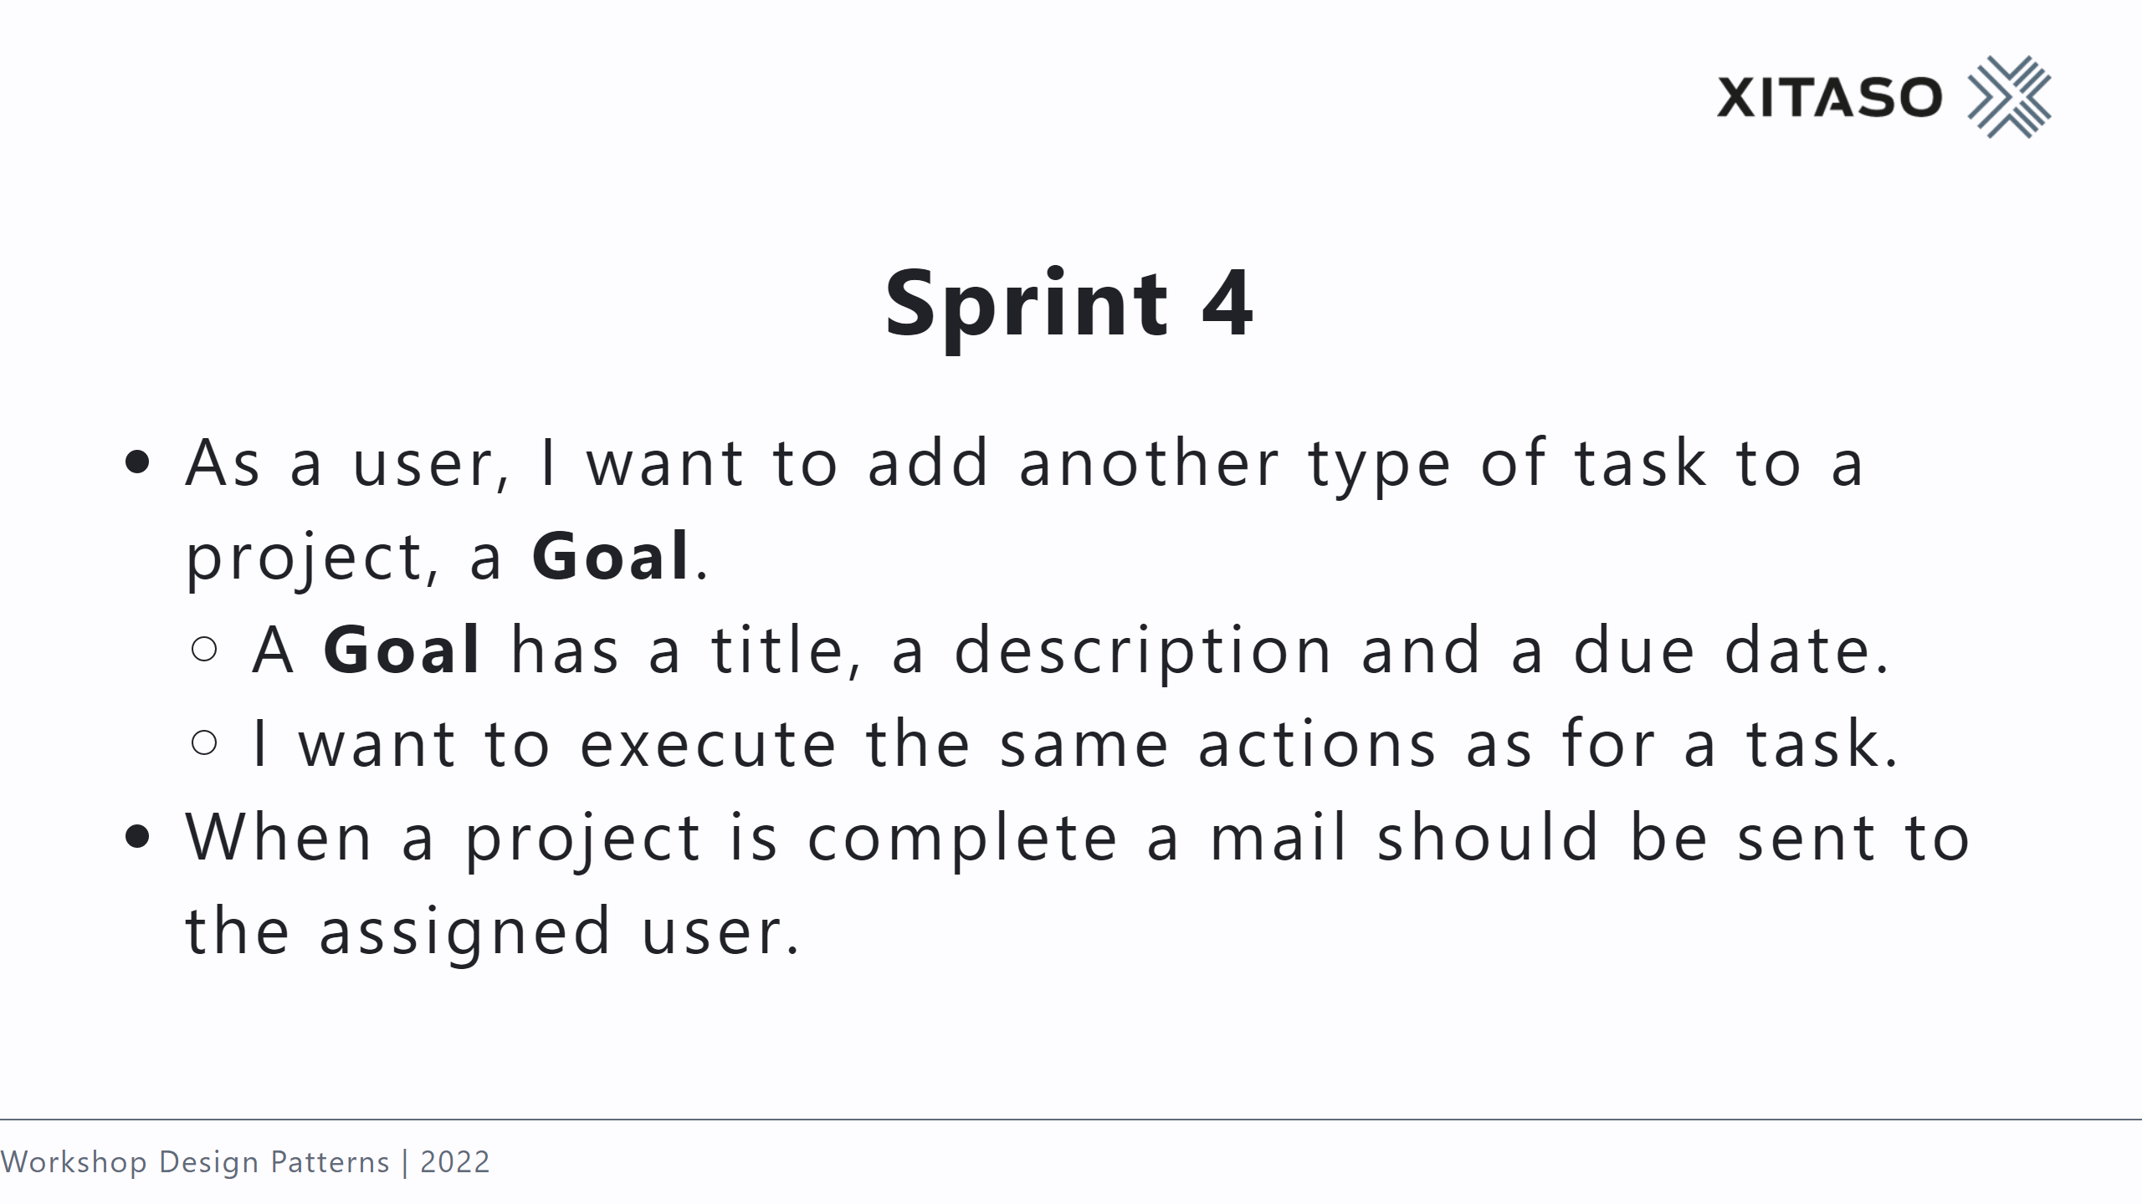
Notes:
- Factory -> Factory method & abstract factory - Observer or Mediator for completion -> Observer (one way connection between two objects) -> Mediator (eliminate mutual dependencies )

Slide 49
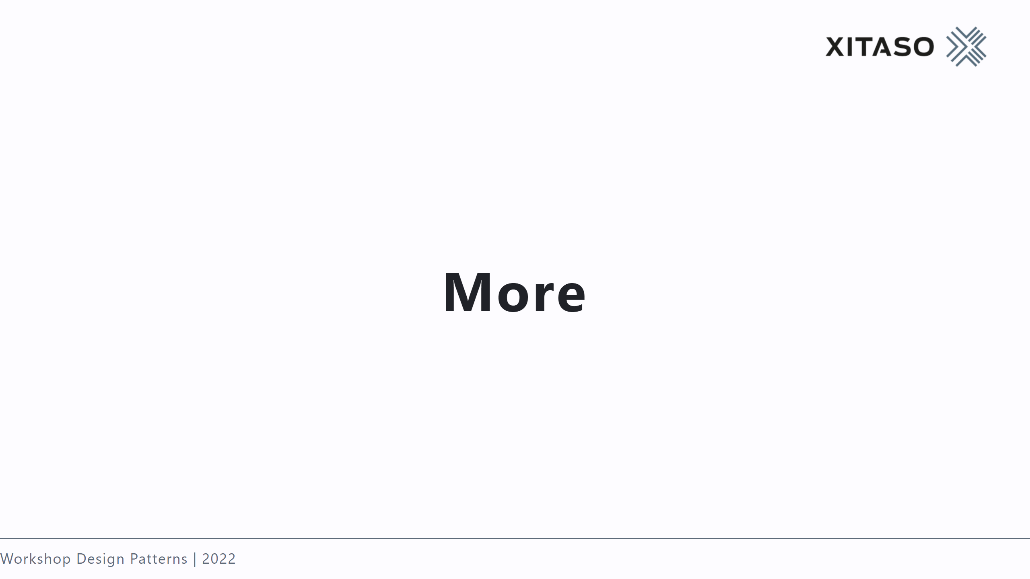

Slide 50
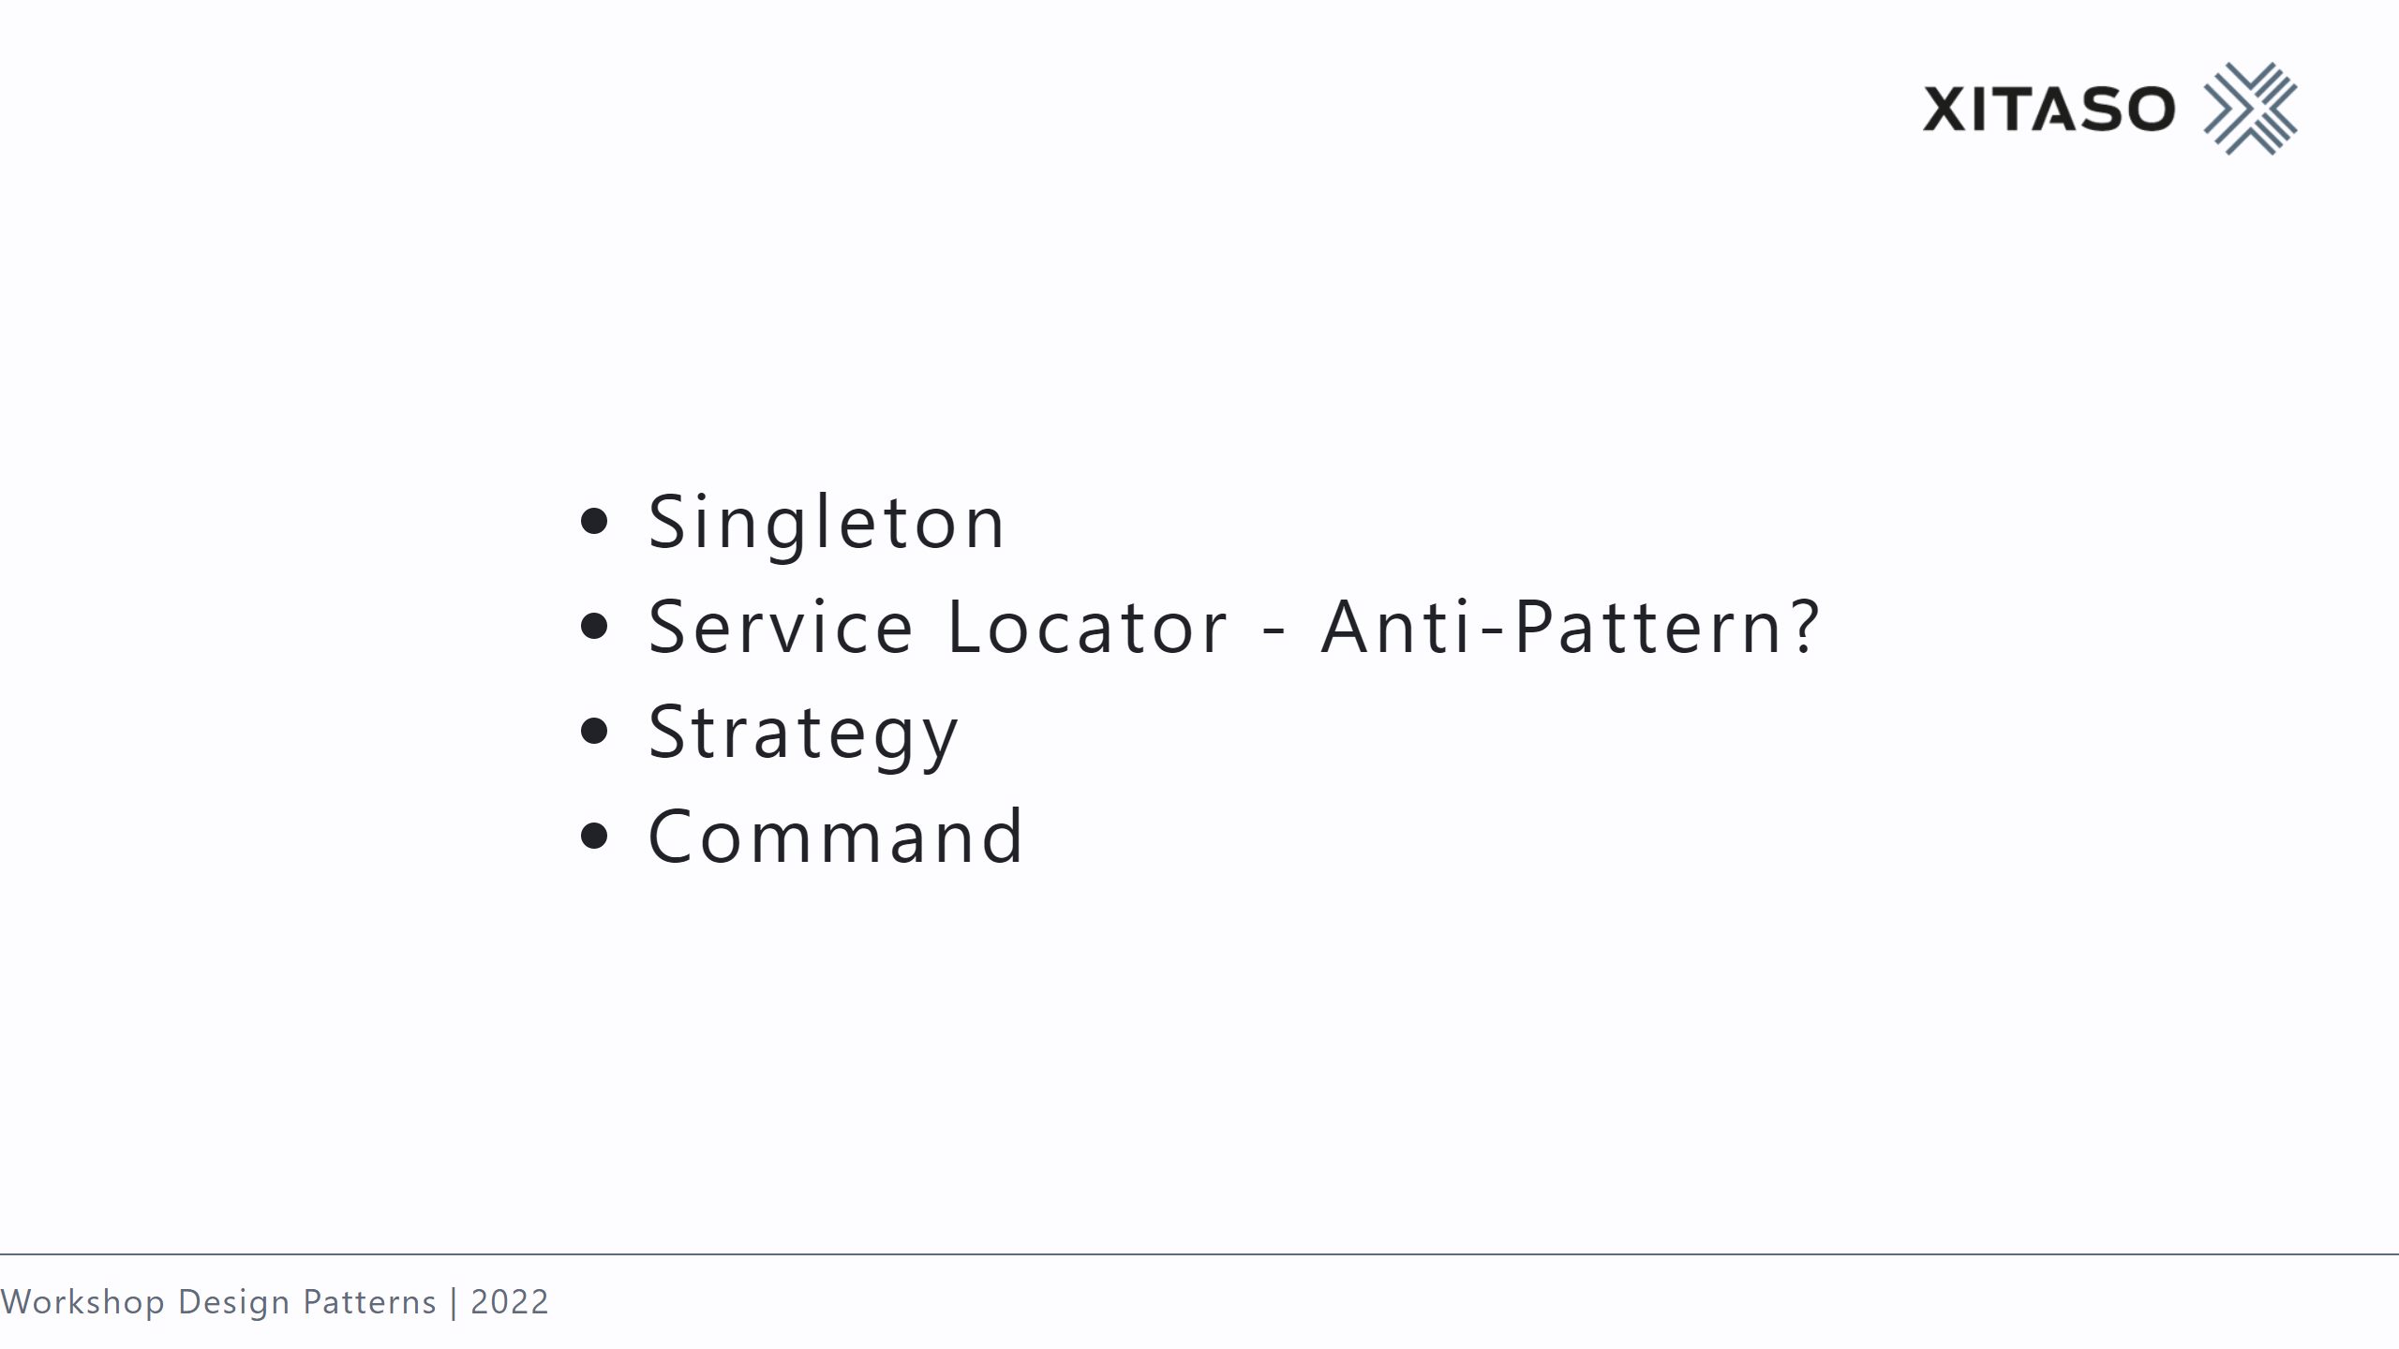
Notes:
static or singleton class => service IServiceCollection; Locator Xml, Json, Database use a class which captures state and logic, instead of a simple method

Slide 51
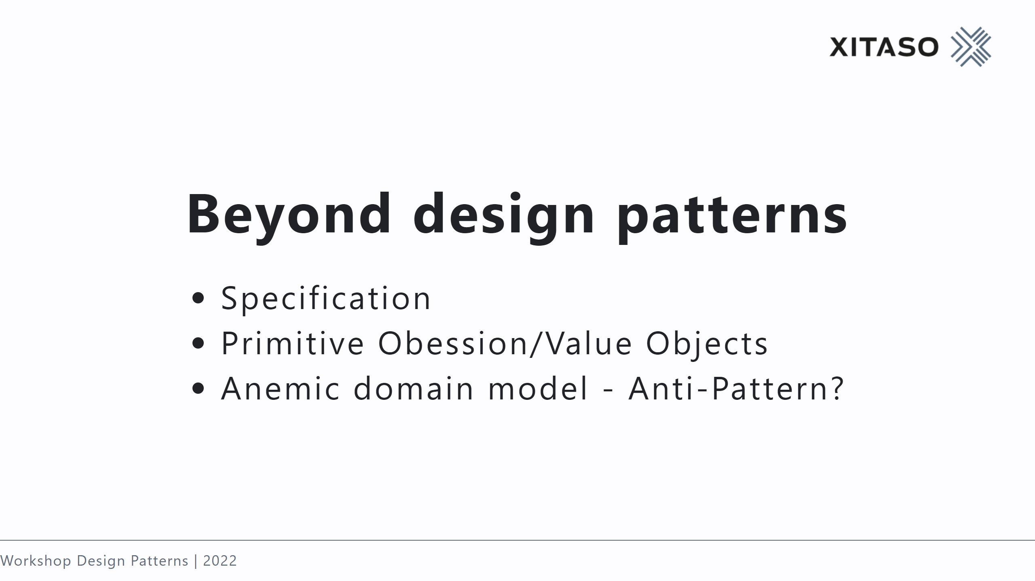
Notes:
check models against it, create something with it use concrete types instead of language naturals dumb data classes

Slide 52
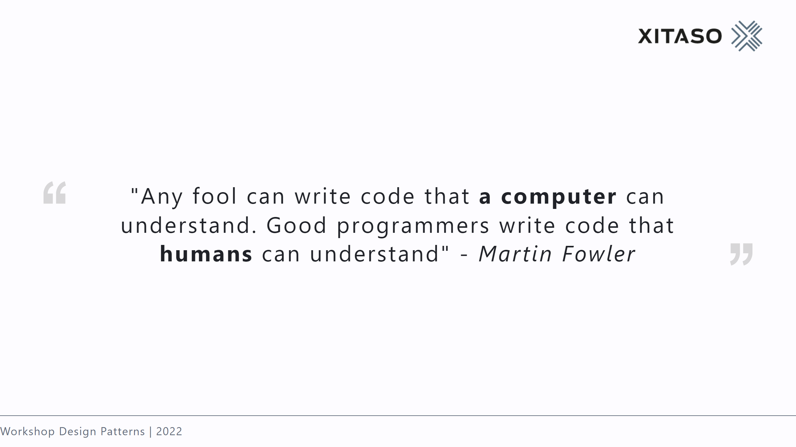

Slide 53
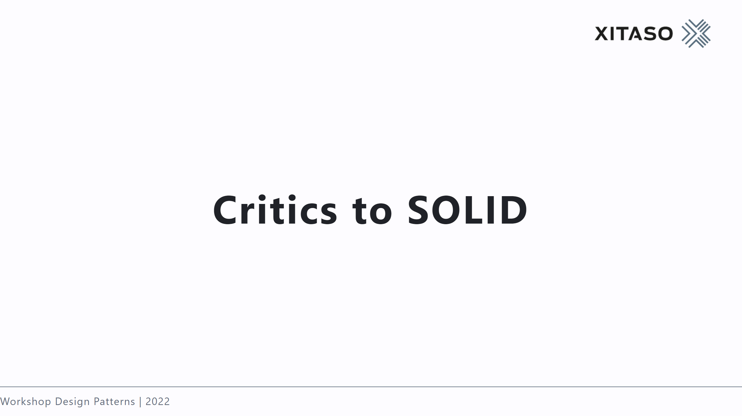

Slide 54
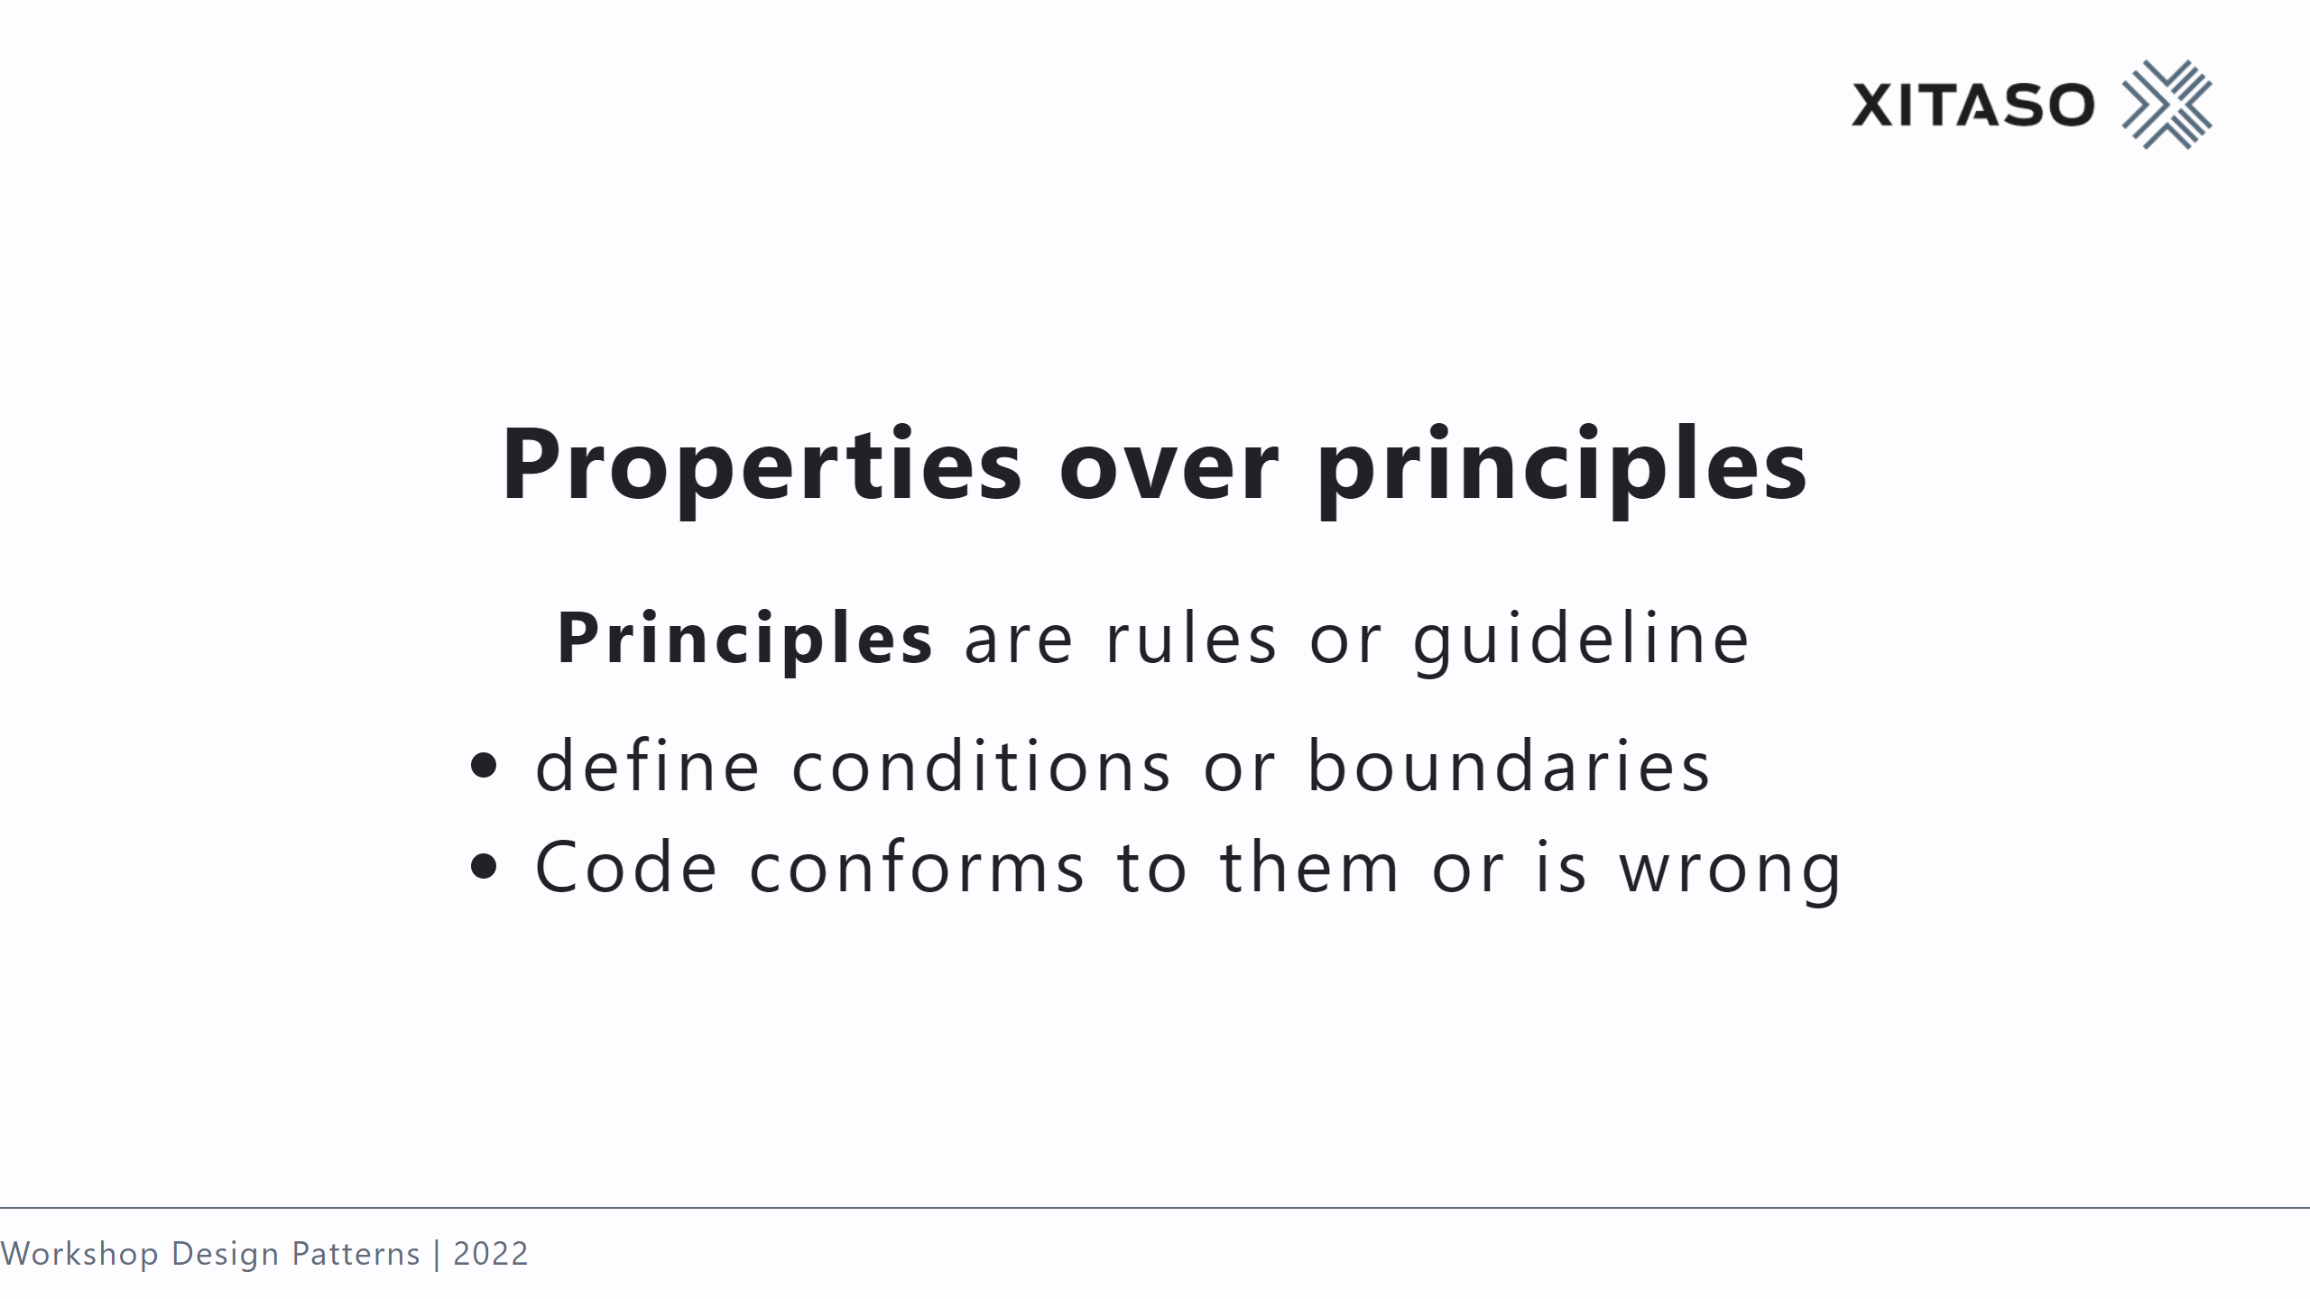

Slide 55
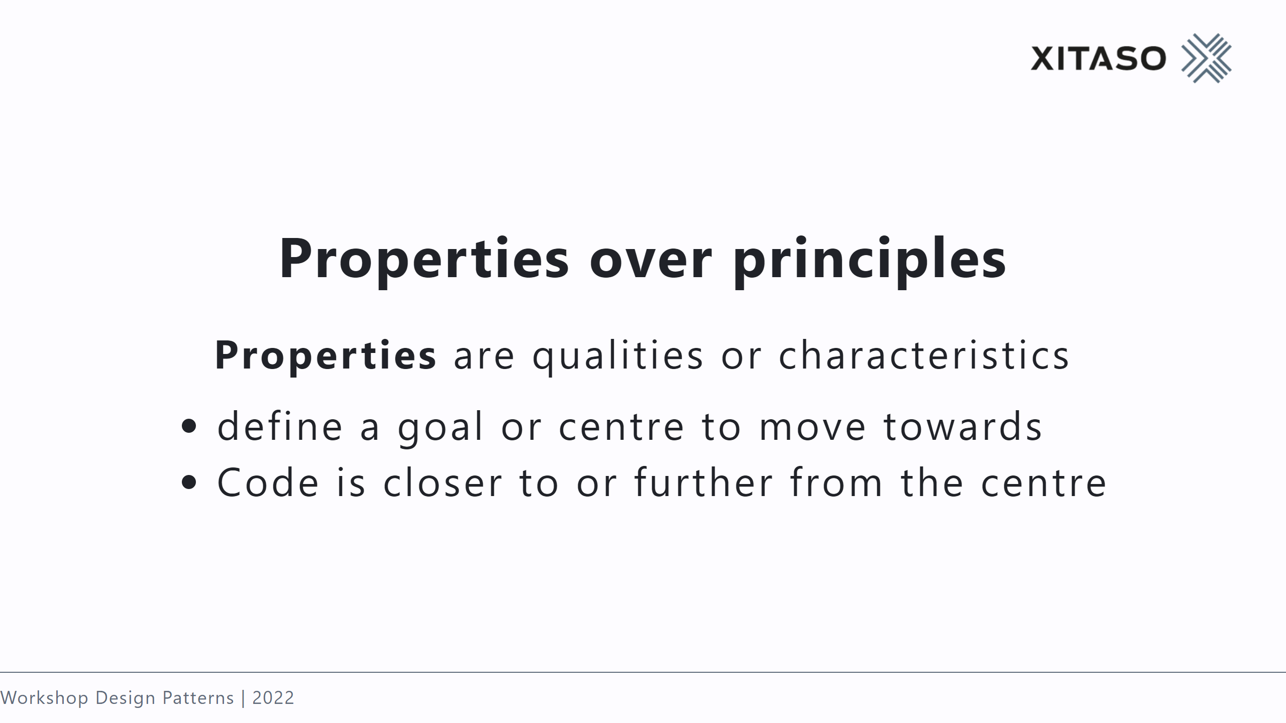

Slide 56
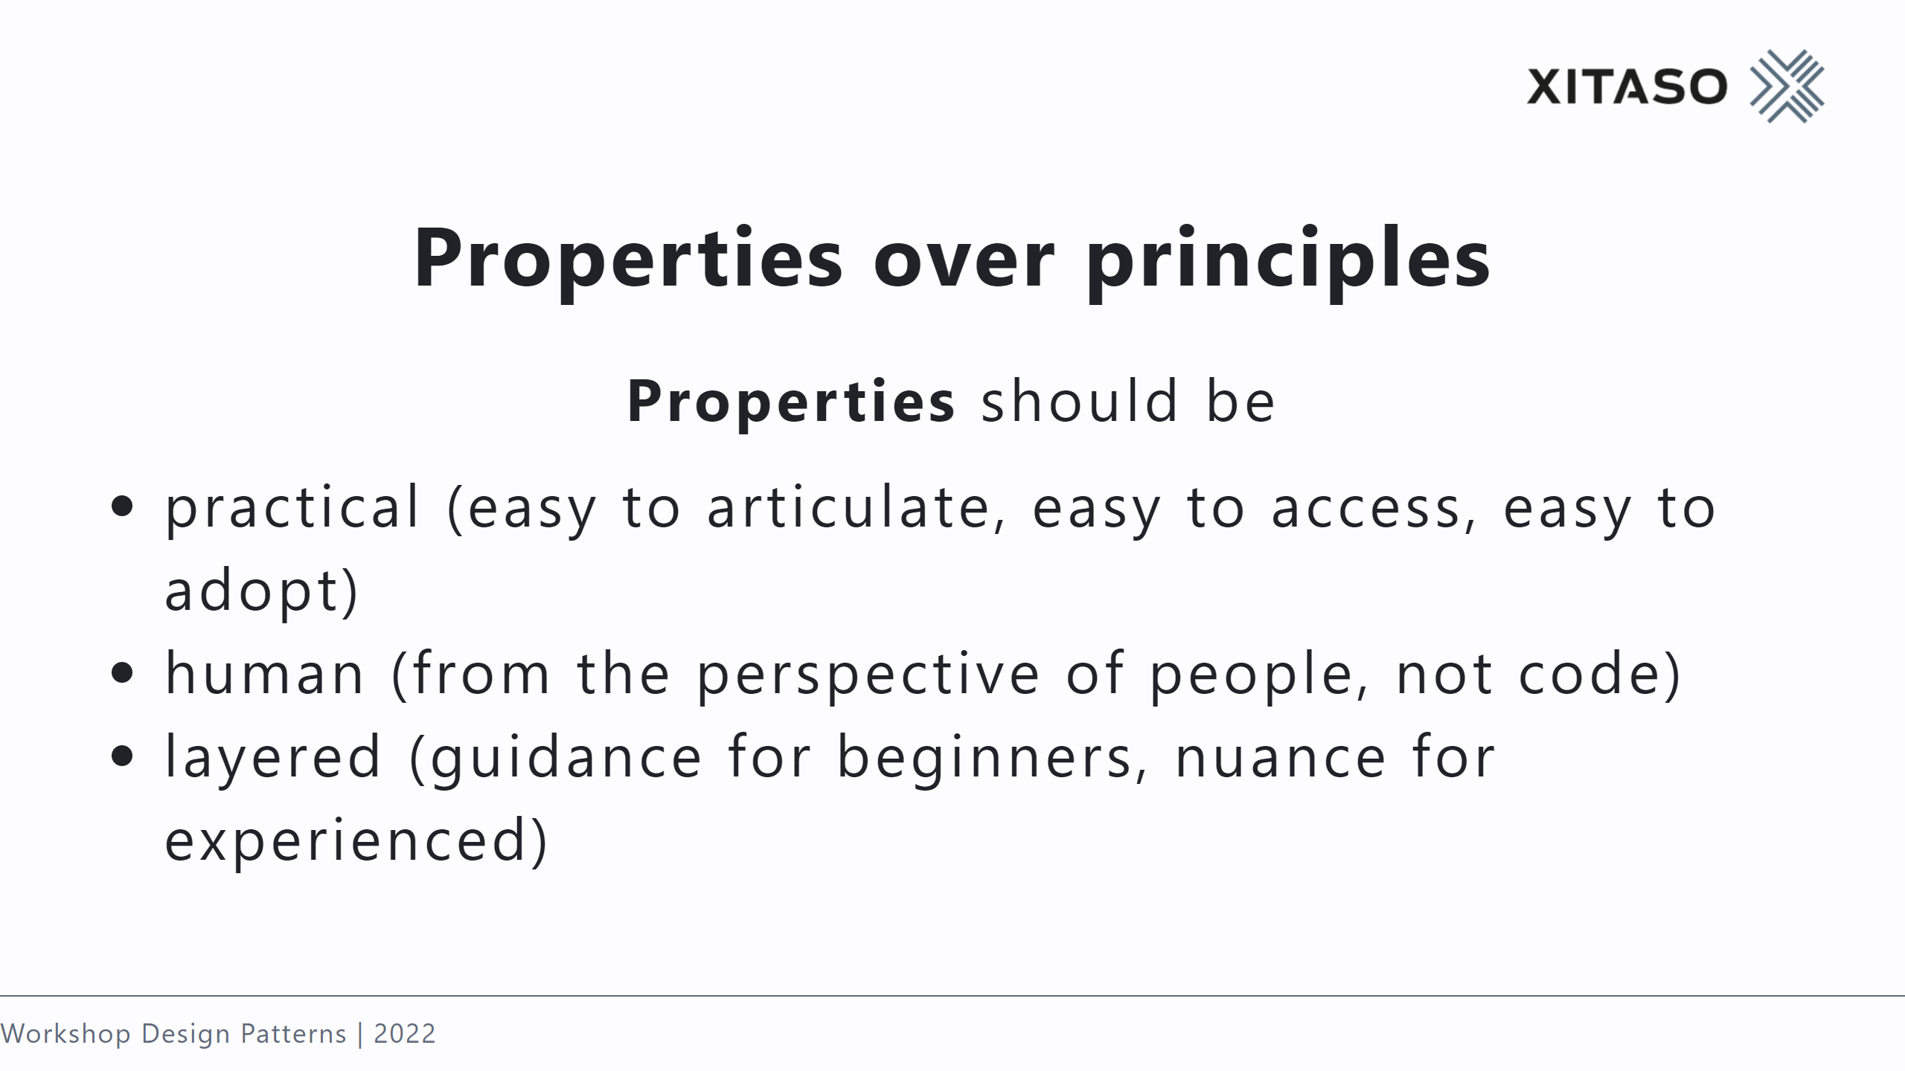

Slide 57
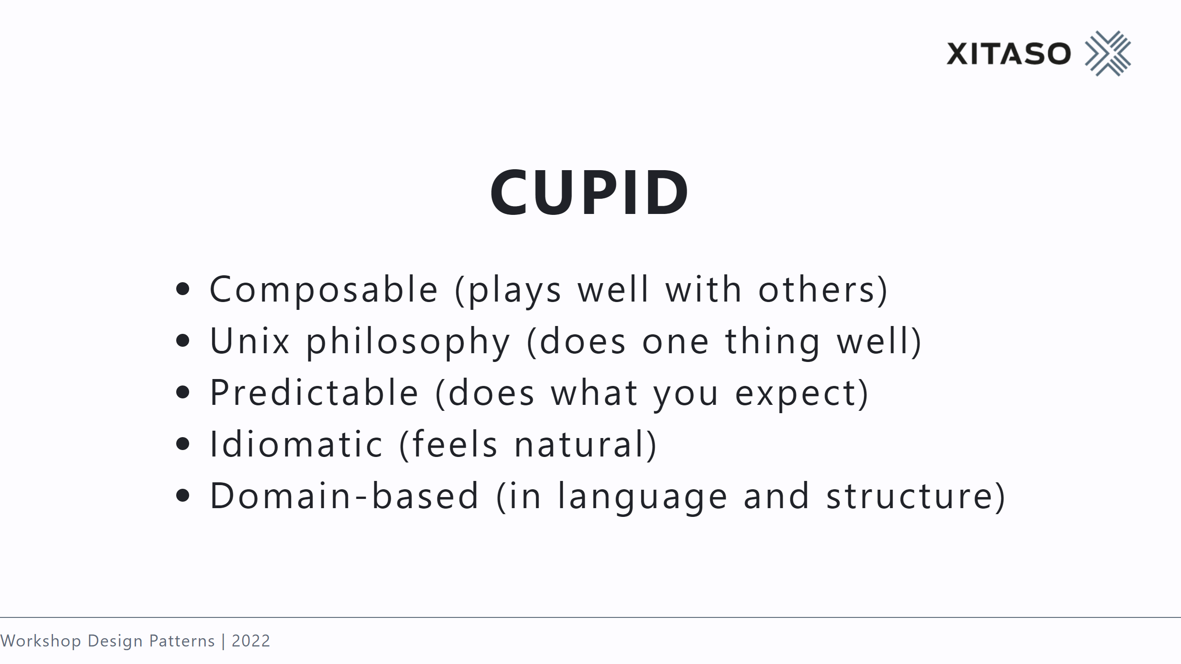

Slide 58


Slide 59


